Slide 1
Optimizing and Operationalizing Public Procurement
May 31, 2023

Slide 2
Agenda
2 - 3 p.m. ET - The Power of the Purse: How to Make Government Procurement a Tool for Innovation and Growth
Mark Funkhouser & Associates provides observations, guidance, recommendations and discussion on procurement innovation opportunities
3 - 3:10 p.m. ET - Case Stories from the ICLEI Network (Alyssa Wilbur, ICLEI USA)
3:10-3:40 p.m. ET - City of Pittsburgh’s Procurement Story (Jennifer Olzinger, Chief Procurement Officer)
3:40-4 pm ET - Discussion

Slide 3
Funkhouser & Associates
Funkhouser & Associates was founded in 2019 by Mark Funkhouser on the idea that we can build a better government by building trusted relationships with each other and government partners.

Slide 4
F&A Primary Presenters
Mark Funkhouser
Mark Funkhouser, president of Funkhouser & Associates, is a municipal finance expert who has spent decades in government service. As the mayor of Kansas City, Missouri, during the Great Recession, Mark made the tough choices to put his city on the path to fiscal sustainability. That experience, his long tenure as an auditor and his most recent post as the publisher of Governing magazine have made him a trusted and credible advisor to government officials across the country.
Notes:
(Alyssa)
Making the case - hopefully beyond this point but may be needed to justify the critical
https://www.climateworks.org/report/framework-costs-of-climate-action/

Slide 5
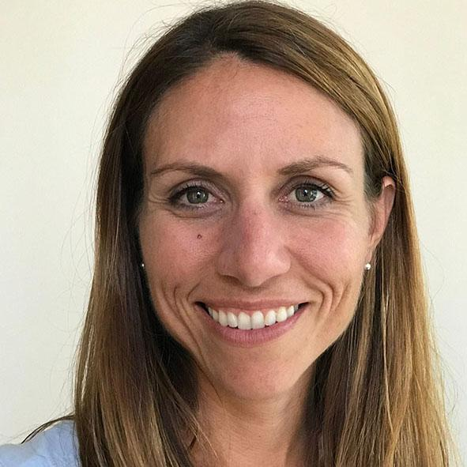
F&A Primary Presenters
Liz Farmer
Liz Farmer, a consultant at Funkhouser & Associates, is a fiscal policy expert and writer whose areas of expertise include budgets, fiscal distress, tax policy and pensions. She takes complicated topics and writes about them in language everybody can understand and her work has appeared in Forbes, Bloomberg, the Wall Street Journal and other national publications. She is also a fellow at the Rockefeller Institute of Government writing about the policy implications of the future of work.
Notes:
(Alyssa)
Making the case - hopefully beyond this point but may be needed to justify the critical
https://www.climateworks.org/report/framework-costs-of-climate-action/

Slide 6
Case Stories from the ICLEI Network

Slide 7
"Sustainable Procurement" is purchasing that builds healthy communities, economies, and environments all along local and global supply chains. At the City, this means we seek to use our purchasing power to reduce carbon emissions, support human and labor rights, improve the health of our communities, and increase supplier diversity - and do this in a way that is ethical and makes financial sense.
City of Portland Sustainable Procurement Policy
Notes:
There are a lot of different approaches to creating a procurement policy that prioritizes climate and/or sustainability. The process needs to start with a clear, concise definition of what you aim to achieve with the policy as an organization. I share this definition of Sustainable Procurement from the City of Portland’s Sustainable Procurement Policy recognizes that:
the products and services the City purchases have inherent social, human health, environmental, and economic impacts;
the human health, environmental, social, and economic impacts of products and services occur throughout their life cycle and throughout the associated supply chains

Slide 8
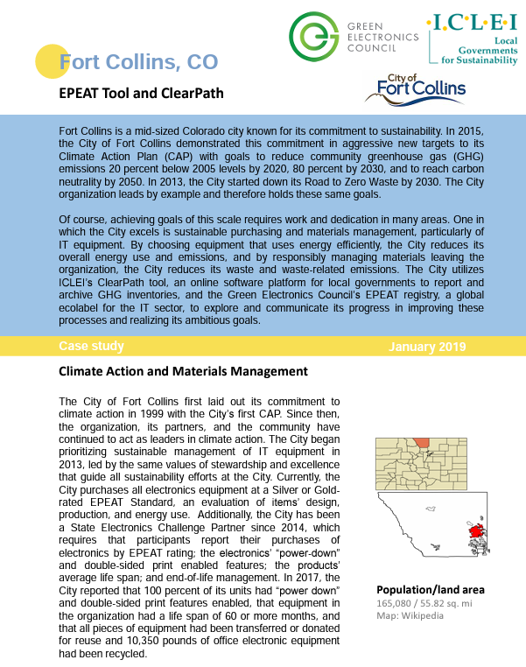
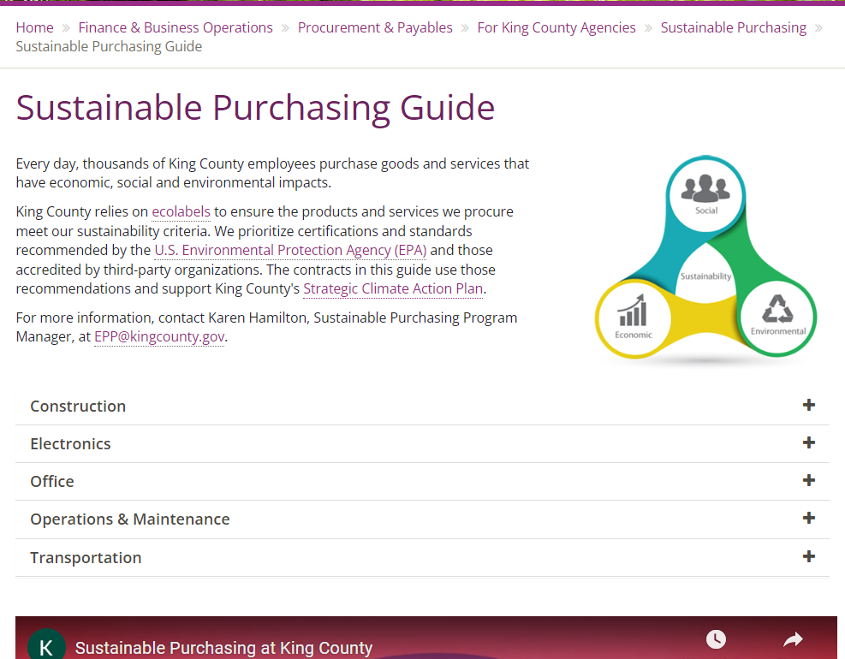
Fort Collins, CO
King County, WA
Notes:
- There is no one size fits all for an organization’s sustainable procurement policy or other climate-oriented purchasing strategies. I want to share some examples of effective, innovative procurement policies and programs happening across the with ICLEI network. In the City of Fort Collins, CO, they prioritized the purchasing of energy efficient IT equipment that also met certain criteria through the EPEAT rating system such as a “power-down” feature, average life-span, and end-of-life management. This approach prioritizes a climate action goal for the organization to increase energy efficiency, while also reducing electronic waste and pollution.
- King County in Washington has put together a comprehensive guide and trainings for employees based on the type of good or service they seek to procure. This guide provides purchasers with information on the types of materials and products they should choose, what to avoid, and how to handle a product at the end of its life.

Slide 9
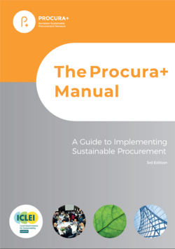
Resources and Tools
Cooperative purchasing agreements and group-buys
Procura+ Manual for Sustainable Procurement
ICLEI’s ClearPath tool for Local Government Operations GHG inventory (for ICLEI members)
Certification and Rating Systems - EnergyStar, EPEAT and Greenseal
Notes:
- There is no shortage of tools and resources available to help organizations create a robust sustainable procurement strategy. I want to highlight a few of these including cooperative purchasing agreements, which can enable group-buys across multiple jurisdictions for products. The European Sustainable Procurement Network, in collaboration with ICLEI has developed a helpful guide called the Procura+ Manual, and though some of the items are not relevant here in the US, it is still a great starting point. Any community on the call that is an ICLEI member can receive support from us for the quantification of greenhouse gas (GHG) emissions associated with their supply chains. This can help prioritize actions if reducing GHG emissions is a main goal of your policy.

Slide 10
City of Pittsburgh Chief Procurement Officer
Guest Presenter
Jennifer Olzinger
Notes:
Sustainable Neighborhoods Program and the Greenhouse Gas Mitigation Program which is intended to ensure upcoming new development aligns with the city's air quality and pollution commitments.

Slide 11
Priority Project Homework
Evaluate and identify procurement operations and policy innovation opportunities in your organization. Continue building priority project(s) implementation plans with a focus on procurement.
Begin evaluating priority project procurement with a focus on:
RFP design reform
Improving supply chain diversity and vendor competition
Policy reform that provides flexibility in selecting the most competitive bidder (not solely based on lowest price)
Read:
PROCURA+ MANUAL
Mission delivery: Exploring how procurement can support
mission-driven governments
The Power of the Purse

