Slide 1
BUDGETING FOR
CLIMATE ACTION
PRIORITY BASED BUDGETING
21ST CENTURY BUDGETING
FROM LINE ITEMS TO GREATER ALIGNMENT

Slide 2
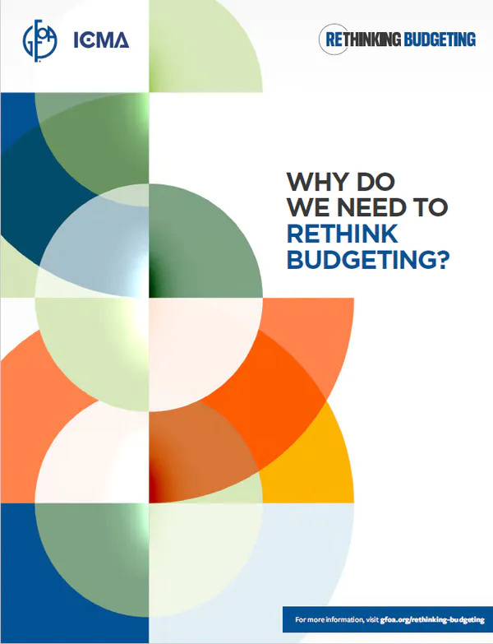
Notes:
The importance of the breakthrough is not trivial – it’s crazy
But before I get to that... That’s the “how” , I want to talk about the outcomes

Slide 3
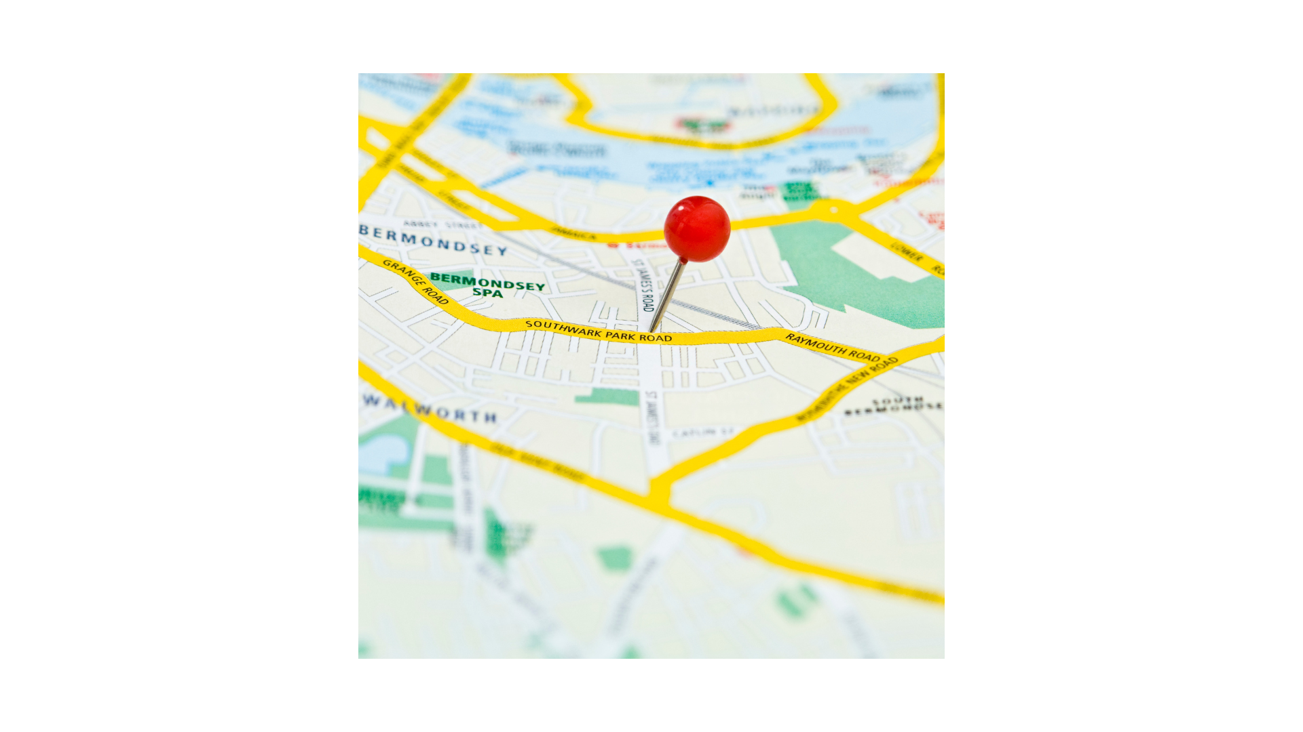
01
BUILDING GREATER ALIGNMENT
COMMUNICATE
03
OPTIMIZE RESOURCES
ACHIEVE RESULTS
PROGRAM JOURNEY
05
06
COLLABORATE
LET DATA LEAD THE WAY

Slide 4
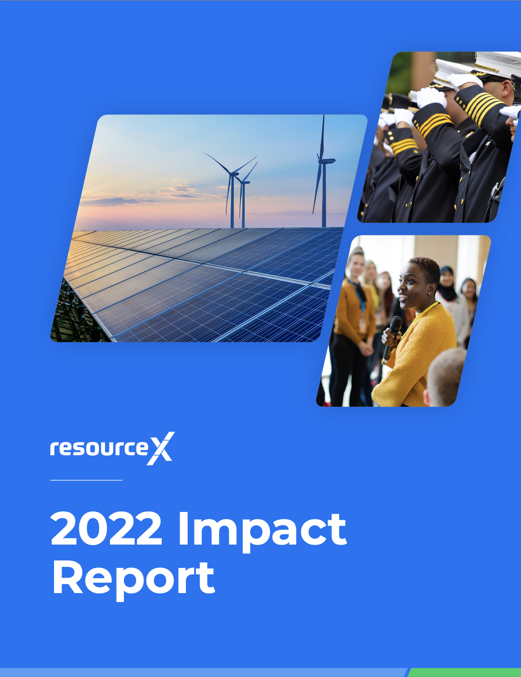
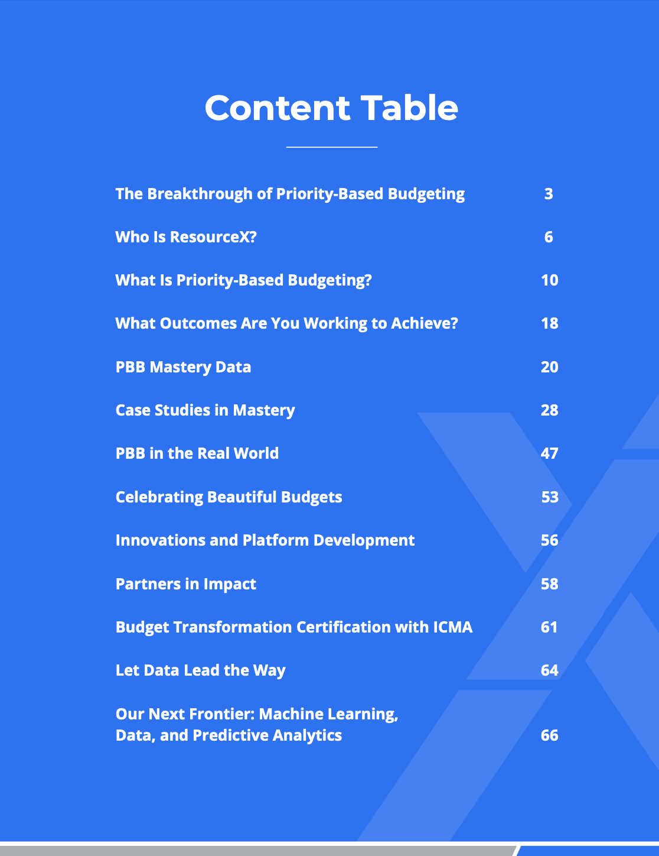

Slide 5
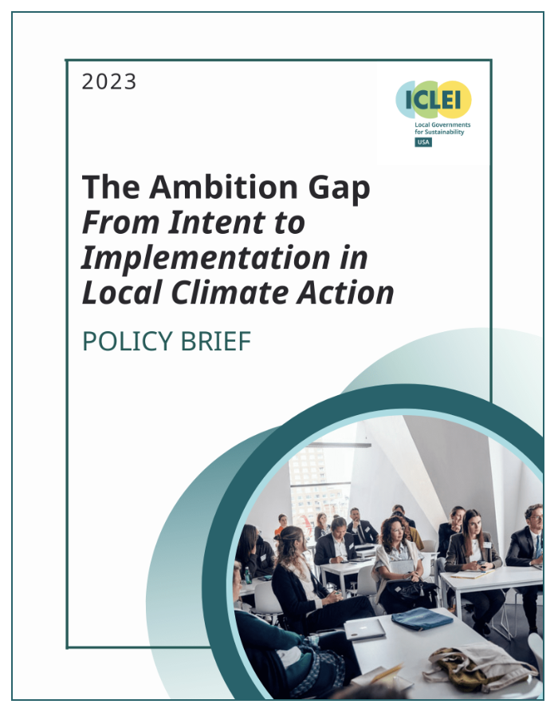
“There’s a disparity between the human and financial capacity allocated by local governments and the goals and ambitions that are being established as part of climate action plans.
We define this disparity as the ambition gap a recognition by many local governments of the need to take significant action on climate, but limiting the level of resource allocation to meet the levels of support required to meet their targets and goals.”

Slide 6
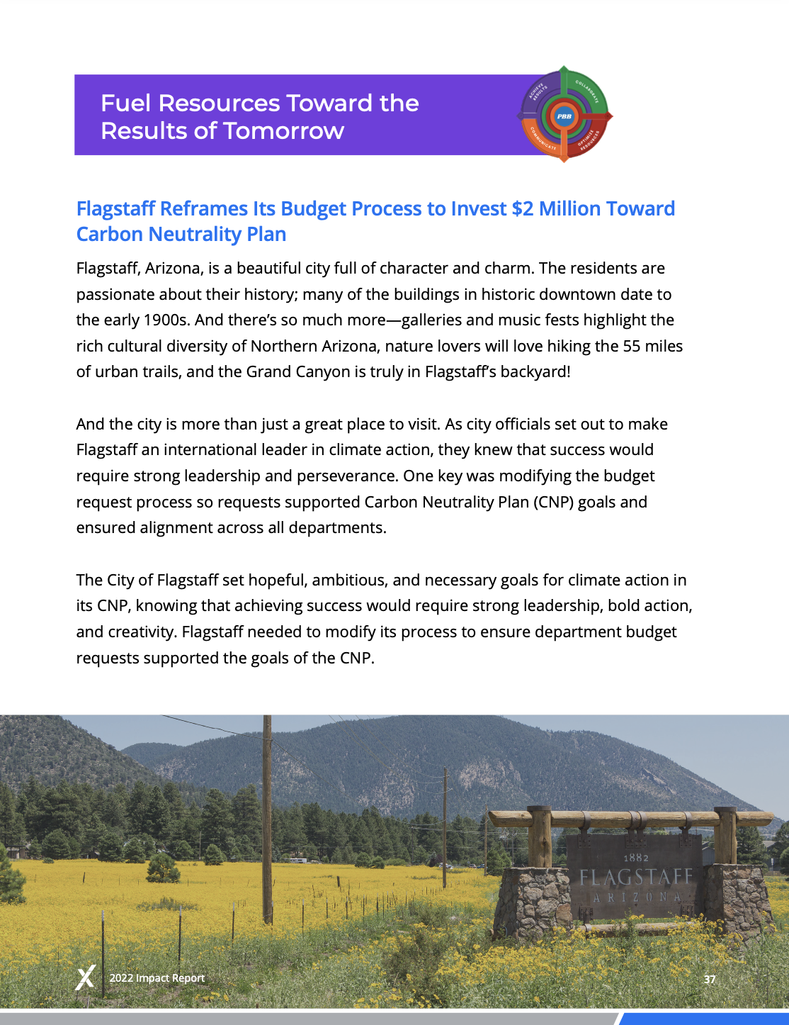
1
Build program (and project) inventory, map line-items to programs, and score
2
Transition from line-item budgeting to priority based budgeting
3
Create a decision-making framework to evaluate and prioritize core services, capital, and all budget requests, relative to priorities (including climate)

Slide 7
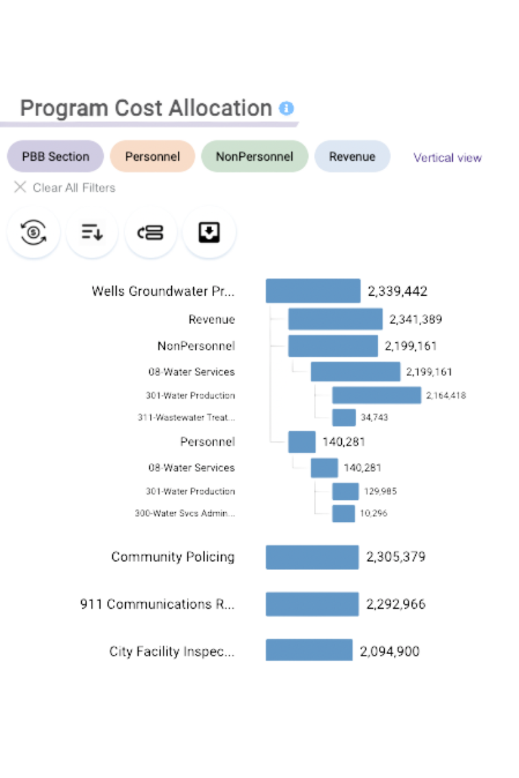
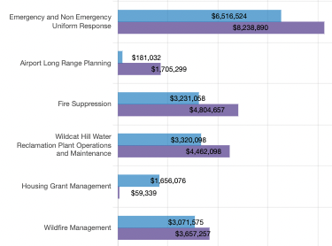
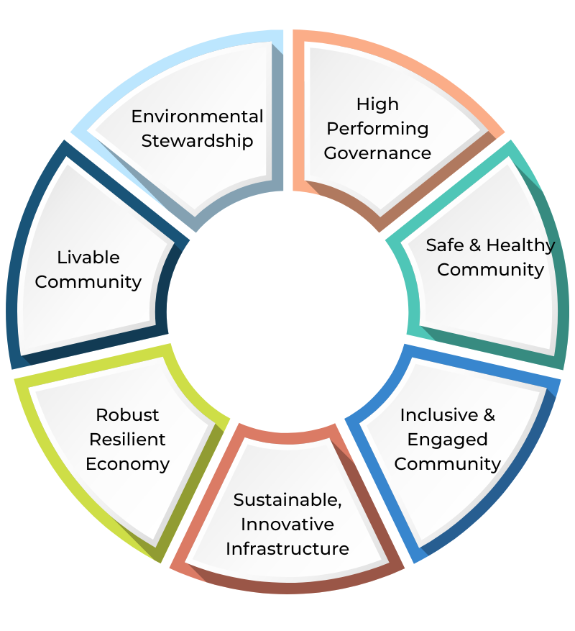
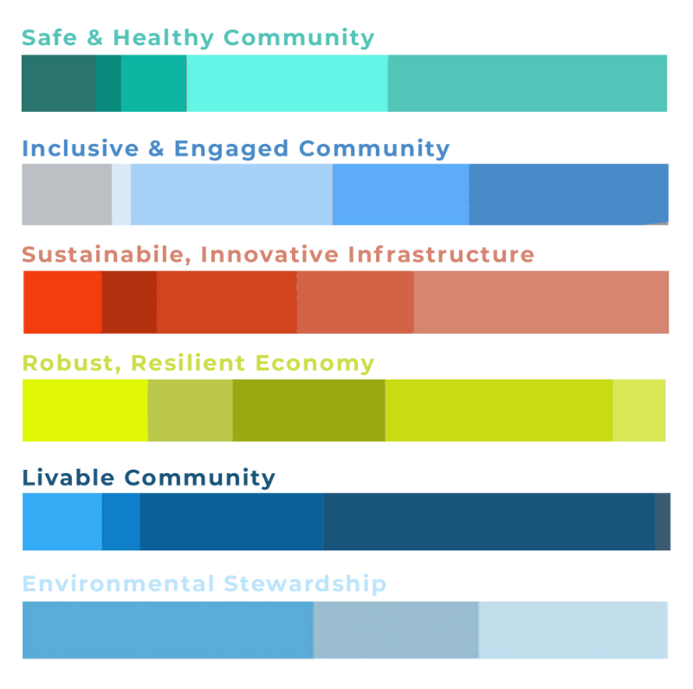
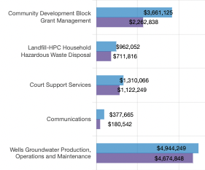
PRACTICAL APPLICATION OF PBB CASE STUDY OF CITY OF FLAGSTAFF
Mission: to create a balanced, data-driven, and sustainable budget process to prioritize spending and reallocate resources from within to launch new programs and envision a better future
Goal: to free up resources and dramatically realign them towards the Carbon Neutrality Plan
Strategy: to build a prioritized program budget through OnlinePBB to enable communication and data-driven decision making

Slide 8
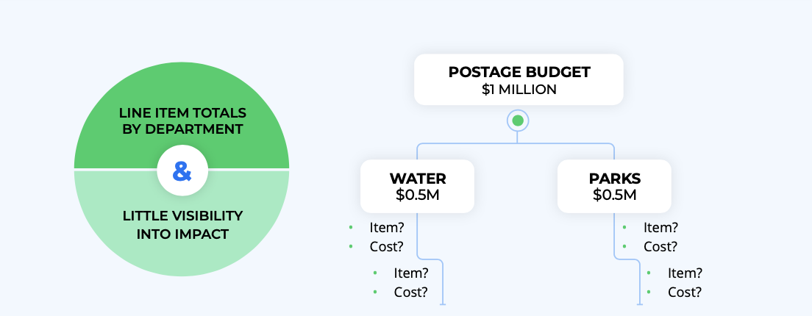
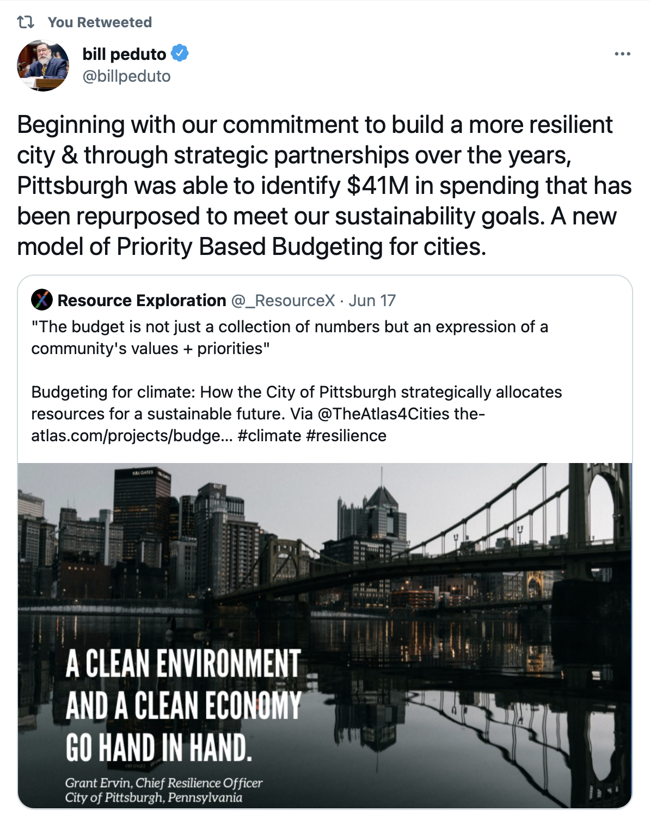
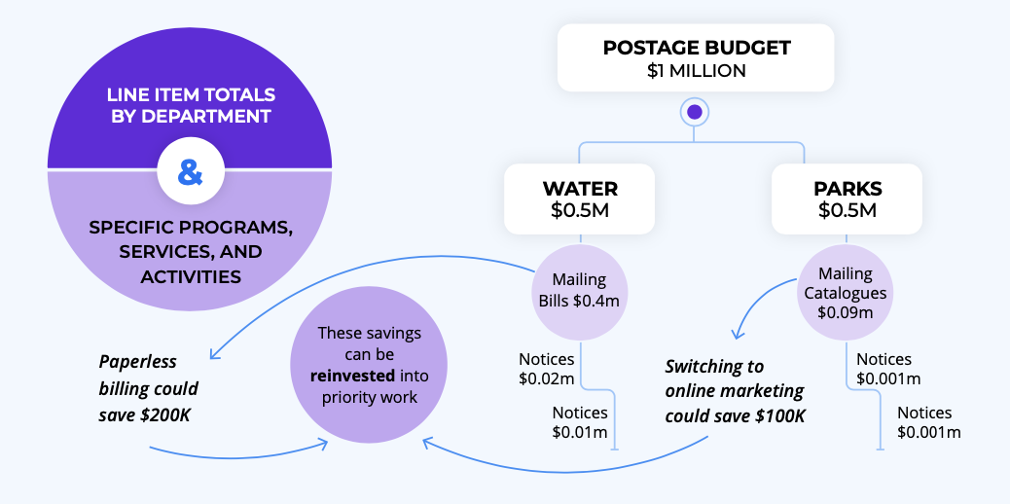

Slide 9
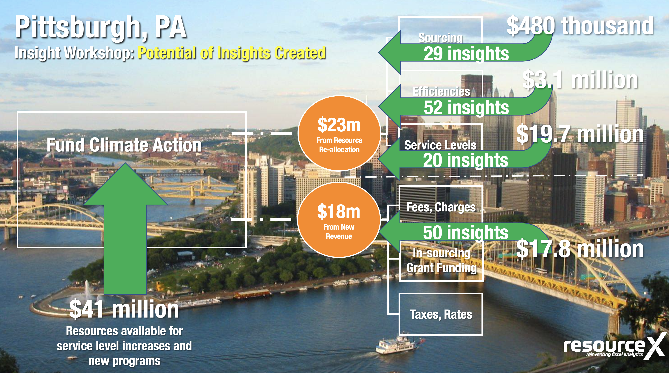
Goal: find resources to fund climate and equity initiatives
Path to Action: 1.) define programs and costs, 2.) program insights for reallocation

Slide 10
WHAT IS PRIORITY-BASED BUDGETING?
PBB PROVIDES THE DATA TO DRIVE COMMUNICATION AND DECISION-MAKING
Maximize budgeting transparency & impact
Understand the true cost of doing business
Align resources with community priorities

Slide 11
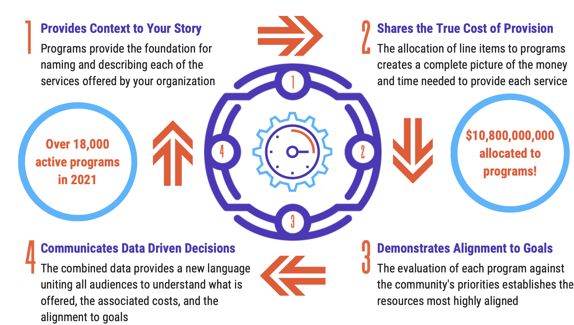
THE PBB PROCESS

Slide 12
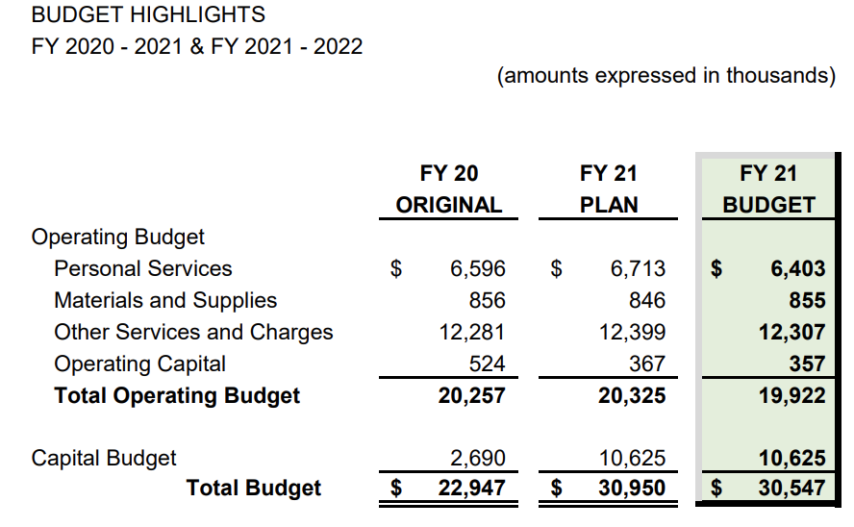
Line Item Budgeting
TRADITIONAL
Most local governments are statutorily obligated to produce a line-item budget or follow an account-based budget structure.
Changes to line-item budgets are overarching, with across-the-board increases and decreases at the organizational or departmental levels.
The line-item approach to budgeting creates a disconnect between funding and understanding the organization's desired outcomes.

Slide 13
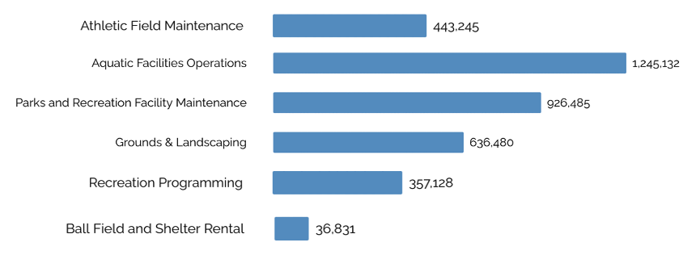
Program Budgeting
PROGRAM
Programs are an efficient way to communicate a local government’s budget in a language that the average person can understand.
A program budget takes a financial language and turns it into a relevant and digestible concept, much like a website is easy for most people to view and understand even if they aren’t familiar with the coding required to create it.
Programs are informed by line items, so they are true representations of your budget.

Slide 14
Priority Based Budgeting
PRIORITY-BASED
Develop a program inventory, allocate costs to these programs, and collect data points to assess the impact of the programs.
Priority-based budgeting looks at the strategic plan with all the programs and resources and aligns them to the stated outcomes.
Priority-based budgeting captures data points through a scoring process that provides in-depth knowledge about each program and its alignment with outcomes, then communicates that information for informed decisions about future resource allocation.

Slide 15
PROGRAM-CENTRIC DECISION-MAKING
Program Inventory
Program Costs
Program Scores
Program Performance Metrics
Create Data
Program’s Future Direction
Impact on Outcomes
Basic Program Attributes
Line-item (resource) data
Program Inventory
Building Business Intelligence (Layering Data)

Slide 16
PROGRAMS ARE THE VEHICLE FOR CHANGE
Show precisely what your government does and how much it costs.
Are meaningful to elected officials and residents because they are directly relevant to how they experience public services.
Create a shared language that includes all stakeholders.

Slide 17
PROGRAM-CENTRIC DECISION-MAKING
Create data
gain insight
TAKE ACTION
Inventory
Costs
Scores
Performance Metrics
Program Future / Fate
Increase Service Levels
Repurpose Resources
Efficiency, Sourcing, Service Levels
Generate Revenue
Budget/approve new program launches
Reallocation of resources
Revenue generation
Execution

Slide 18
PRIORITY BASED BUDGETING
MILESTONES
CREATE PROGRAM INVENTORY
ALIGN PROGRAMS TO PRIORITIES
01
02
03
04
05
1
2
3
4
5
UPLOAD BUDGET DATA
ALLOCATE LINE ITEMS TO PROGRAMS
APPLY DATA TO ACHIEVE OUTCOMES

Slide 19
05
PROGRAM ANALYSIS
5
03
PROGRAM COSTING
3
04
PROGRAM SCORING
4
UPLOAD BUDGET DATA
01
1
02
PROGRAM INVENTORY
2

Slide 26
As you consider what programs you offer…
Do you advertise that you provide a service?
Who benefits from the service?
Curbside Recycling
Payroll Processing
Is someone willing to pay a fee or offer a grant for a service?
Are you mandated to provide a service?
Building Permit
Elections
Do you do something unique?
Is there another public or private agency that does something similar?
Sheep Grazing
Youth Swim Lessons

Slide 27
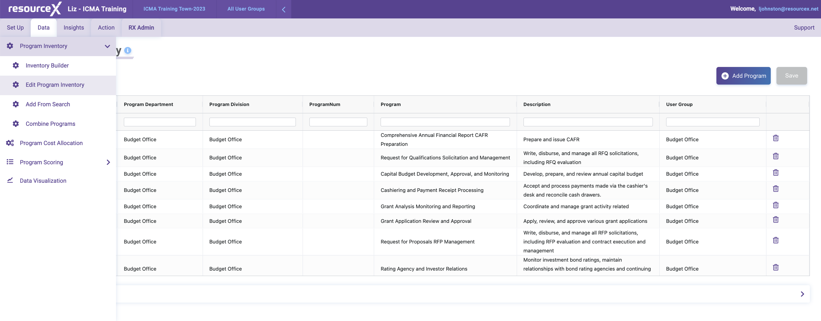
In THE TOOLS
Edit program inventory

Slide 29
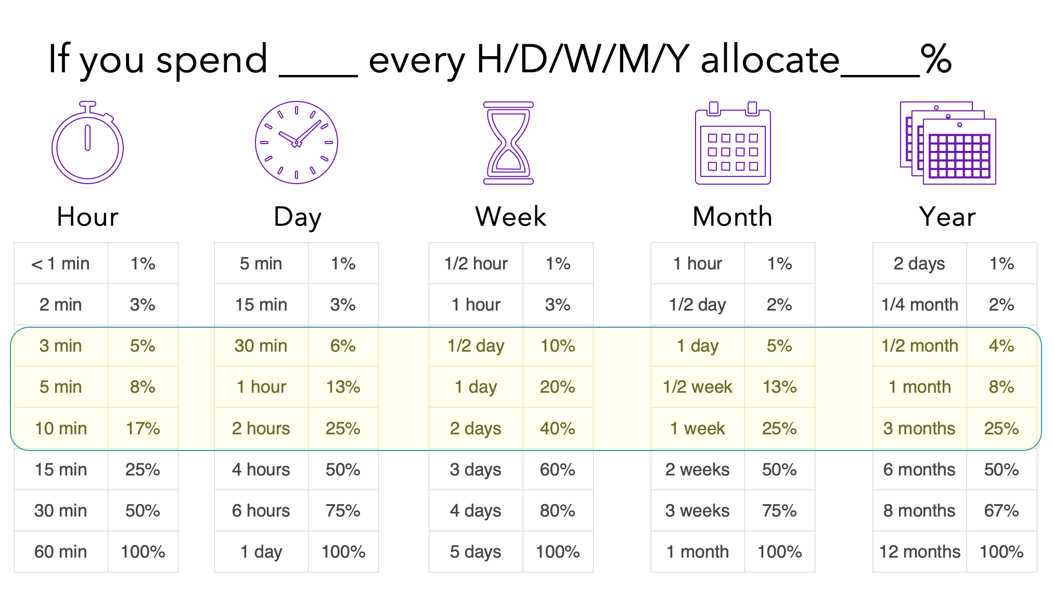
In the tools
Program Costing

Slide 30
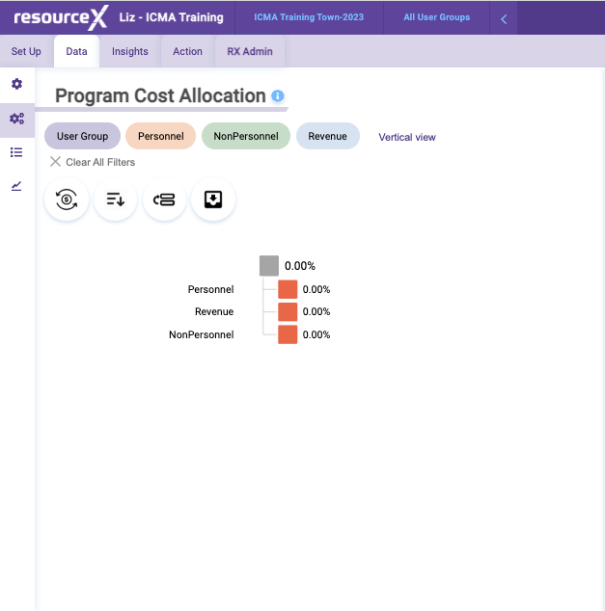
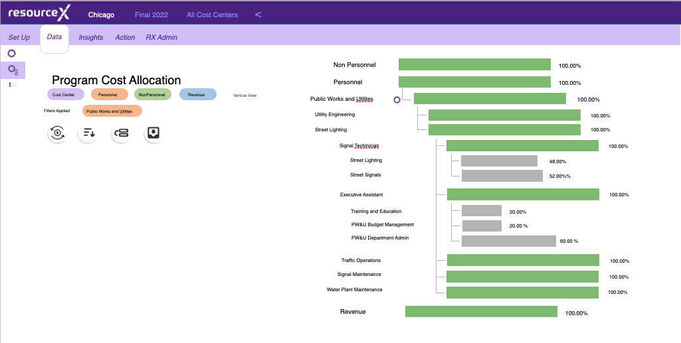
In the tools
Program Costing

Slide 31
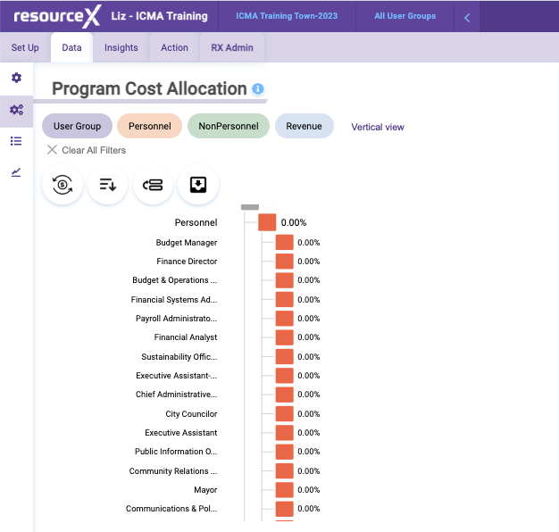
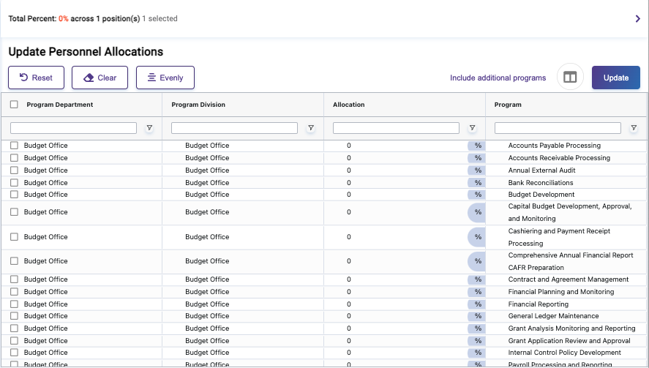
In the tools
Program Costing

Slide 32
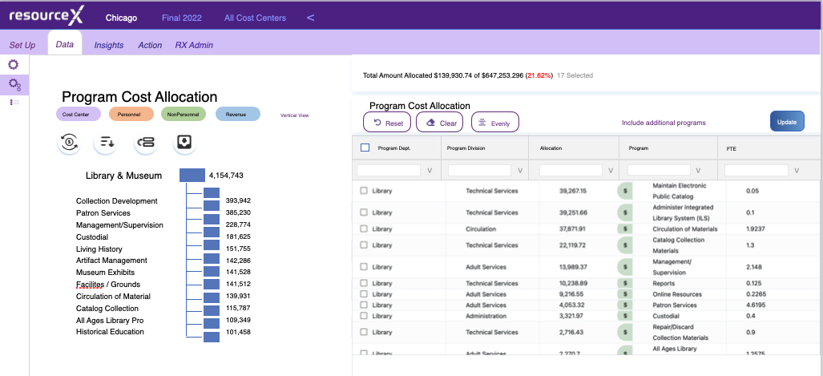
In the tools
Program Costing

Slide 33
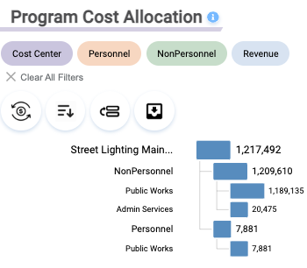
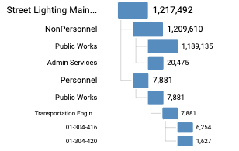
The data you have now is already a monumental step forward…
What does it cost to offer Street Lighting Maintenance?
$1,217,492
What departments allocate resources to this program?
Public Works & Admin Services
What is driving the cost of this program? Personnel Costs or Non-Personnel Costs
Non-Personnel Costs

Slide 34
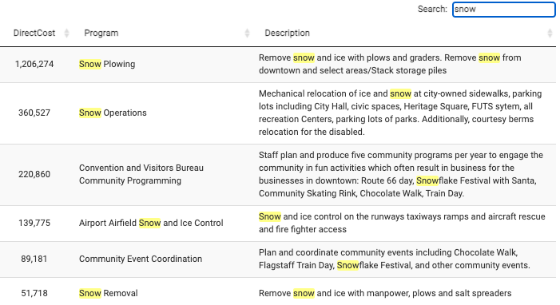
SNOW REMOVAL
FLAGSTAFF, AZ

