Slide 1
BUDGETING FOR
CLIMATE ACTION
PRIORITY BASED BUDGETING
21ST CENTURY BUDGETING
FROM LINE ITEMS TO GREATER ALIGNMENT

Slide 2
LEARNING JOURNEY
04
02
Advantages & Challenges of Priority-Based Budgeting
04
Creating Program Data
02
03
03
The PBB Process and Methodology
01
What is a 21st Century Budget?
05
01
05
In the Real World

Slide 3
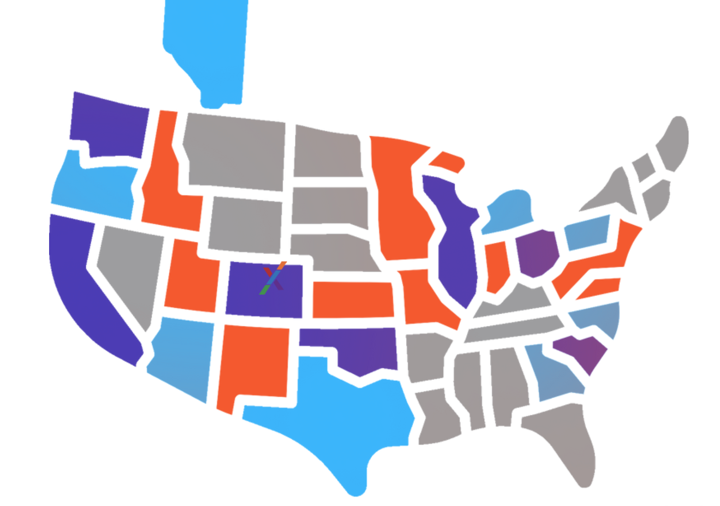
WHO IS RESOURCEX?
We provide the tools and expertise to assist you on your Priority Based Budgeting Journey.
Over 100 cities in the ResourceX community
Over $15,000,000 in funds allocated to programs
Over 20,000 programs created in our tools

Slide 4
WHAT IS PRIORITY-BASED BUDGETING?
PBB PROVIDES THE DATA TO DRIVE COMMUNICATION AND DECISION-MAKING
Maximize budgeting transparency & impact
Understand the true cost of doing business
Align resources with community priorities

Slide 5
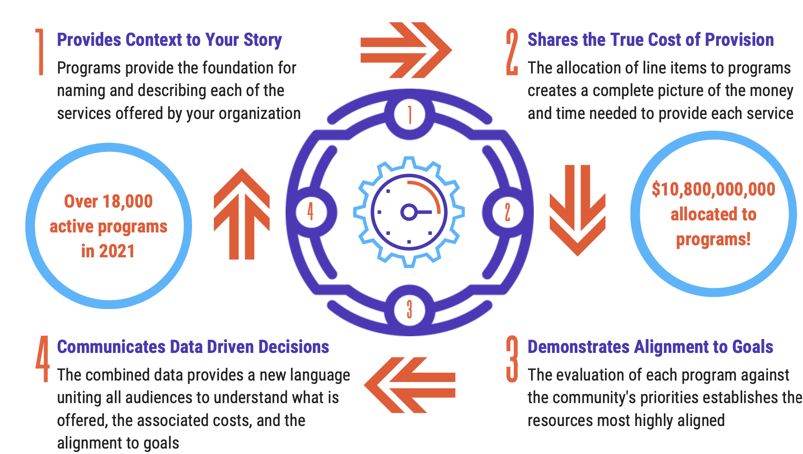
THE PBB PROCESS

Slide 6
ADVANTAGES & CHALLENGES OF PRIORITY-BASED BUDGETING

Slide 7
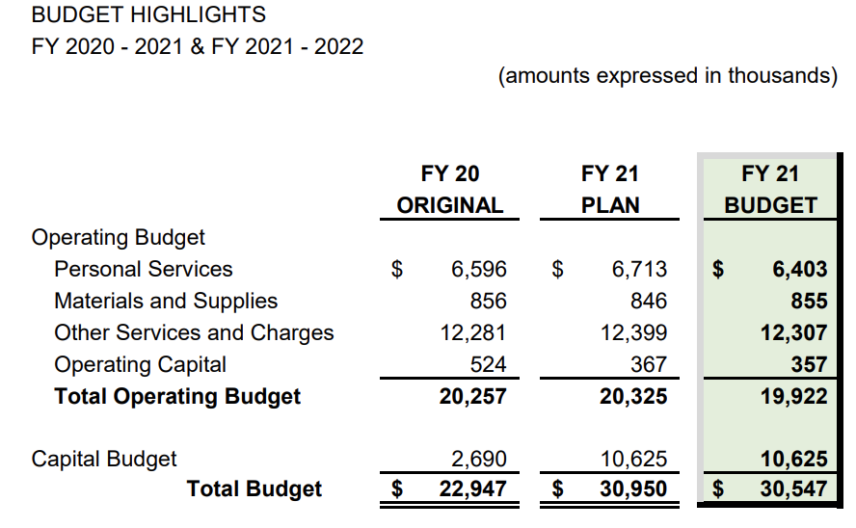
WHICH METHODOLOGY ARE YOU USING?
TRADITIONAL
Most local governments are statutorily obligated to produce a line-item budget or follow an account-based budget structure.
Changes to line-item budgets are overarching, with across-the-board increases and decreases at the organizational or departmental levels.
The line-item approach to budgeting creates a disconnect between funding and understanding the organization's desired outcomes.

Slide 8
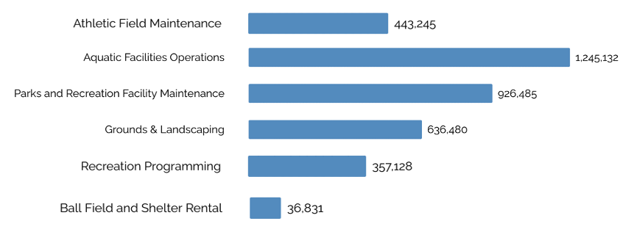
WHICH METHODOLOGY ARE YOU USING?
PROGRAM
Programs are an efficient way to communicate a local government’s budget in a language that the average person can understand.
A program budget takes a financial language and turns it into a relevant and digestible concept, much like a website is easy for most people to view and understand even if they aren’t familiar with the coding required to create it.
Programs are informed by line items, so they are true representations of your budget.

Slide 9
WHICH METHODOLOGY ARE YOU USING?
PRIORITY-BASED
Develop a program inventory, allocate costs to these programs, and collect data points to assess the impact of the programs.
Priority-based budgeting looks at the strategic plan with all the programs and resources and aligns them to the stated outcomes.
Priority-based budgeting captures data points through a scoring process that provides in-depth knowledge about each program and its alignment with outcomes, then communicates that information for informed decisions about future resource allocation.

Slide 10
PROGRAM-CENTRIC DECISION-MAKING
Program Inventory
Program Costs
Program Scores
Program Performance Metrics
Create Data
Program’s Future Direction
Impact on Outcomes
Basic Program Attributes
Line-item (resource) data
Program Inventory
Building Business Intelligence (Layering Data)

Slide 11
PROGRAM-CENTRIC DECISION-MAKING
Create data
gain insight
TAKE ACTION
Inventory
Costs
Scores
Performance Metrics
Program Future / Fate
Increase Service Levels
Repurpose Resources
Efficiency, Sourcing, Service Levels
Generate Revenue
Budget/approve new program launches
Reallocation of resources
Revenue generation
Execution

Slide 12
PROGRAMS ARE THE VEHICLE FOR CHANGE
Show precisely what your government does and how much it costs.
Are meaningful to elected officials and residents because they are directly relevant to how they experience public services.
Create a shared language that includes all stakeholders.

Slide 13
CHALLENGES AND ADVANTAGES OF PROGRAM BUDGETING
CHALLENGES
ADVANTAGES
Aligning with accounting structure
Shift in mindset
Resolving differences of opinion about the alignment of programs
Offers transparency
Allows more meaningful comparisons
Understand where the workforce is spending their time
Create invaluable data points for decision-making
Align resources to community priorities
Gives decision-makers more insight
Directs funds straight to community priorities

Slide 14
TRANSPARENCY
TRADE-OFFS
SOURCING
WORKFORCE PLANNING
PERFORMANCE

Slide 15
PRIORITY BASED BUDGETING
MILESTONES
CREATE PROGRAM INVENTORY
ALIGN PROGRAMS TO PRIORITIES
01
02
03
04
05
1
2
3
4
5
UPLOAD BUDGET DATA
ALLOCATE LINE ITEMS TO PROGRAMS
APPLY DATA TO ACHIEVE OUTCOMES

Slide 16
05
PROGRAM ANALYSIS
5
03
PROGRAM COSTING
3
04
PROGRAM SCORING
4
UPLOAD BUDGET DATA
01
1
02
PROGRAM INVENTORY
2

Slide 22
IN THE REAL WORLD

Slide 23
GOAL
Clearly communicate the services offered by the City with regards to snow and how much it costs to offer them
PATH TO ACTION
SNOW REMOVAL
FLAGSTAFF, AZ
Identify programs
Allocate costs and determine the total investment in snow-related programs
Utilize program data for communication
SKILLS AND CAPACITY
Apply data to internal and external communications and utilize data to assist with decisions about future service and resource needs

Slide 24
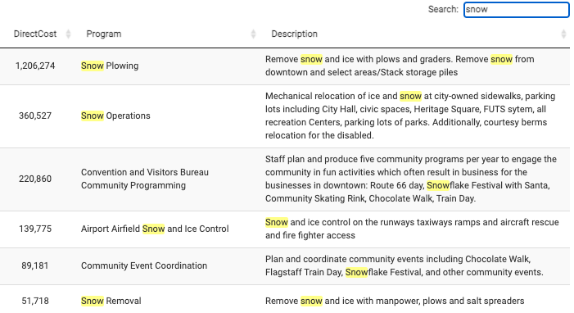
SNOW REMOVAL
FLAGSTAFF, AZ

Slide 25
CASE STUDY

Slide 26
PRACTICAL APPLICATION OF PBB CASE STUDY OF CITY OF FLAGSTAFF
Flagstaff set ambitious goals for climate action in their Carbon Neutrality Plan
Their budget process didn’t provide the necessary data to easily communicate organization wide
How current resources aligned with climate action driven priorities
How changes in resource allocation would impact existing services
How to identify opportunities in their existing budget for resource reallocation
How to identify opportunities for new revenue generation in support of their priorities
1
1
Create a language through which they could communicate their current service offering
2
2
Identify where resources were currently being utilized to provide those services
3
3
Produce the data to show alignment to community priorities for a better decision-making process

Slide 27
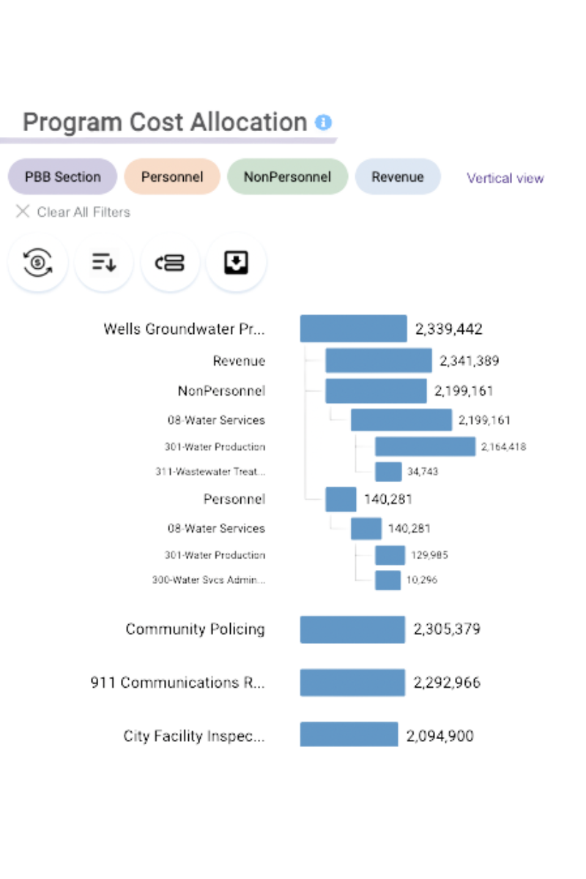
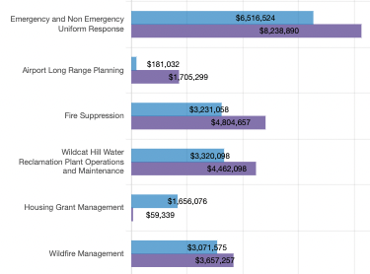
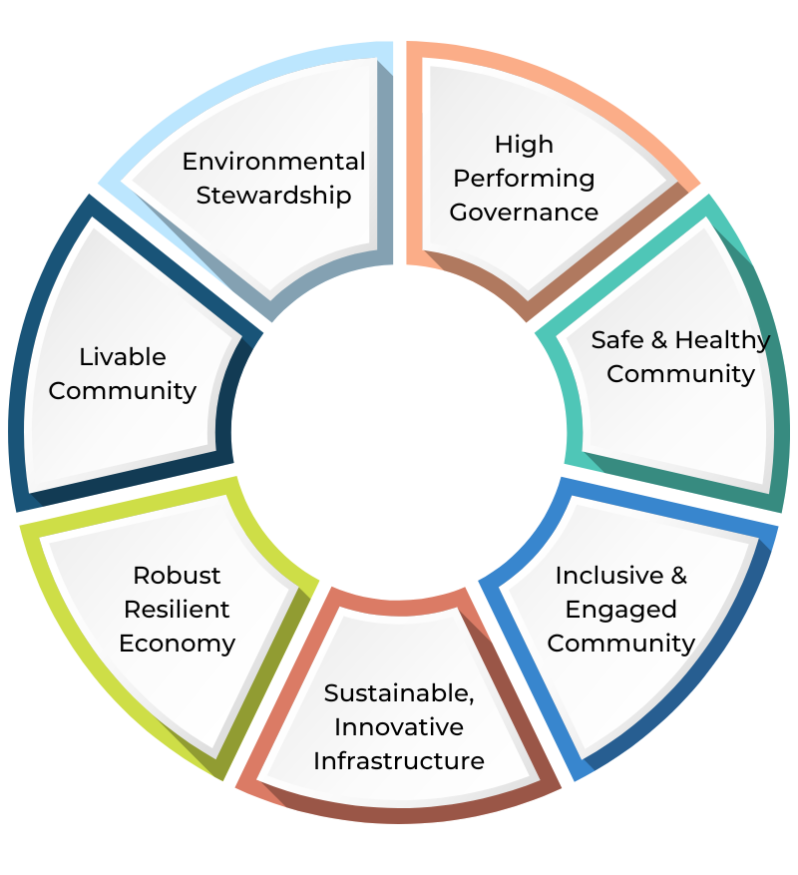
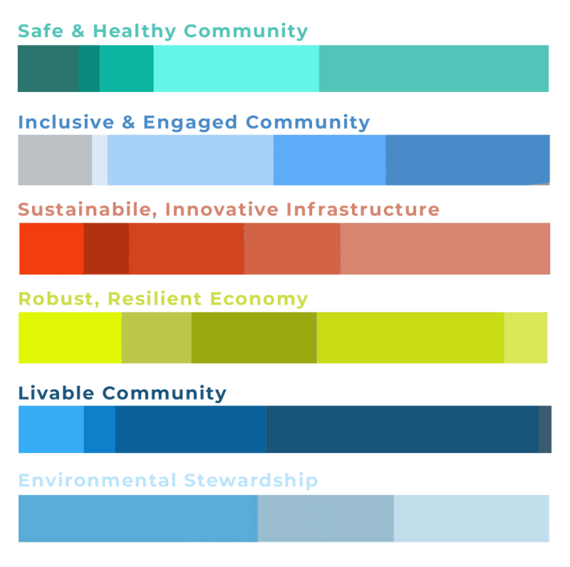
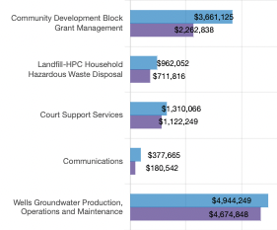
PRACTICAL APPLICATION OF PBB CASE STUDY OF CITY OF FLAGSTAFF
Mission: to create a balanced, data-driven, and sustainable budget process to prioritize spending and reallocate resources from within to launch new programs and envision a better future
Goal: to free up resources and dramatically realign them towards the Carbon Neutrality Plan
Strategy: to build a prioritized program budget through OnlinePBB to enable communication and data-driven decision making

