Slide 1
Decision Leadership
= decision architect

Slide 2
What is a Decision Architect?

Slide 3
Someone who helps people make better choices…
…by design of the decision context and process

Slide 4
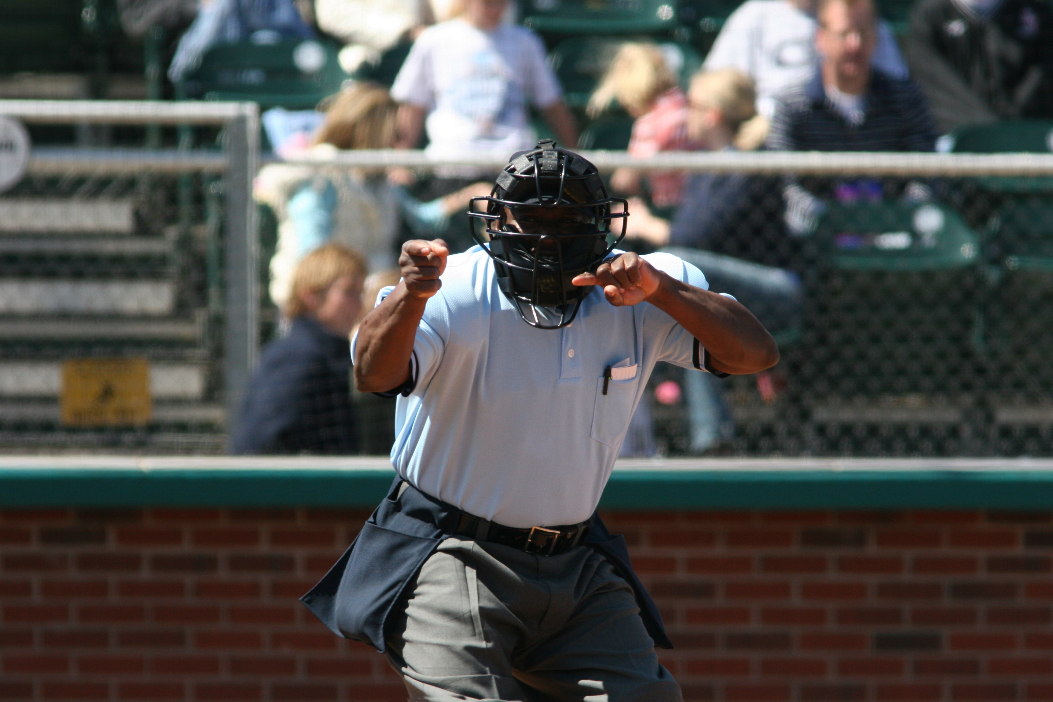
A Popular conception of a finance officer
A neutral arbiter, who calls “balls” and “strikes”

Slide 5
Neutrality is impossible
The finance officer architects the decision-making environment by deciding what information to present and how it is presented

Slide 6


An illustration…
Notes:
To illustrate, let’s consider a decision-making environment in our daily lives: a visit to the grocery store. The decision is what we choose to buy, and the environment is the layout of the grocery store. For example, you may have noticed the fresh produce is usually located close to the entrance. This is because we are likely to allow ourselves to later buy ice cream or candy if we have first placed some healthy produce in our cart. Also, items placed at eye level on the shelf are more likely to be purchased than those not at eye level. One might point out that the grocer has the incentive to maximize profit so will engage in this kind of decision architecting. However, if a grocer wanted to be “neutral,” it would be impossible to do so. Some items have to be closer to the entrance than others. Some have to be closer to eye level on the shelf than others. Even if the grocer decided to randomly select the items that would occupy the most favorable spots on a shelf, then that still will influence the customers’ choices. Similarly, it is not possible for the finance officer to “opt out” of decision architecting. The way in which information is presented has an inescapable influence on how people use the information to make decisions. Just as it is impossible to have a neutral presentation of products in a grocery store, it is impossible to have a neutral presentation of financial and budget information that has no impact on how decisions will be made by others. For example, later we will show that something as seemingly innocuous as the order that options are presented can impact the final choice.

Slide 7

Four Decision-making Villains
Narrow Framing: We tend to see only a few viable options, often just preferring the default
Overconfidence: We tend to be overly certain in our assumptions
Confirmation bias: We tend to embrace ideas that support our assumptions and dismiss ideas that contradict them
Short-term thinking: We tend to choose for the present at the expense of the future.

Slide 8

A Key point about these villains…
The villains are not a result of character flaws, lack of intelligence, etc.
Rather, they result from mental shortcuts gone awry
We need mental shortcuts to get through life, but they sometimes backfire. When they do, they are called “cognitive biases”

Slide 9
Four Skill areas for a decision Architect
#1. Help decision-makers see a wider option set
#2. Help decision makers test assumptions (and uncertainty)
#3. Help decision makers choose highest value options
#4. Create trust in the process
Notes:
Addresses the villians
Counter narrow framing
Counter overconfidence
Counter confirmation bias and short-term bias
Develop a process accomplishes the foregoing and that people feel good about

Slide 10
Question Preview: What’s one thing you might do after this presentation to apply the decision architect skills back at your government?

Slide 11
Help decision-makers see a wider option set

Slide 12


The Problem
Cognitive Bias Example:
Anchoring Bias
People tend to obsess about single burning problems, one best solution, creating a Go-No go decision.
Notes:
They that found people who landed on 10 in the first half of the experiment guessed around 25 percent of Africa was part of the U.N. Those who landed on 65 said around 45 percent. The subjects had been locked in place by a psychological phenomenon known as the anchoring effect.
The agents visited the house and were given a comprehensive booklet of information that included an asking price. Half of the agents were shown an asking price that was substantially higher than the listed price. Alternatively, the other half of the agents were shown an asking price that was substantially lower than the listed price. Each agent was then asked to give his or her own estimate on a reasonable buying price for the house and the lowest price at which he or she would sell the house if he or she owned the house.
After giving their estimates, the agents were asked what factors affected their judgments. While the real estate agents claimed that they ignored the asking price in their calculations, the results of the experiment showed otherwise. The amount of the asking price that the agents were shown actually did influence their judgments without them realizing. The asking price had a 41% anchoring effect on the real estate agents’ reasonable buying price calculations. Despite the fact that the real estate agents took pride in their self-perceived ability to ignore the asking price, the agents’ anchoring effect was only 7% lower than the 48% effect the asking price had on a set of business school students with no real estate experience who went through the same experiment. Dr. Kahneman makes note that the only difference between the study of the real estate agents and that of the business students was that the students were able to concede that the asking price did in fact influence their valuations. A real estate agent should real

Slide 13


Slide 14

Biggest Anchor in local Government finance?
The Default
Status quo or historical precedent is often the default

Slide 15
Strategies for Overcoming anchoring bias and widening the Option Set
Be intentional about framing of decisions.
Most common example?...
…Last year’s budget used as context for next year’s budget.
Notes:
Last year’s budget may not longer be affordable or relevant in changing times.
Layering on effect

Slide 16
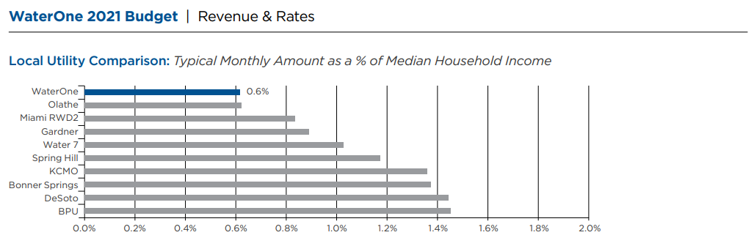
Case of water affordability
Common to use a benchmark percentage for the average bill as a percent of median household income
Notes:
Another example of anchoring bias is when benchmark statistics from comparable governments are used as a basis for making decisions about reserves, rates, etc. Though having a reference point can be helpful in some cases, benchmarks can be a hindrance if they are not relevant to your government’s context
“For water affordability, it is very common to compare your rates to your neighbors and then also use a benchmark percentage for the average bill as a percent of median household income. Everyone uses either their neighbors’ rates or this generic threshold to determine affordability—which may or may not actually mean the utility is affordable based on the specific demographics of the service territory

Slide 17
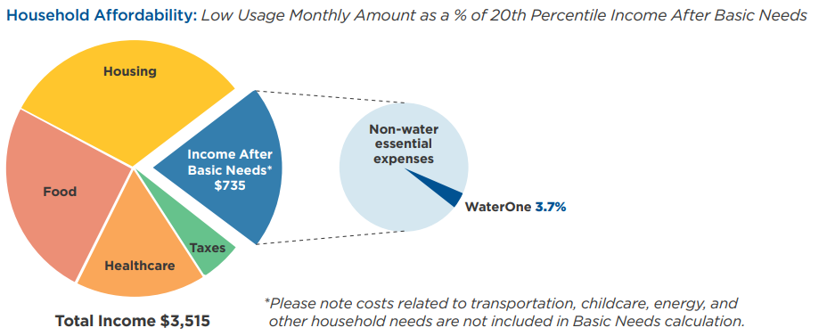
Here is a different perspective…
Focus on the indivual low income ratepayer may lead to a new conclusion
Notes:
As WaterOne took a closer look at how our lowest income customers might be disproportionately burdened by their water bill, we liked to use the analogy ‘when we are buying shoes, we shouldn’t be measuring our neighbor’s feet.’
Meaning we want to make decisions based purely on what is best for our rate payers and what our publicly elected Board determines to be affordable for our rate payers.”
Here is a graphic with benchmarking data and then a new graphic that avoids peer comparisons. If the objective is to provide affordable water to low-income households, the new graphic seems like a clear improvement. The old graphic might imply that low-income residents are paying too little! The new graphic emphasizes how little income low-income residents have, so anything WaterOne can do to help them save money could make a difference

Slide 18
Enlist the outside View
Help people look beyond their immediately available information and experiences
To estimate the cost/benefit of a new program, visit another govt that has already tried it
To highlight the need for investing in infrastructure, take a tour of the infrastructure
Find a wider pool of evidence to inform judgement

Slide 19
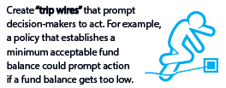
Create a Trip wire
Reserves as self-insurance

Slide 20
Question: What’s one thing you might do after this presentation to help decision-makers see a wider option set back at your government?

Slide 21
Help decision makers test assumptions
(and uncertainty)

Slide 22

The Problem
Cognitive Bias Example:
Overconfidence Bias
People have difficulty thinking about and talking about uncertainty.

Slide 23
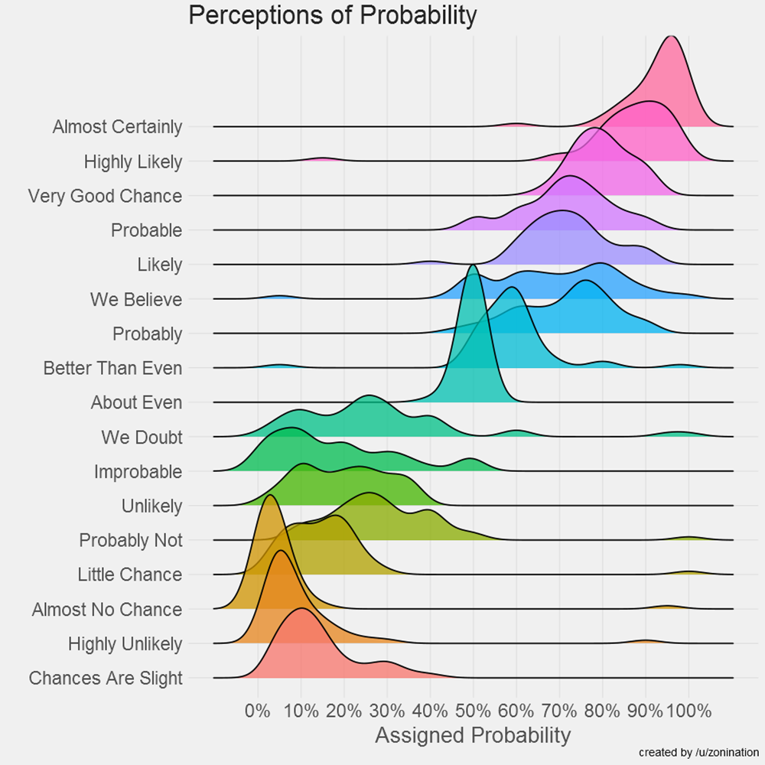
Clarify Assumptions
Notes:
Sports gambler vs never bought a lotter ticket
Another reason that risk matrices can be counterproductive is they act as an “analysis placebo,”12 where decision-makers think they understand the risk because they have subjectively characterized the risk as high,” “low,” etc. But, because the risk matrix is not based on hard data about the chance of loss and the potential magnitude of loss, decision-makers are overconfident about how well they understand the risk
Easy and cheap but low value

Slide 24
Calibrate How you communicate
Finance officers often need to communicate uncertainty
A revenue forecast might be described in this way…
“I’m 75% certain that revenues will increase by at least 1% next year.”
Research shows people prefer advisors who quantify their uncertainty but are still confident.
Our example omits hedging language like “maybe,” “I’m not sure, but…”, etc.
It comes across as confident, even though it is expressed as a probabilistic likelihood (75%).

Slide 25
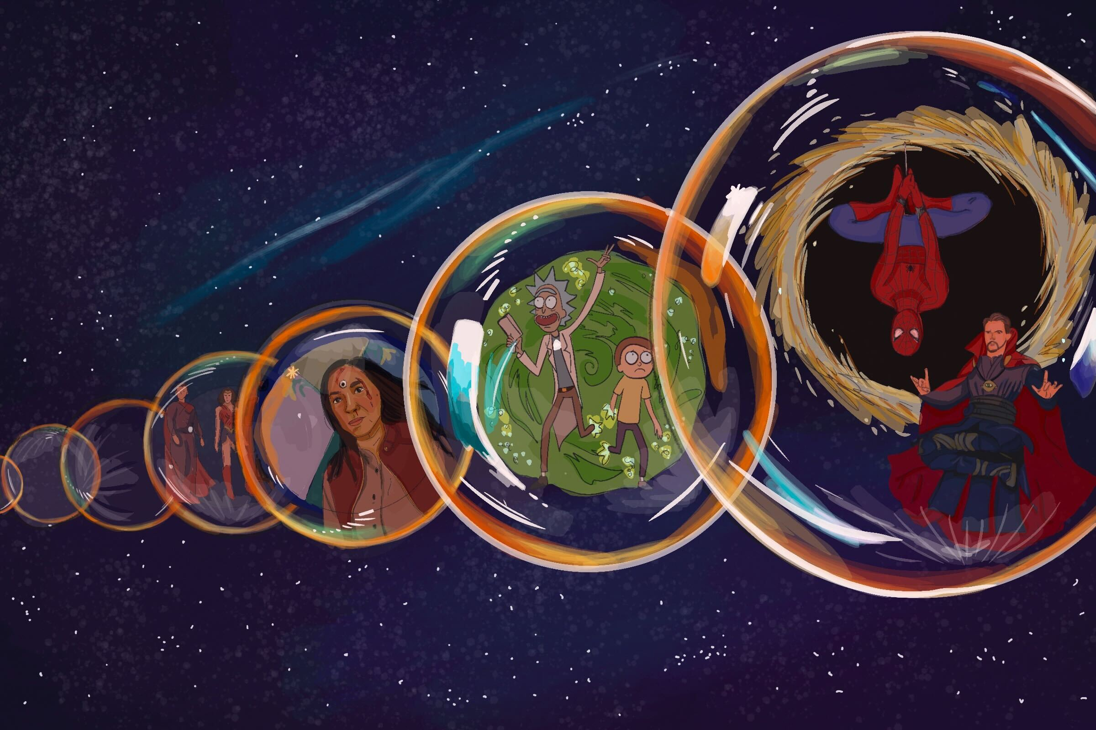
Prompt multiple construal
Use forecast scenarios to help people imagine a future that is different than the one they have in mind
Imagine multiple, different future outcomes
Notes:
Tell story about SJC

Slide 26
Break For Excel

Slide 27
Question: What’s one thing you might do after this presentation to help decision-makers test their assumptions back at your government?

Slide 28
Help Decision-makers choose the highest value options

Slide 29
The Problem
Let’s See some Cognitive Bias Examples…
People have questions about if potential investments of tax dollars are in line with the values and mission of government, if those investments are worth the cost.

Slide 30
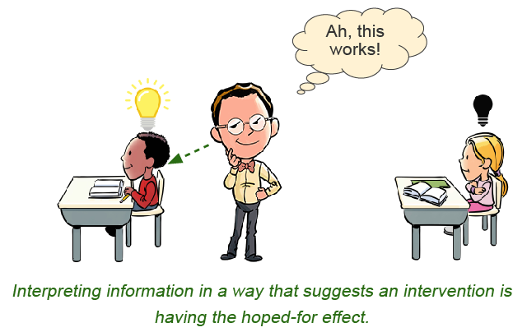

Confirmation Bias
Tendency to look for evidence that confirms a hypothesis or failing to look for disconfirming evidence.

Slide 31
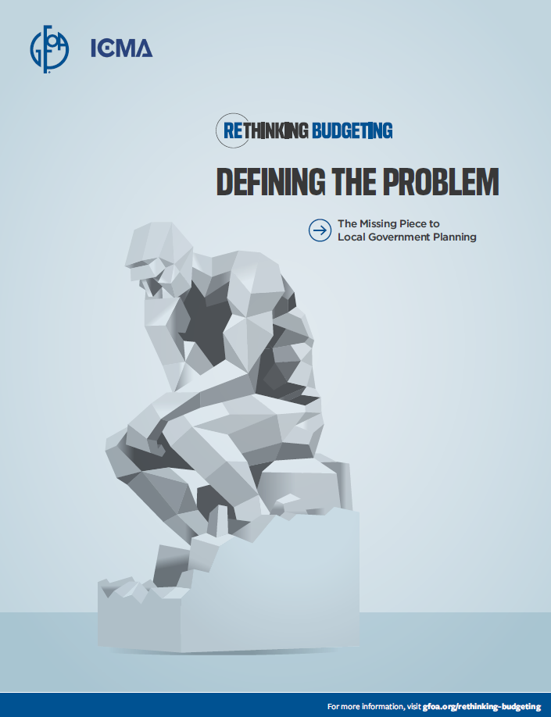
“A problem not fully understood is unsolvable, and a problem that is fully understood is half solved.”
-Charles Kettering, Inventor
Notes:
his famous quote from Charles Kettering holds great significance for local government planning and budgeting
The traditional budget process is inadequate for dealing with the complex problems that local governments are asked to deal with, such as degradation of the natural environment, encouraging economic
opportunity, drug addiction, and more.
The budget and planning process is ill-equipped to deal with these kinds of complex problems because they have characteristics that confound traditional planning and budgeting. Let’s explore these characteristics on the next slides

Slide 32
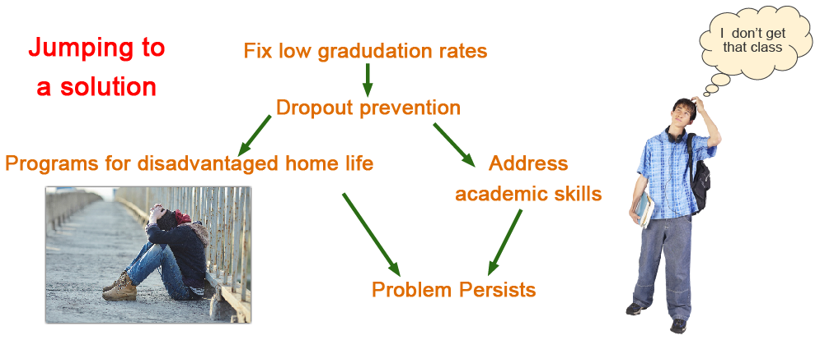
Jumping to a Solution

Slide 33
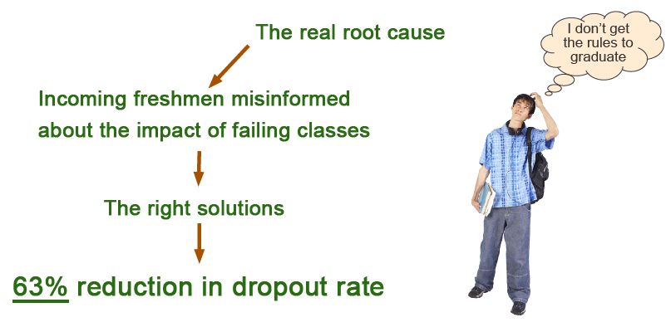
Real Root Cause

Slide 34
Traverse City Area Public Schools
Aging Facilities
Declining Enrollment
Declining Revenue
Difficult Decisions

Slide 35
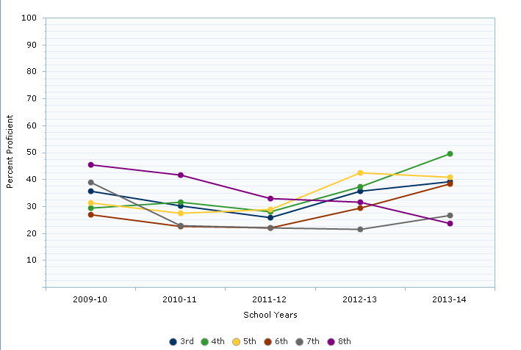
Range of State Average

Slide 36

“We love math! We love math!”
-A chant of 4th grade students at Westwoods Elementary

Slide 37
Champion the long-term view by a Pre-commit to good Decisions
Making good decisions in the heat of the moment is hard.
Commit to good choices when the pressure is less.
A good example is a one-time revenue policy

Slide 38
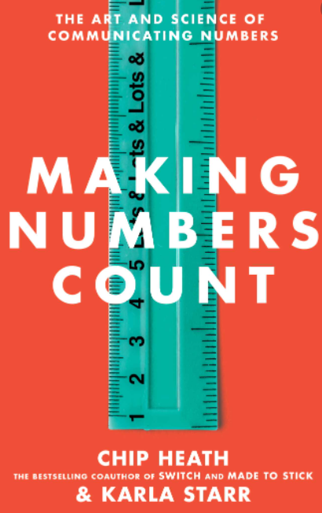
People do not really understand numbers, especially the very large numbers that make up a budget.
“Our brains were designed to grok 1, 2, 3, 4, and 5. After that, it’s just “lots.”
Information is lost unless numbers are translated into human experience.
Notes:
most languages in the world and throughout history have names for the numbers 1, 2, 3, 4, and 5. But after that, the supply of numbers with names runs dry, and the language is forced to resort to a generic word such as “lots” for all the other numbers—from 6 and 7 on up to a billion gazillion.
But while our cultural math infrastructure has changed, our brains are still the same from a biological perspective. Even if we train a lot—and we do all the way up through college—mathematics is a blisteringly new piece of high-tech software strapped on top of a clunky piece of hardware. It can work, but it will never be our first instinct.
Consider this thought experiment designed to help people understand the difference between “a million” and “a billion.” You and a friend each enter a lottery with several large prizes. But there’s a catch: If you win, you must spend $50,000 of your prize money each day until it runs out. You win a million dollars. Your friend wins a billion. How long does it take each of you to spend your lottery windfall? As a millionaire, your run out of money after 20 days. If you win on Thanksgiving, you’re out of money more than a week before Christmas. For your billionaire friend, they would have to $50,000 a day for… 55 years. Approximately two generations. Almost 14 presidential terms.
Think of what we accomplished by forcing you to imagine watching your friend spend $50,000 every day for 55 years. Not only does it make the number click, it morphs our envy into something so real and palpable. It’s an animated picture that brings the number to life.

Slide 39
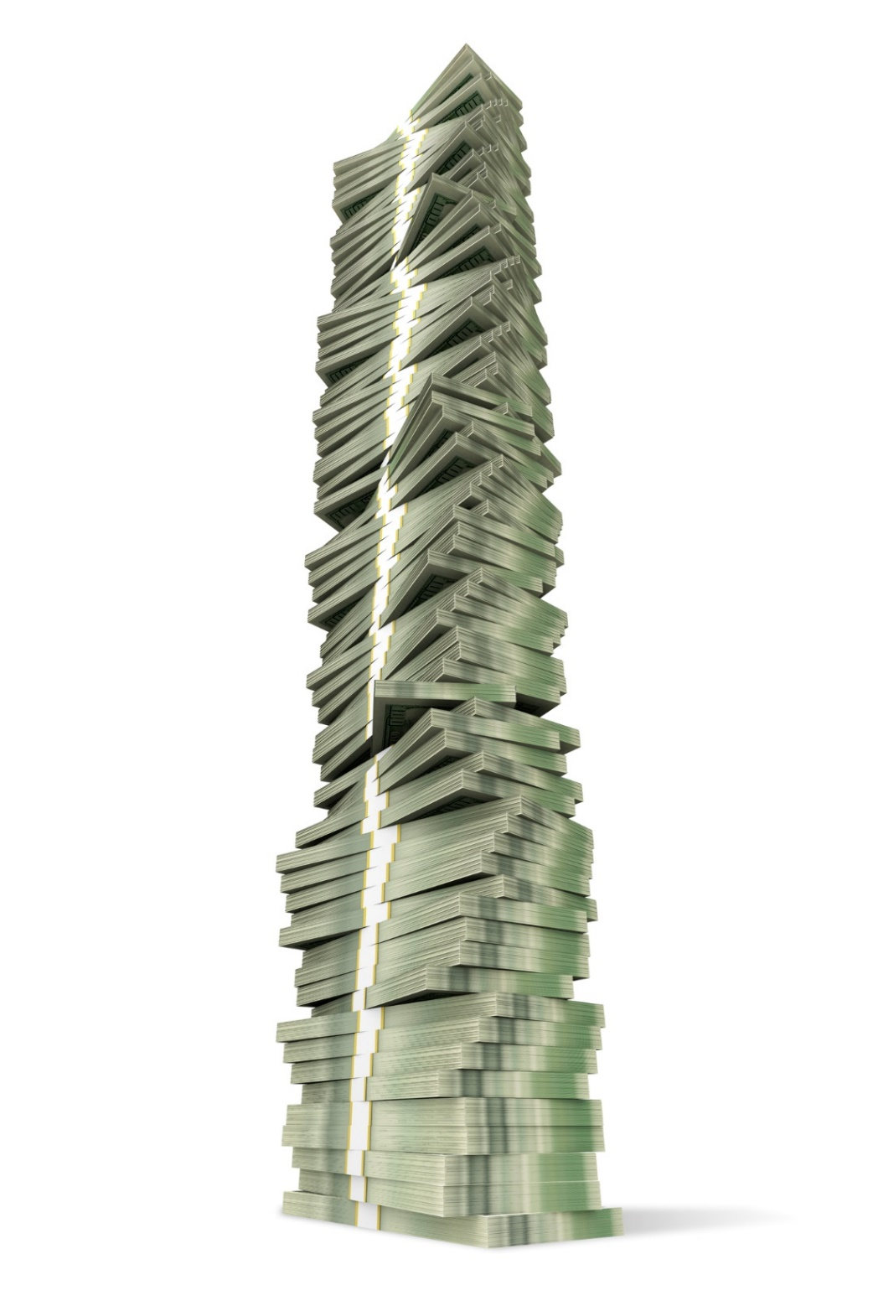
The higher number get, the less sensitive we become to them.
This is known as “psychophysical numbing”
Every number can be translated into something that is easier for people to grasp, like an analogy, a comparison, and more.
Notes:
Moving on the number scale from 10 to 20 feels significant. But moving an equal distance from 340 to 350, even though it’s the same increase, we feel nothing… that’s “numbing.”

Slide 40
Three building blocks
Notes:
Note that the book has many strategies. We are focusing on just three today

Slide 41


Translate everything
Try focusing on 1 at a time
Bring big numbers down to the personal level
Impact on Tax Bill of Average Home
Per Capita Figures
Notes:
Microsoft’s search engine, Bing, delivers millions of facts a day in response to queries. MS wondered whether some simple contextual phrases would help people understand and remember their numerical search results. So instead of just reporting that Pakistan has an area of 340,000 square miles, they added a brief “perspective phrase,” something like “that’s about the size of 2 Californias.” And then, they tested people to see if they remembered the fact they had been shown. Some perspective phrases were better than others. But ALL phrases were better than nothing. Even a slightly unwieldy comparison was more effective than a number alone. In fact, adding a single perspective phrase cut the error rates in half when people tried to recall the facts. That doesn’t mean every guess was a bull’s-eye. There were still plenty of errors. But people were at least hitting the dartboard, not the poster next to it on the wall.

Slide 42
Favor User-Friendly Numbers
Round with Enthusiasm
  $3,405,892 -> $3.4 million
Concrete is better: Use Whole Numbers to Describe Fractions
Department | Percent of Spending | For Every $10 in the Budget…
Police | 36% | $4
Fire | 31% | $3
Public Works | 22% | $2
Administration | 11% | $1
Notes:
Psychologist George A. Miller wrote one of the most famous papers in psychology on How big is human working memory? His answer was “The Magical Number 7, Plus or Minus 2.” That number was the limit for how many things we could hold in our short-term memory. Whether it’s numbers, names, digits, or anything else, if we have to memorize more than 7 pieces of info (sometimes just 5, or up to 9), we start to lose track. In fact, a single unfriendly number can crash the system all on its own. Think of a complicated fraction (17/139), multidigit number (4,954,287), or long decimal (.092383). These numbers only measure one thing, but take up many slots in our memory. Even if we manage to memorize them, we have no room to remember anything else, and the message is lost.

Slide 43


Help people grasp your numbers
Use Simple Familiar Comparisons
Cost of Municipal Service vs. Consumer Goods
Trade Time for Money
Notes:
Cultures have used this formula for millennia to develop measurements. One survey of 84 cultures, found that most cultures understood units of measurement through the human body, an omnipresent measuring stick. The length of outstretched arms, fingertip to fingertip, developed as a measurement in half of the cultures. (In English, we call this a “fathom.”) One in every four cultures developed a measurement defined as the length of the forearm, called a “cubit” in Middle English; “Mile” comes from the Latin phrase for “thousand steps.”
The best number translations blend easily imagined comparisons and simple multipliers.
Converting to time is useful in many situations because, in a world ruled by schedules, we have plenty of experience clocking it. We might not know how many miles away our favorite coffee spot is, but we know just how long it takes to get there.

Slide 44
Question: What’s one thing you might do after this presentation to help decision-makers pick the highest value option back at your government?

Slide 45
Create Trust in the Process

Slide 46
Three Elements of Trust
Procedural Justice
Interactive Justice
Distributive Justice

Slide 47
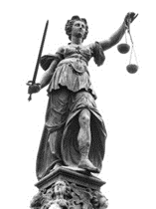
Procedural Justice
Decisions based on accurate information
Transparent & consistent decision-making criteria applied equally
Stakeholders given opportunity for input
Mistakes recognized & corrected
Notes:
Incorporating Procedural justice into your decision-making is one way you can avoid destructive conflicts.
Key features of procedural justice:
Decisions are based on accurate information.
A transparent and consistent set of decision-making criteria is applied to everyone equally.
All affected stakeholders are given the opportunity for input.
Mistakes are recognized and corrected.
At the end of the day, people might not like the final decision, but the hope is that they understand it and can accept it.
Can be particularly useful in collective bargaining situations.
Also can be useful if you are thinking about implementing priority-based budgeting.

Slide 48

Notes:
Let’s move on to another example about a municipal vehicle replacement fund that was running of money and how procedural justice was applied

Slide 49
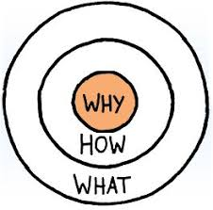
Start with Why
Notes:
The starting point for the CFO was to explain to departments why the charges and a healthy vehicle replacement fund was important and how the charges were calculated. This removed the mystery behind the fund.

Slide 50

Cross Departmental Team Develops New Approach
Opportunity for input
Team develops criterial to evaluate need for vehicles
Notes:
e CFO formed a cross-departmental committee to help redesign the city’s approach to vehicle replacement. Bringing other departments into decision-making demonstrated that the finance office wanted their perspectives. The committee put together a set of criteria for evaluating whether to replace a vehicle. A transparent and agreed-upon set of criteria brought a sense of objectivity to deciding which vehicles to replace.

Slide 51
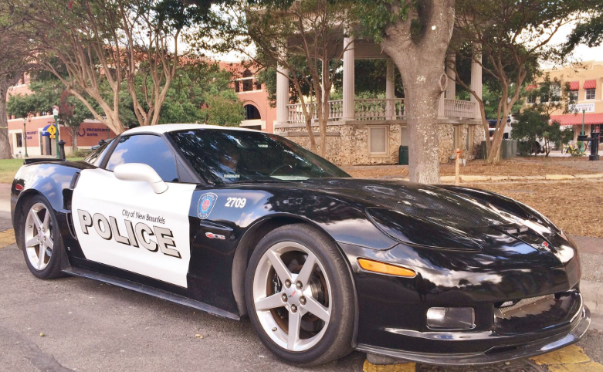
The Team Makes a Discovery!
Notes:
The committee then examined the city’s inventory of vehicles. It found that the city’s police department seized several vehicles that made their way into the city’s motor pool. These vehicles added unplanned maintenance costs, and departments often expected to replace these vehicles when their useful lives ended. The city resolved to auction off seized vehicles, thereby increasing revenues as well as eliminating the expense associated with maintaining them. Because the committee went through this examination, every department felt they had input into the decision.
Ultimately, the city was able to increase revenue to the fund through higher charges and auction proceeds and decrease fund expenses by reducing the number of vehicles in the pool. Departments supported this change, and trust was built with the finance office.

Slide 52

A counter-example
Notes:
We can also see how a lack of perceived procedural justice played out in a county government’s budget process. In this county, each year departments are asked to submit a “status quo” budget for performing the same level of service as the prior year. If they want new or expanded services, projects, etc., those must be submitted as a separate package that is considered at the end of the budget process. Once the status quo budget has been found to be affordable and the county budget office knows how much discretionary revenue is left, requests for new spending are considered.
The budget office requires that these requests be well justified and the office fully reviews all of the data submitted. However, there are no established criteria that determine how one request will be prioritized versus another. Rather, the county administrator’s office determines which requests can be included in the budget based on available funding and other factors that aren’t made clear to people outside the central administrative office.
Departments advocate for their projects to the budget office and the county administrator but only hear about the fate of their request at the end of the process. They do not see the details of the other requests and are not included in the decision-making. Some departments that feel their request was unfairly denied make an appeal to the county board at public budget hearings. The board will then sometimes overturn the county administrator’s decisions on the spot at a late stage in the budget preparation process. This further reinforces the impression that the process is capricious and unfair.
To provide an illustration, a small office of emergency management (OEM) wanted to add five new staff members to its existing staff of 10. The budget office asked for a rigorous justification for such a large increase in staffing. In the view of the county’s budget officer, the OEM did not provide sufficient data about its workload to justify the added staff. As a result, the request was not approved.
Although the decision was based on the data the OEM provided, the criteria used to make the decision were not described clearly to the OEM. The head of the OEM, however, was not willing to take the budget decision at face value. He contended that the decision was based on a personal dislike that the CAO had for him. In other words, the decision was not objective. Because the criteria were not transparent, it was impossible to show the decision was objective. The county board even got involved in the dispute and began to question this decision and other decisions about requests for new and expanded projects that year.

Slide 53
Question: How is your process doing on the elements of procedural justice?

Slide 54
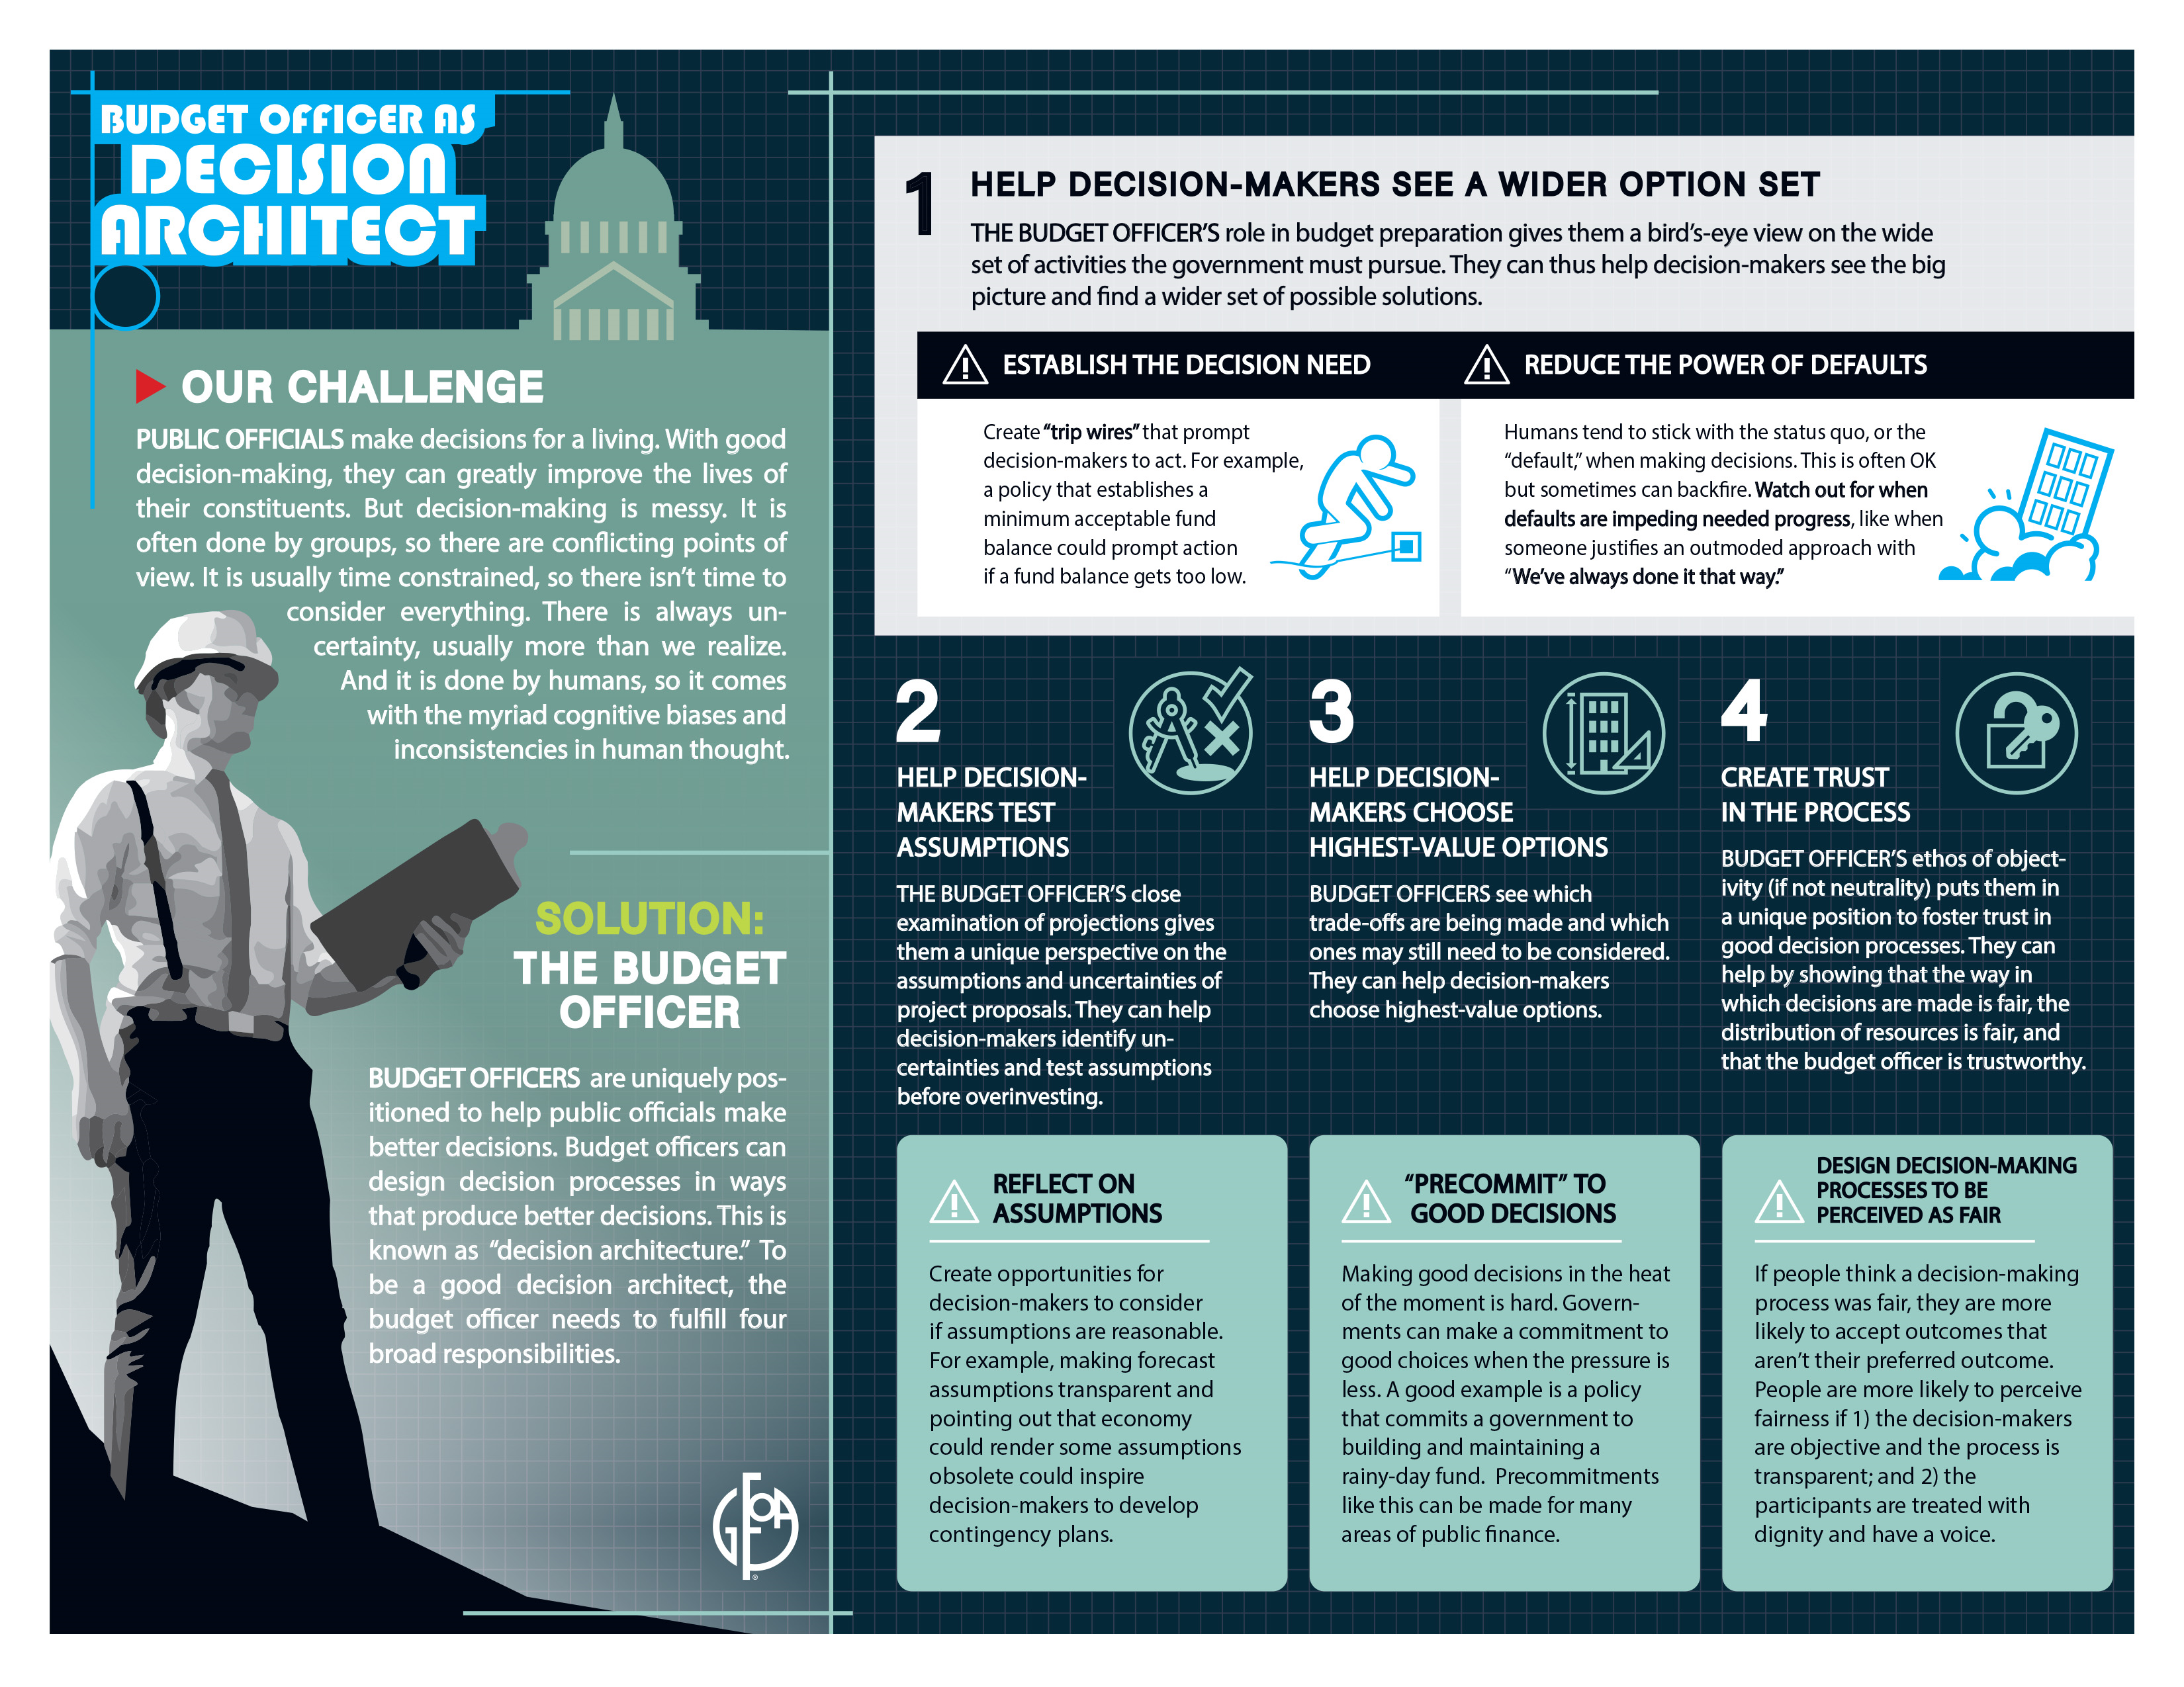

Slide 55
Other Resources

Slide 56
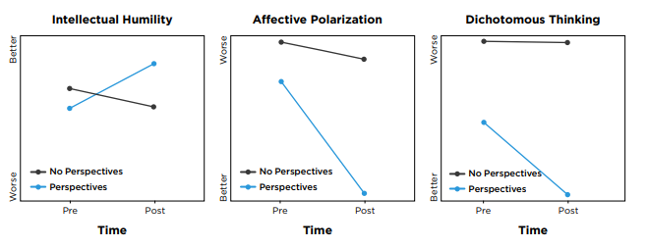
On average, participants rated their satisfaction with the program as a 9 out of 10.
Results from Our Nationwide Study

Slide 57
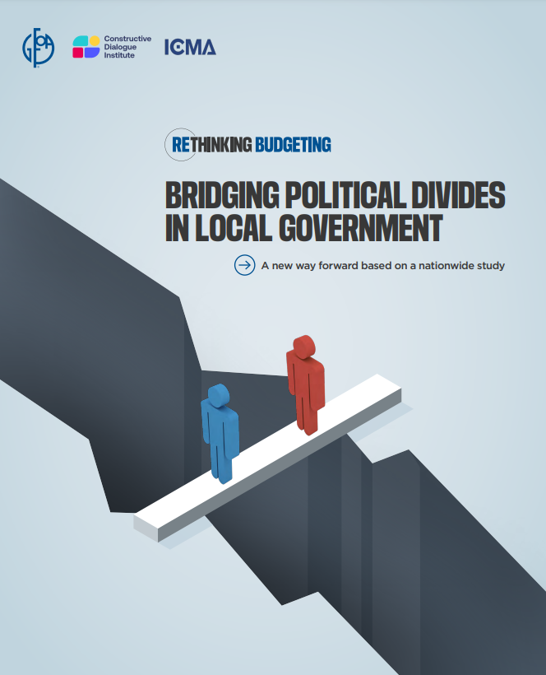

Slide 58

GFOA Fairness series gfoa.org/fairness
Issues of Fairness and Equity are Being Considered by Many Local Governments
“All public servants should read these”
-Timothy Riordan, GFOA President, 1995
Notes:
The conventional budget decreases or avoids conflict by relying on historical precedent. In decades past, however, income inequalities were far less and median real wages had been growing for many years.23 Also,
back then, people were not as aware of (or perhaps less concerned about) racial disparities.24 So, in the past, some potential conflicts were less acute and/or local governments were comfortable ignoring them. Today, it seems more people are interested in addressing these conflicts and are less willing to accept conditions that are regarded as unfair. Therefore, avoiding conflict is not really an option. The only good option is to handle it constructively. Hence, better budgeting and more attention to fairness in the budget could play a role in positively influencing some of the most important potential conflicts of our time.

Slide 59
Coming Soon: Budgeting for Equity Study Results

Slide 60
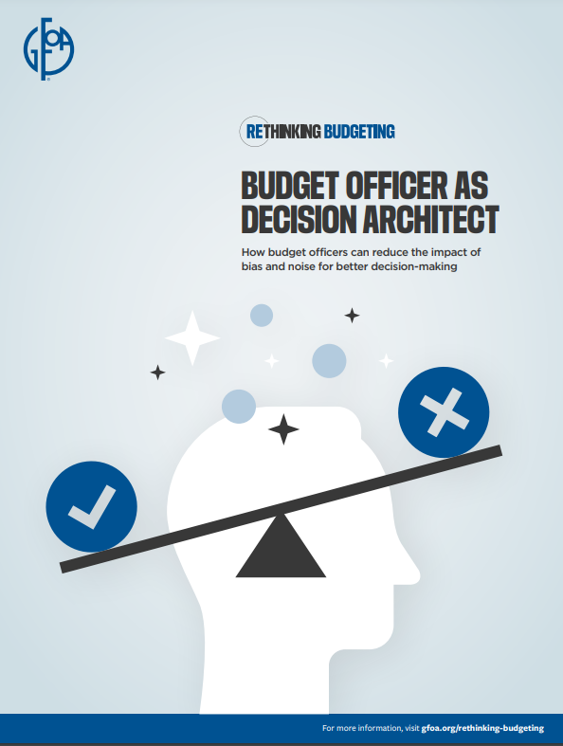
The End

