Slide 1
Making Your Resources
Work for
Your Priorities
Climate Cohort
Kick-Off Session
Andrew Salkin
Founding Principal
March 8, 2022

Slide 2
ACTIVATING WHAT YOUR CITY HAS TO SUPPORT YOUR PRIORITIES
Uncover additional city stakeholders who can unlock support and resources critical for the implementation
Develop an appreciation for current resources and tools in your city today
Inspire new ways of looking at existing city processes to unlock opportunities to achieve your goals
Start thinking about creative ways to fully achieve the goals in your CAP.
Notes:
So to kick off our conversation today – we’re focusing on those resources that are already at your disposal – some of which you may be very familiar with and others that you may not have considered before – resources at your city that we here at 100RC refer to as levers
Levers because they have the potential to help you as CRO and your colleagues to get initiatives and actions off the ground in ways you may not have contemplated
So our goals for this morning’s brief introduction to these concepts are to:
Develop an appreciation for the impact that existing city resources can have in support of your resilience initiatives
Uncover critical city stakeholders who should be engaged in Phase II to set the CRO up for success in Implementation
Open up new areas of inquiry for you, your team and Discovery Area Working Groups to research in Phase II

Slide 3
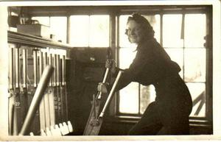
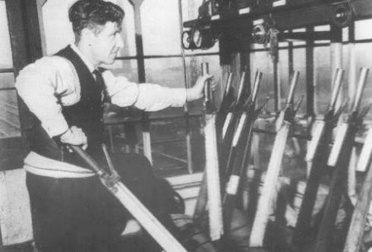
Government Levers
Notes:
So when we talk about levers we are talking about the means you have at your disposal to get your initiatives off the ground and building resilience in your city

Slide 4
Levers I What’s in your sphere of influence?
Other People’s Money:
Government / Private Sector Intersection
Government Money
Government Assets
“Things You Own”
Expense Budget
Capital Budget
Procurement – Built Environment
Procurement – Contracts
Franchising
Government Owned Property
Government Employees
Government Processes
Government Operations
Government Convening Power
Zoning / Land Use
Rules & Regulations
Enforcement
Tax Policy / Incentives
Licensing & Permits
Philanthropic Opportunities
Notes:
You as a municipal government have a whole host of levers of influence, resource and reach that you need to be considering as you think through possible initiatives that will find their ways into your respective strategies and as you pull together your Discovery Area Working Groups for Phase II
These initiatives and the people who wield influence over them will be critical to your efforts now – and MOST IMPORTANTLY – in implementation as you transition to leading

Slide 5
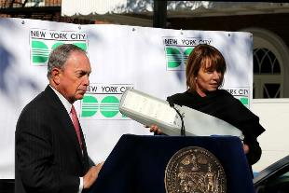
Levers I Government Money – Expense Money
Government
Money
Revenue Streams: You already have the money:
Energy, Water, Waste, and Taxes – built-in revenue stream systems support the current state, but could they fund a better state?
Planning and budgeting for the future outcome – 10, 20, 50 years….
These are not fixed costs - Managing slow-moving variable costs
How can we think about expense budgets over time to save money and / or improve service while meeting bigger goals?
Mayor Bloomberg Announces All 250,000 Street Lights in New York City Will Be Replaced With Energy-Efficient LEDs by 2017, $79 Million Program Will Reducing Energy Consumption and Annual Cost Savings of $6 Million In Energy and $8 Million in Maintenance.
October 24, 2013
Notes:
You as a municipal government have a whole host of levers of influence, resource and reach that you need to be considering as you think through possible initiatives that will find their ways into your respective strategies and as you pull together your Discovery Area Working Groups for Phase II
These initiatives and the people who wield influence over them will be critical to your efforts now – and MOST IMPORTANTLY – in implementation as you transition to leading

Slide 6
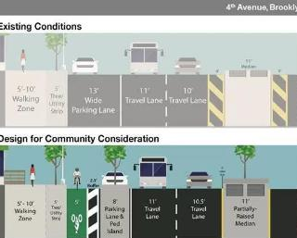
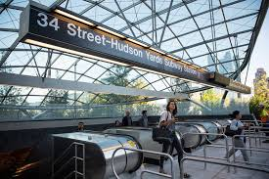
Levers I Government Money – Capital Budget
Government
Money
Capital projects take years to plan and their impact is felt even longer. How can you leverage your capital spend to achieve your resilience goals?
Money over time adds up:
10, 20, 30 years
Reoccurring Budgets add up
Big investments create Big Value Are you leveraging this value for its best use?
Value Capture – focus on your goals
Linking your capital spend with priorities
Design standard (model streets)
Link to zoning and targeted neighborhoods (NYC park spend)
Notes:
NYC Dept of Transportation – City of NYC spends on average $200M on street reconstruction a year, over 10 years that is $2B and is a lot of money. Imagine what the City would look like over time if you change.

Slide 7
Levers I Government Money
Government
Money
Money you don’t have to get what you want
Give up future tax revenue (Tax Credits) in return for something your city wants/needs (affordable housing)
BONUS – Match zoning and development policy with supporting budgets (parks) to increase impact
Incentives and Benefits:
For you or them? Partnership?
Housing
Redevelopment
New Construction
Rent Assistance
Notes:
You as a municipal government have a whole host of levers of influence, resource and reach that you need to be considering as you think through possible initiatives that will find their ways into your respective strategies and as you pull together your Discovery Area Working Groups for Phase II
These initiatives and the people who wield influence over them will be critical to your efforts now – and MOST IMPORTANTLY – in implementation as you transition to leading

Slide 8
Levers I Government Money – Procurement
Government
Money
After labor contracts, you spend most of your money buying goods and services. But while the buying process is cumbersome and annoying, it’s too important to be ignored.
Are you getting the best solutions for the money?
Is there a better way to spend/leverage funds?
Are you dictating answers or asking for solutions?
Procurement is a Partnership
Franchise or Concession Agreements?
Leverage what you do well and transfer what you don’t.
Who has a procurement that could make a difference?
What do you do that you shouldn’t?
Notes:
(Big U, Mental Health, Food spend)
Big U conversation
Money Ball – San Antonio - 18,000 people per year. Jails were overflowing – mostly with Mental Health patients. Jail, Hospitals, Courts, Police and Mental Health Dept – all functioned differently. They created an integrated single system for Mental Health patients. While savings are $2.5 M per year, the impact on lives of the people is dramtic – better care, quicker and not ending up homeless and in jail.

Slide 9
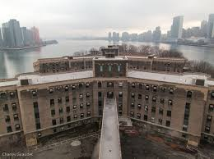
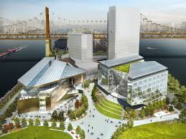
Levers I Government Owned/Controlled Assets
Government Assets
Leading by example and holding yourself accountable is critical.
Placing the same standards on government-owned assets as private-sector assets are critical
What do you have that someone may value?
How do you leverage this value to achieve your goals?
Using your assets for greater gain (NYC and Cornell)
What does your City have that a partner may want?
Notes:
Competition for use of a city asset –
Cornell Tech Campus – Free (previously unused space) to campus and some seed funds. Led to international competition – Stanford vs. Cornell – Winner – pledged to build a $2B campus. Serving 2,000 students and creating 30,000 jobs within 30 years. And $20B in new taxes.

Slide 10
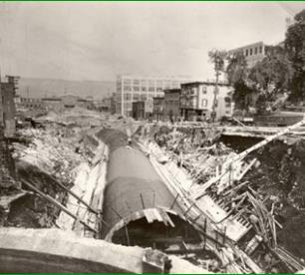
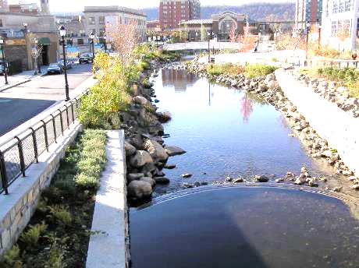
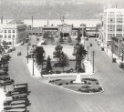
Levers I Government Owned/Controlled Assets
Government Assets
Government Assets
Reimagining your assets and partnership with the natural environment – Day Lighting Creeks (Save $, Earn $)
Notes:
Daylighting waterways are proving effective solutions:
Storm water management and can handle increase flows
Coupled with park and community amenities, they are often economic engines
Bring people together helps strengthen city and build resilience
Parks amenities help people remain healthy.
Increase tax revenues from visitors and property tax
Project Basics:
$48 M for six block project
Along with new Zoning for high density residential and office space.
Driving new investment in area totaling over $500 M

Slide 11
Levers I Other People’s Money
Other People’s Money:
One of the greatest assets in your city is other people’s money and wealth.
Unlocking this wealth can help your city achieve your resilience goals and improve wealth.
Property Assessed Clean Energy – PACE
Lowering the barriers to loans against poverty equity
What could you replace Clean Energy with?
Cooling?
Water capture?
Energy Efficiency? Solar Power?
Policies and Regulations that support your goals
Energy Efficiency Requirements
Storm Water capture requirement
Re-Zoning leverages the developer’s money to achieve your goals (or do they?)
Property Equity wealth can work for you and make homes worth more – ideas?
Notes:
PACE Financing – helps unlock equity in homes for a specific goals – makes admin easier – city collects. Banks have okayed. Work is pre-defined. Approved venders.

Slide 12
Levers I What’s in your sphere of influence?
Other People’s Money:
Government / Private Sector Intersection
Government Money
Government Assets
Expense Budget
Capital Budget
Procurement – Built Environment
Procurement – Contracts
Franchising
Government Owned Property
Government Employees
Government Processes
Government Operations
Government Convening Power
Zoning / Land Use
Rules & Regulations
Enforcement
Tax Policy / Incentives
Licensing & Permits
Philanthropic Opportunities
Notes:
You as a municipal government have a whole host of levers of influence, resource and reach that you need to be considering as you think through possible initiatives that will find their ways into your respective strategies and as you pull together your Discovery Area Working Groups for Phase II
These initiatives and the people who wield influence over them will be critical to your efforts now – and MOST IMPORTANTLY – in implementation as you transition to leading

Slide 13
Making Your Resources
Work for
Your Priorities

