Slide 1



RESOURCE
REALLOCATION & MAXIMIZATION
UTILIZING THE PBB BLUEPRINT TO
OPTIMIZE & MAXIMIZE RESOURCES
Notes:
Duration: 70 minutes

Slide 2
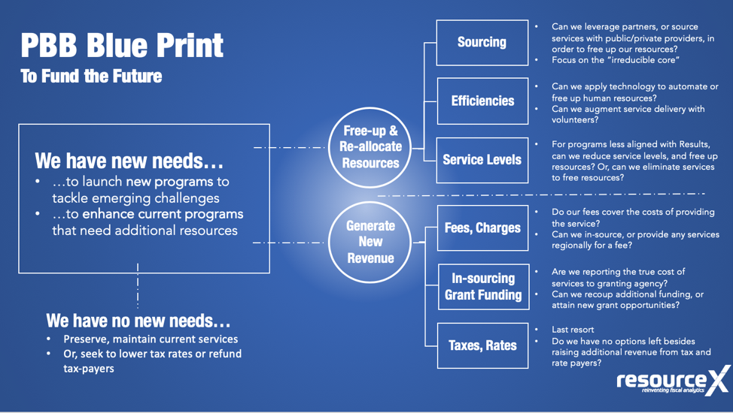
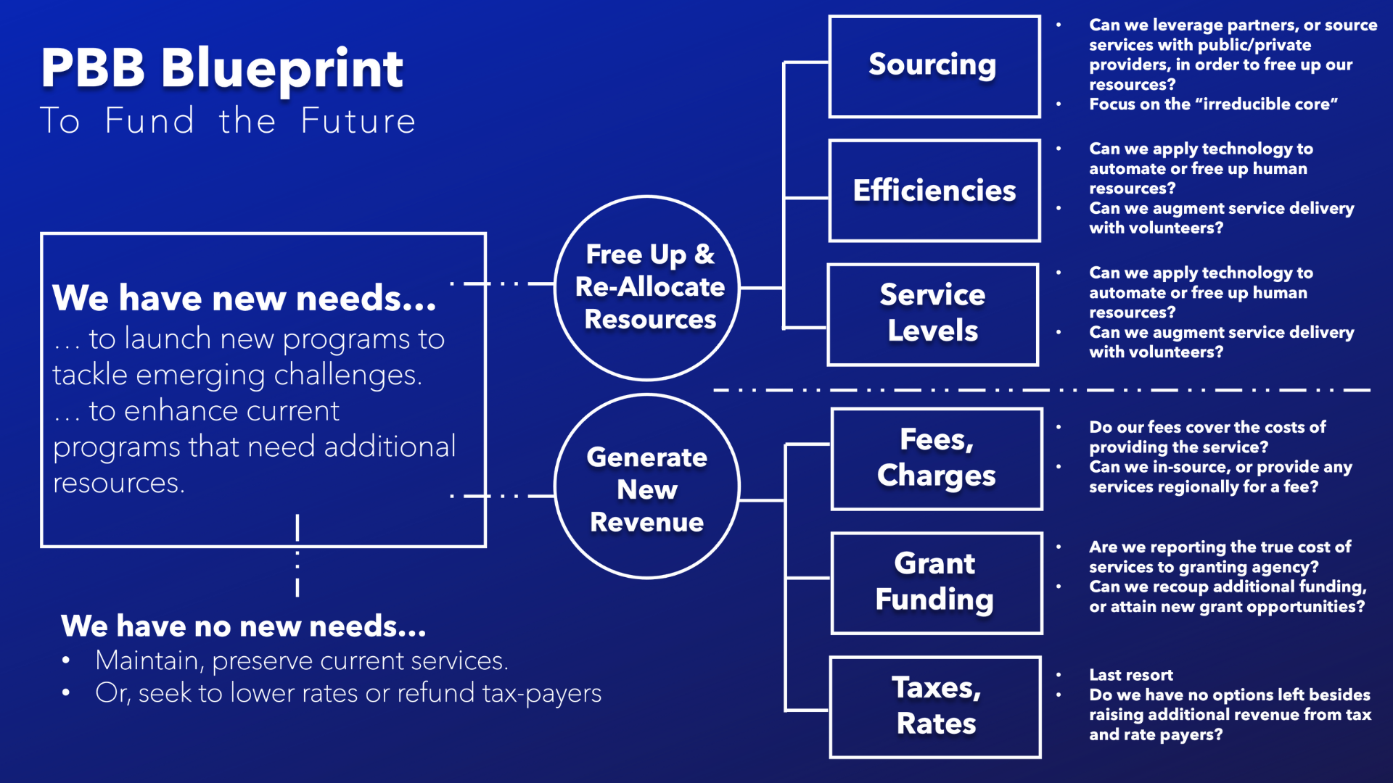
IT’S 3-5 YEARS DOWN THE ROAD
WHAT NEEDS TO GROW IN YOUR DEPARTMENT?
WHAT PROGAMS NEED TO UNDERGO SOME KIND
OF TRANSFORMATION?
WHAT NEW PROGRAMS CAN YOU IMAGINE YOU
WILL NEED TO LAUNCH?
Notes:
Duration: 2 minutes
Explain: From the PBB data, you can begin to imagine scenarios where services can be offered differently. The PBB BluePrint walks organizations through a repeatable framework through which each program can be reviewed for opportunities, or as we say, Every Program Has a Future. It is through the language of programs that departments can collaborate to find opportunities, personnel can demonstrate where they are spending time and where they want to/need to spend time, and how programs can better serve the priorities of the community.

Slide 3
ENTREPRENEURIAL OPPORTUNITY:
REVENUE
GROWTH
Notes:
Duration: 2 minutes
Say: We don’t want our first approach to be counting on tax growth for new funds for future needs, so where can one look for new revenue generation? Have you explored regional in-sourcing? What is something that you do really well that neighboring local governments, non-profits, or even private sector organizations could use?

Slide 4
OPPORTUNISTIC OPPORTUNITY:
FREE UP AND REPURPOSE
Notes:
Duration: 2 minutes
Say: In addition to new resources, we want to ensure that all existing resources are being maximized to their fullest extent. Where are there opportunities to free up and reallocate resources? Can you find an efficiency? Is there a trade-off?

Slide 5
Notes:
Duration: 2 minutes
Say: You can walk every program through this framework to determine a future. That future can be to maintain the status quo. That is an important data point!

Slide 6
Sourcing
Can we leverage partners, or source services with public/private providers, in order to free up our resources?
Focus on the “irreducible core”
PBB Blue Print
To Fund the Future
Efficiencies
Can we apply technology to automate or free up human resources?
Can we augment service delivery with volunteers?
Free-up &
Re-allocate Resources
Service Levels
For programs less aligned with Results, can we reduce service levels, and free up resources? Or, can we eliminate services to free resources?
We have new needs…
…to launch new programs to tackle emerging challenges
…to enhance current programs that need additional resources
Fees, Charges
Do our fees cover the costs of providing the service?
Can we in-source, or provide any services regionally for a fee?
Generate
New
Revenue
In-sourcing, Grant Funding
Are we reporting the true cost of services to granting agency?
Can we recoup additional funding, or attain new grant opportunities?
We have no new needs…
Preserve, maintain current services
Or, seek to lower tax rates or refund tax-payers
Taxes, Rates
Last resort
Do we have no options left besides raising additional revenue from tax and rate payers?

Slide 7
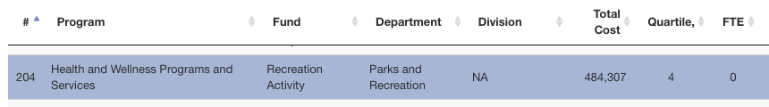
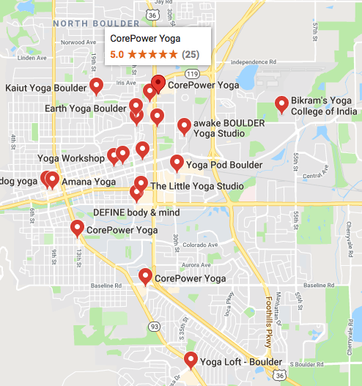
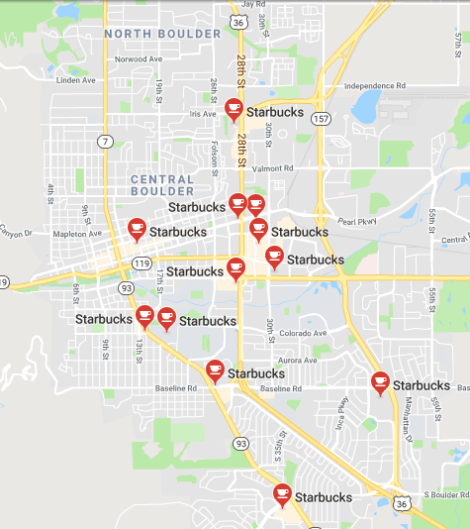

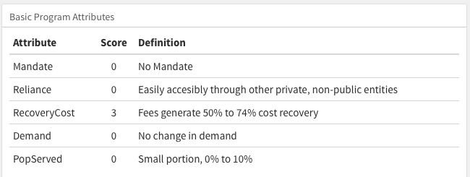
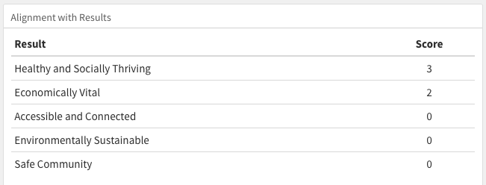
Fees, Charges, Cost Recovery
BOULDER
COLORADO
yoga
Notes:
Let’s talk more about programs

Slide 8
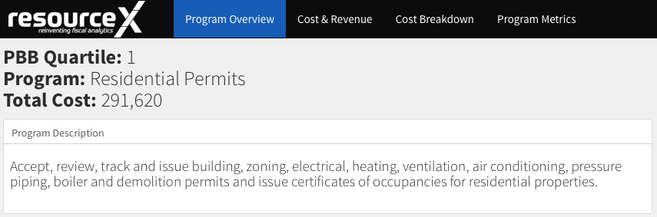
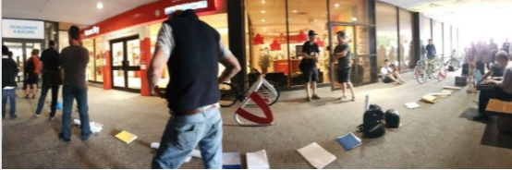
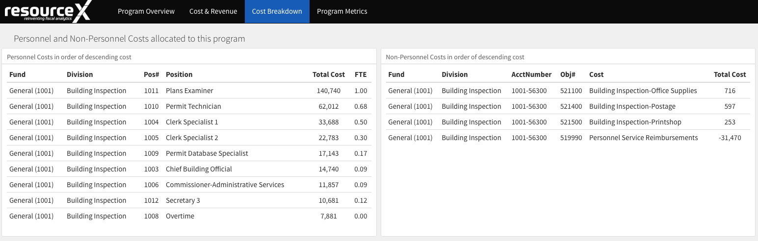
Fees, Charges, Cost Recovery
TOLEDO
OHIO
residential inspections
Notes:
Let’s talk more about programs

Slide 9
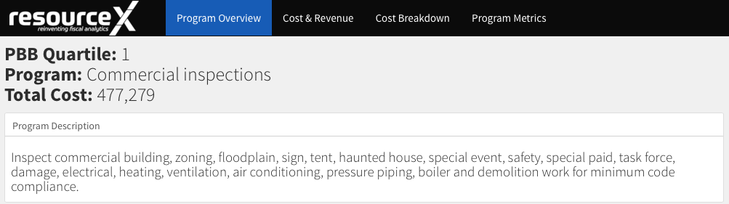
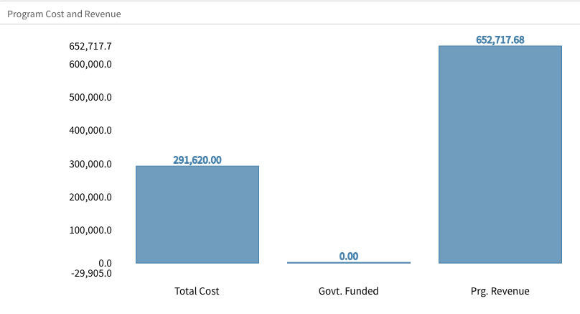
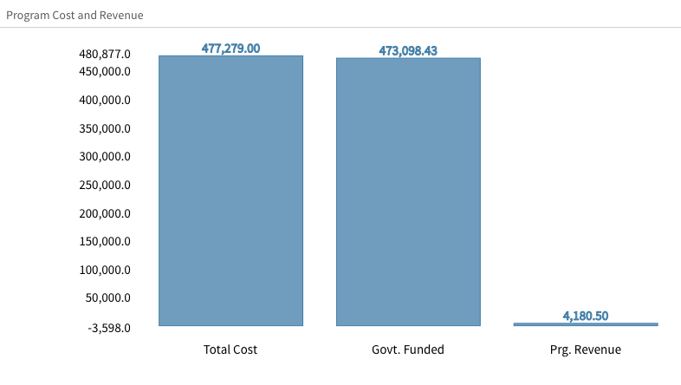
Fees, Charges, Cost Recovery
TOLEDO
OHIO
residential inspections,
commercial inspections
Notes:
Let’s talk more about programs

Slide 10
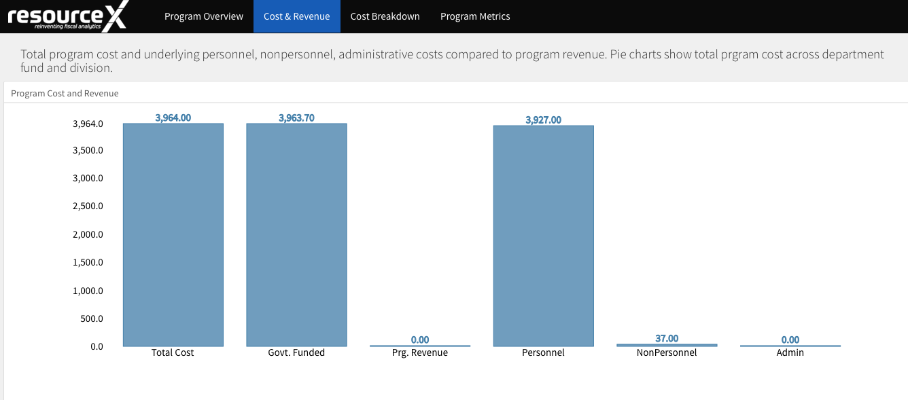
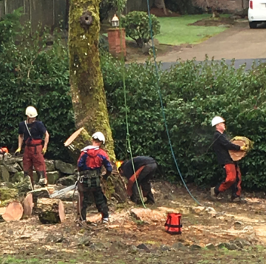
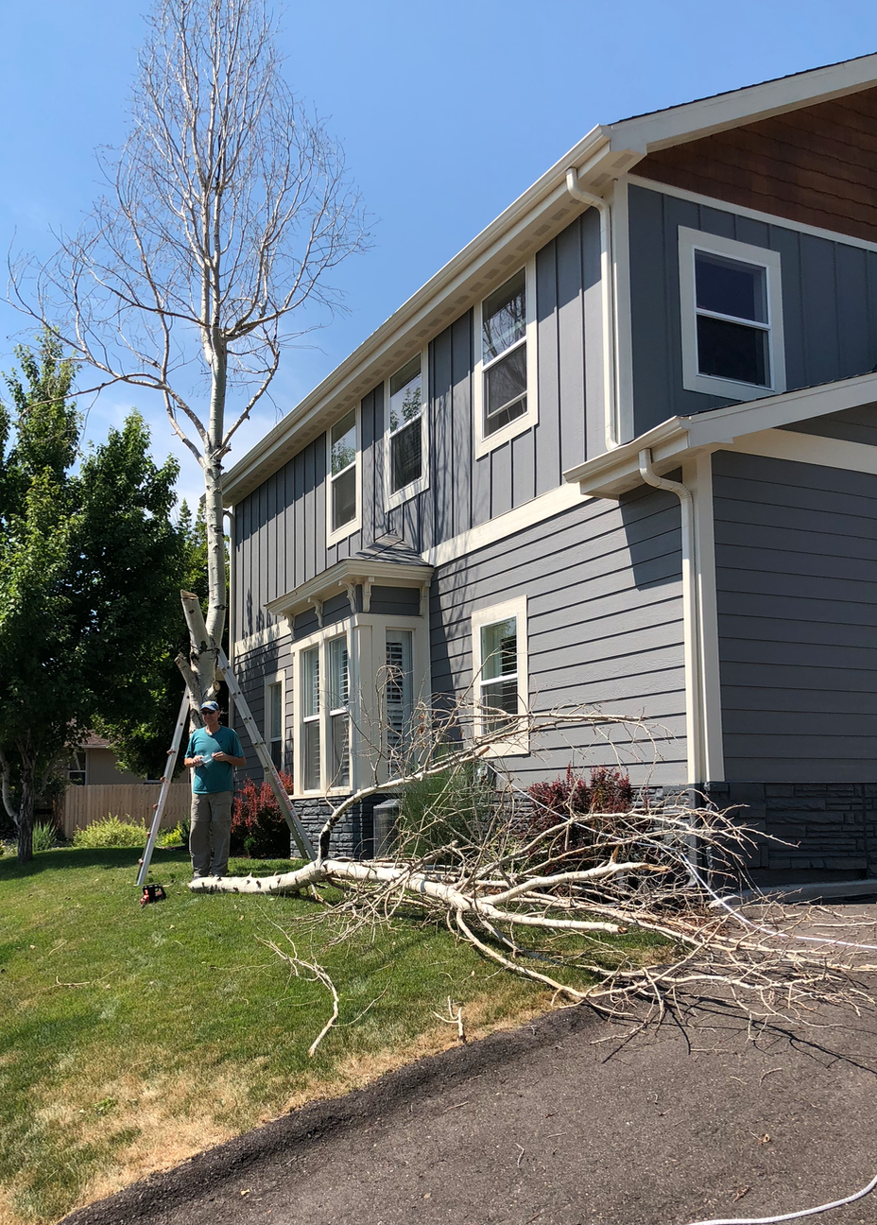
Fees, Charges, Cost Recovery
BRANSON
MISSOURI
residential tree removal
$3,927.00
$0.00
Notes:
Let’s talk more about programs

Slide 11
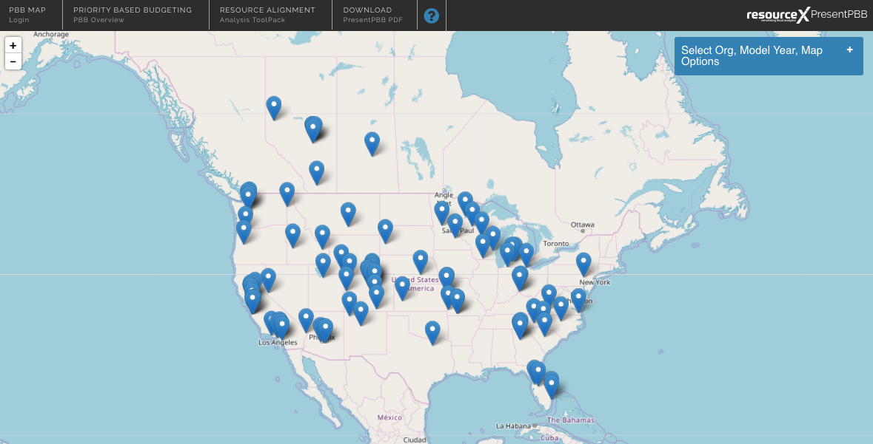
Punchline:
Are you looking for opportunities to charge for the full cost of doing business?
PBB Blue Print
Opportunity Area
Fees, Charges, Cost Recovery
Uncollected Fee Revenues Across 170 Organizations in the PBB Data Mine
$4.1 Billion
On Average:
16%
Untapped Revenue Opportunity, across all PBB Implementers
Total Revenues
(total taxes, fees, grants)
*narrowed down list, characterized by programs that already charge a fee, and where the fees collected are less than the cost of providing the program
Notes:
Let’s talk more about programs

Slide 12
How Do You Compare to #16%
Blue Print Opportunity Area #1: Fees, Charges
Average %, Untapped Revenue Across All PBB Implementers
Shawnee, KS
Goodyear, AZ
10 More Organizations...
$12.5 million
23% Gaston County, NC
24% Boise, ID
17% Douglas County, NV
9% Duluth, MN
10% Washington County, WI
10% Englewood, CO
19% Clear Creek County, CO
20% South Bend, IN
37% San Juan County, NM
11% Joplin, MO
$9.46 million
16%
Untapped Revenue Opportunity, as % of
Total Budget
9%
Untapped Revenue Opportunity, as % of
Total Budget
Total Revenues
(total taxes, fees, grants)
Total Revenues
(total taxes, fees, grants)
*narrowed down list, characterized by programs that already charge a fee, and where the fees collected are less than the cost of providing the program

Slide 13
Taking Action on Your PBB Data:
PBB Blue Print
Opportunity Area
Fees, Charges, Cost Recovery
Do our fees cover the costs of providing the service?
Bonus: included in “Policy Question 0”
Basic Program Attributes:
What characteristics of programs would make the best opportunities?
Other PBB Considerations:
What characteristics of programs would make the best opportunities?
Cost Recovery
Program Relevance
Low
High
Low
High
State statute limitations
No political will
Down economy
Others?
Degree of Mandate
Total Program Cost
Low
High
Low
High
Reliance from Users
Workload (FTE?)
Low
High
Low
High
Change in Demand
Political Sensitivity?
Low
High
Low
High
Notes:
Let’s talk more about programs

Slide 14
Sourcing
Can we leverage partners, or source services with public/private providers, in order to free up our resources?
Focus on the “irreducible core”
PBB Blue Print
To Fund the Future
Efficiencies
Can we apply technology to automate or free up human resources?
Can we augment service delivery with volunteers?
Free-up &
Re-allocate Resources
Service Levels
For programs less aligned with Results, can we reduce service levels, and free up resources? Or, can we eliminate services to free resources?
We have new needs…
…to launch new programs to tackle emerging challenges
…to enhance current programs that need additional resources
Fees, Charges
Do our fees cover the costs of providing the service?
Can we in-source, or provide any services regionally for a fee?
Generate
New
Revenue
In-sourcing, Grant Funding
Are we reporting the true cost of services to granting agency?
Can we recoup additional funding, or attain new grant opportunities?
We have no new needs…
Preserve, maintain current services
Or, seek to lower tax rates or refund tax-payers
Taxes, Rates
Last resort
Do we have no options left besides raising additional revenue from tax and rate payers?

Slide 15
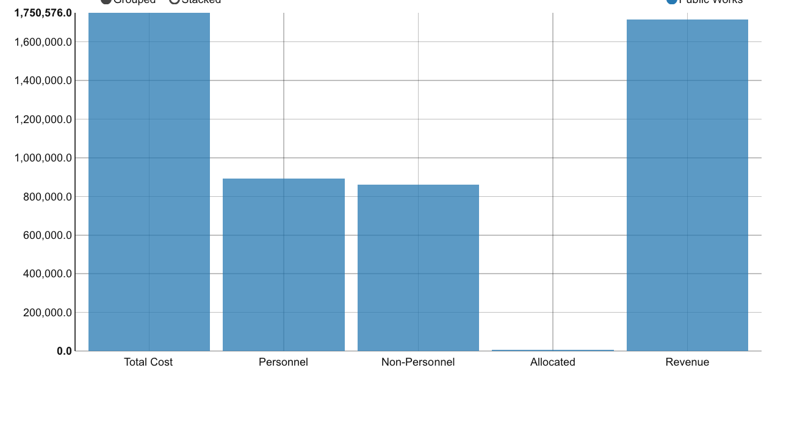
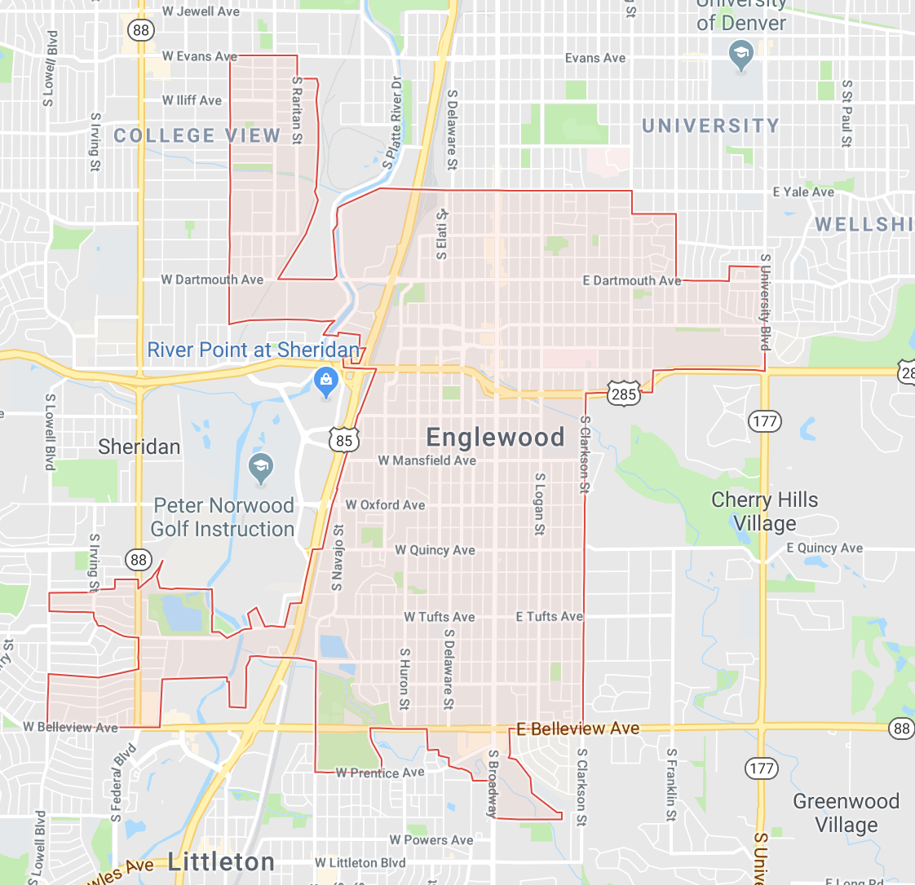
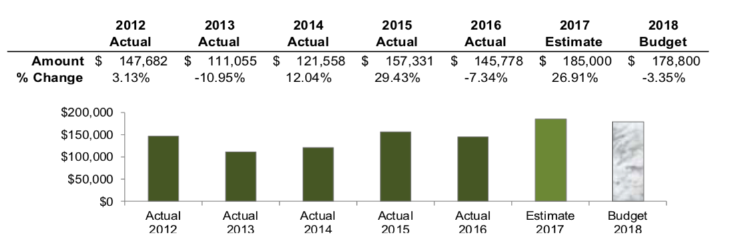
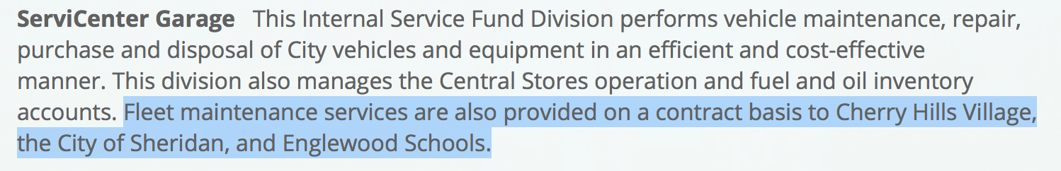
In-Sourcing
ENGLEWOOD
COLORADO
fleet services
Notes:
Let’s talk more about programs

Slide 16

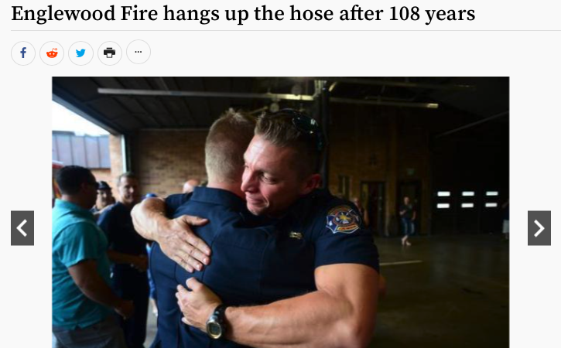
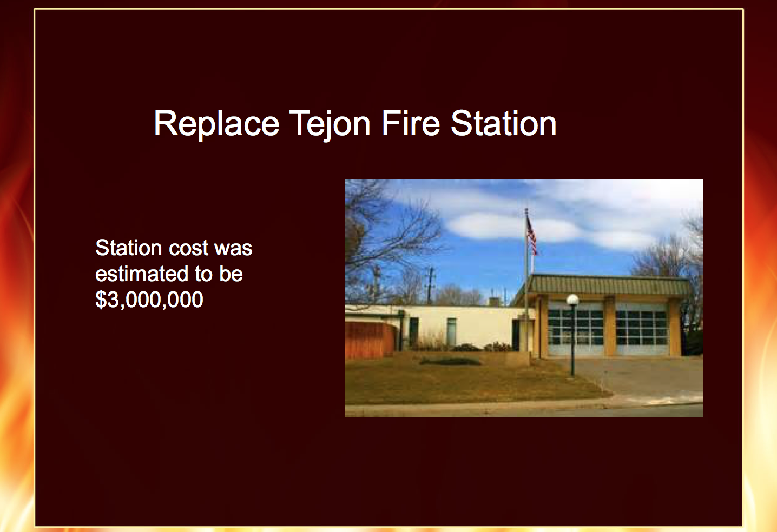
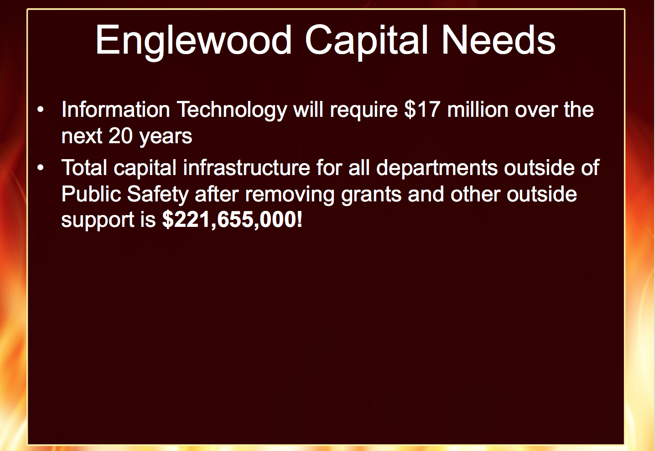
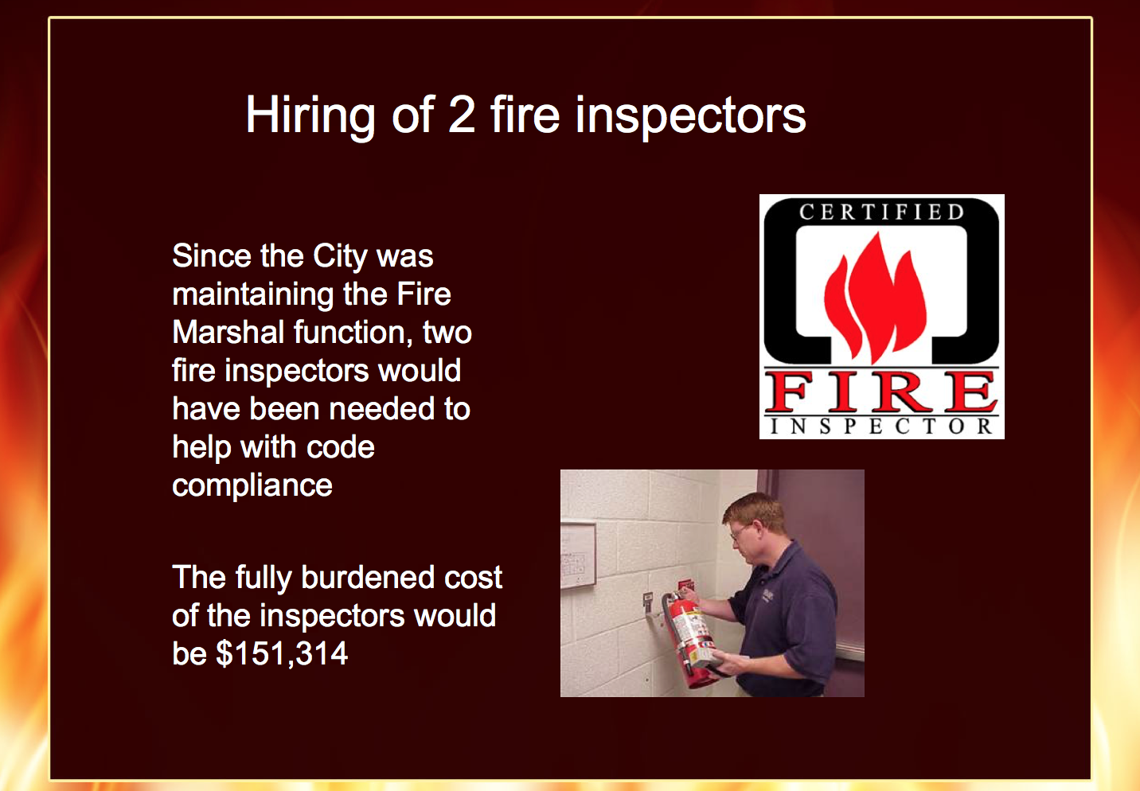
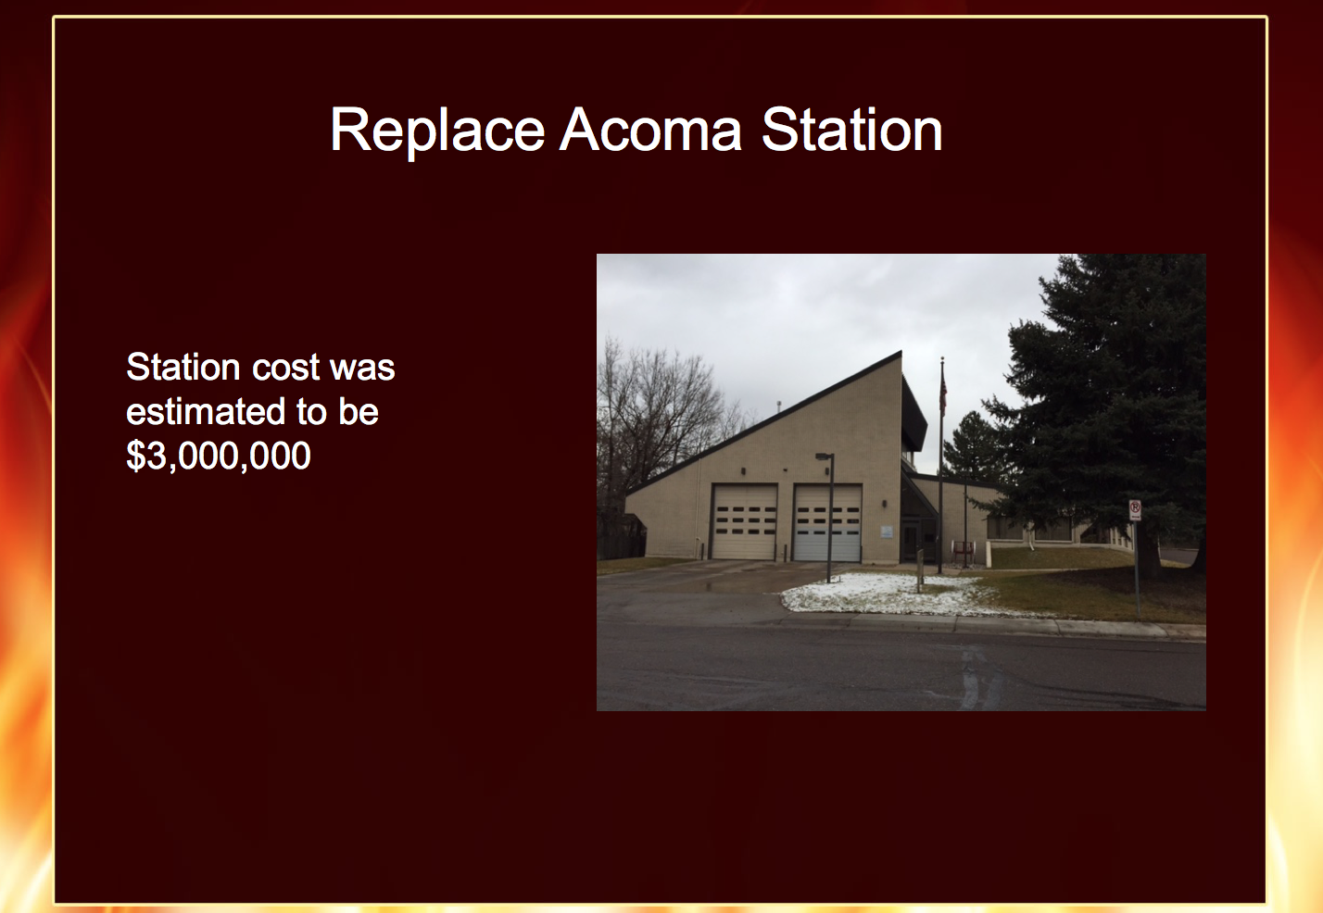
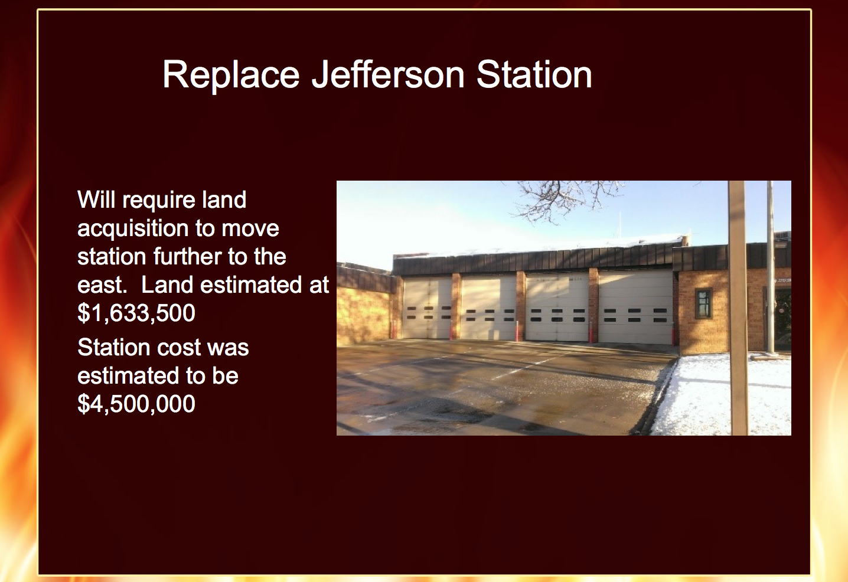
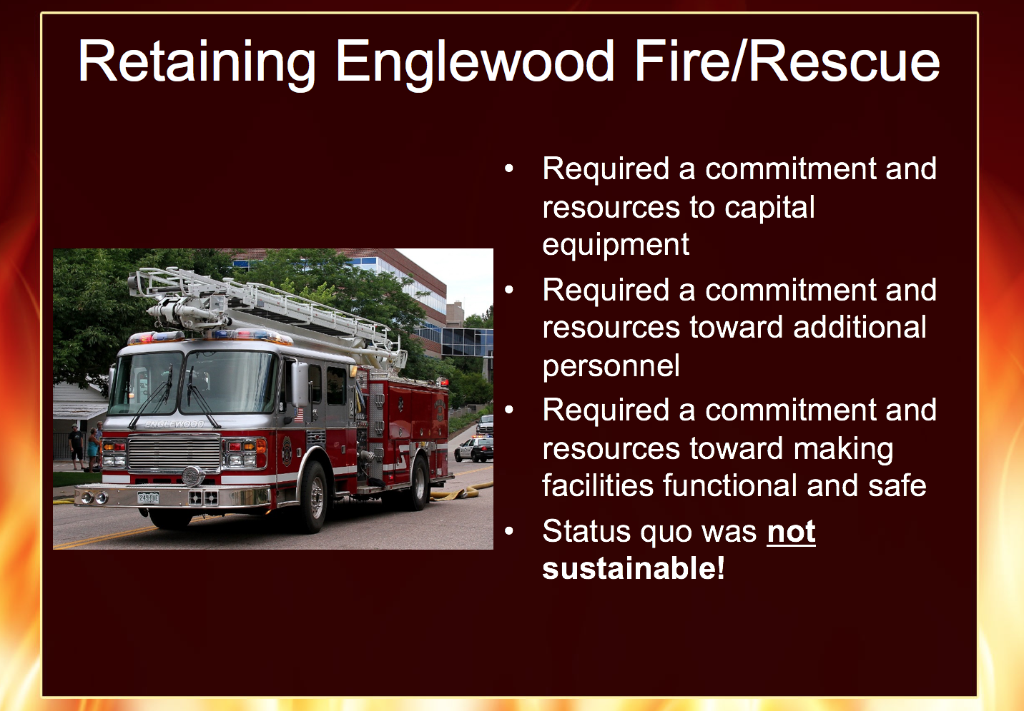
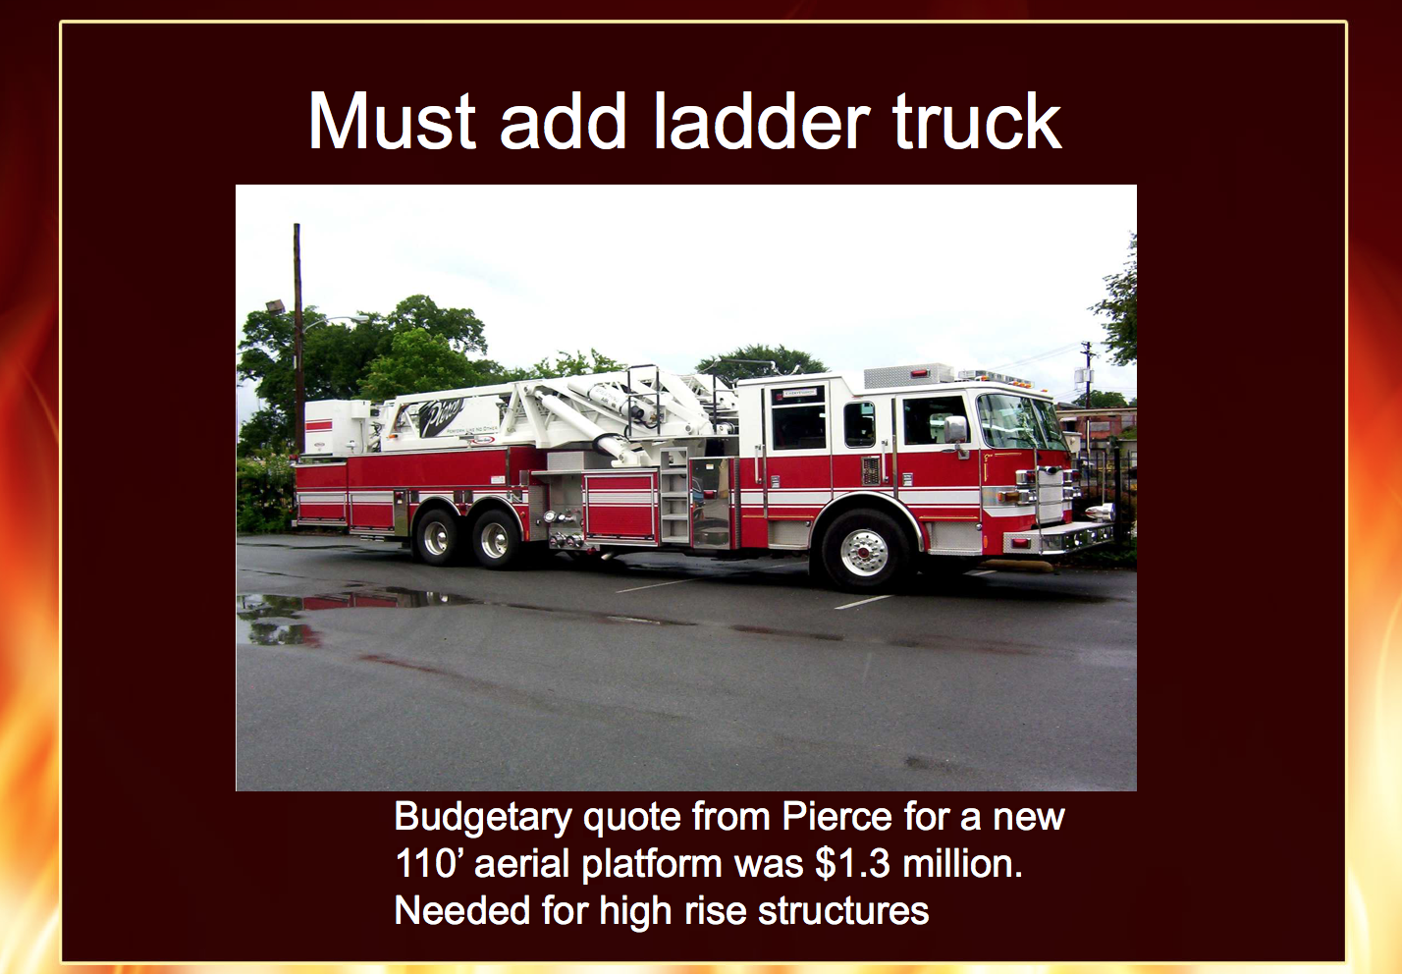
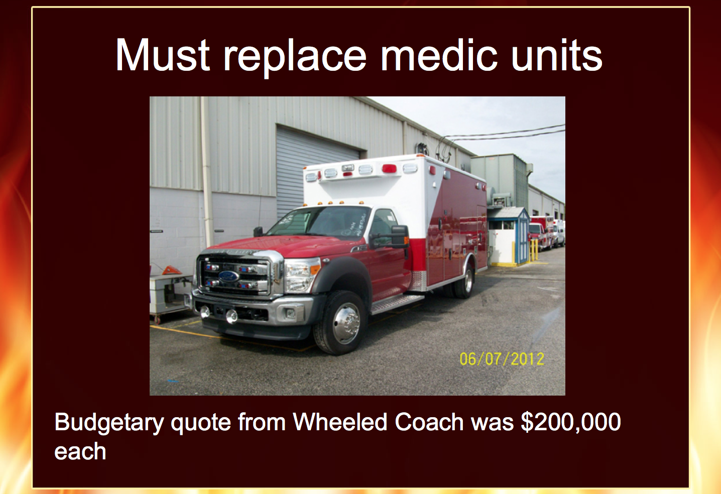
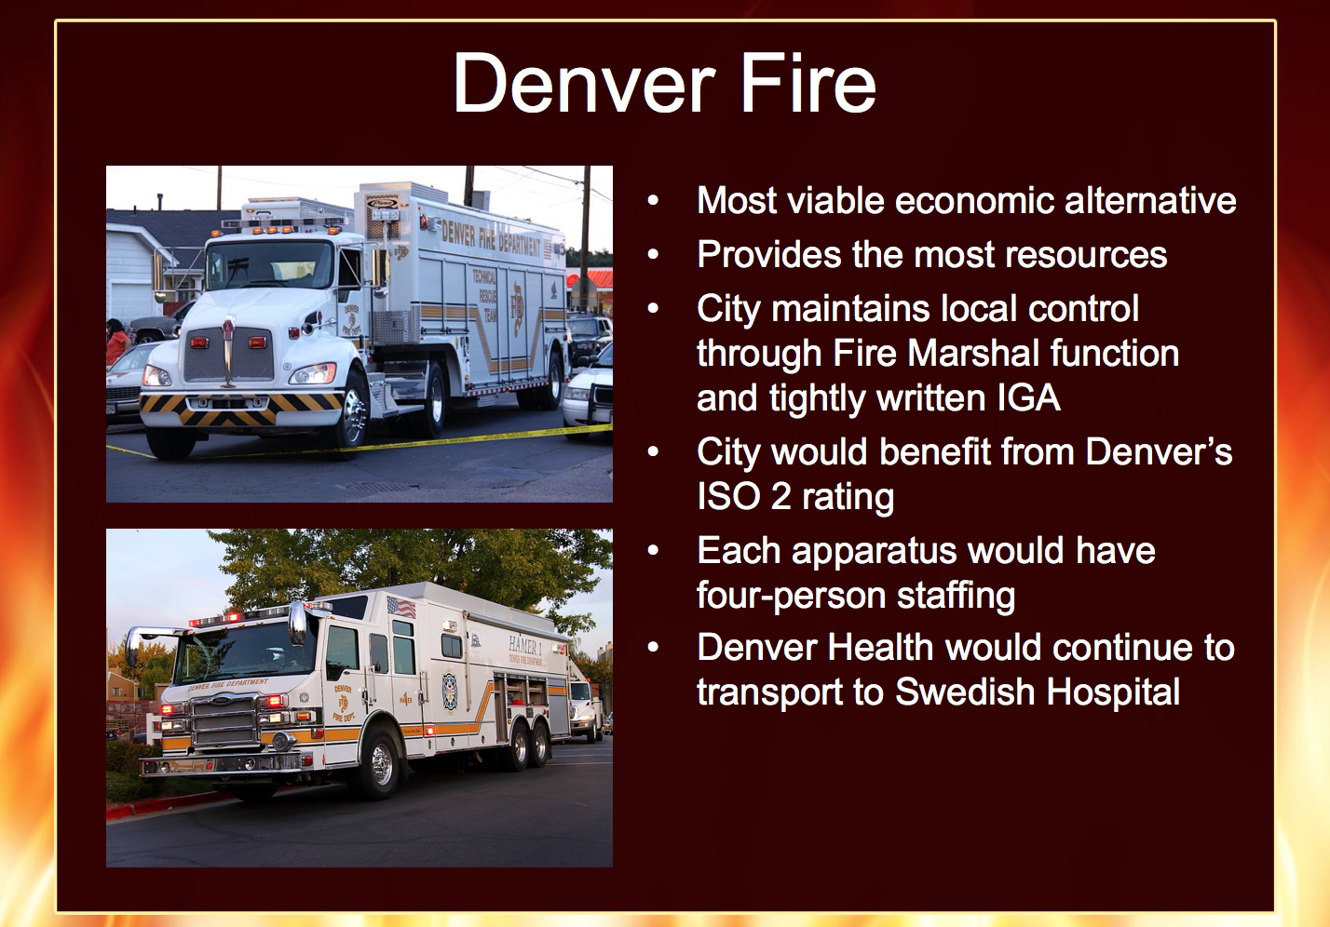
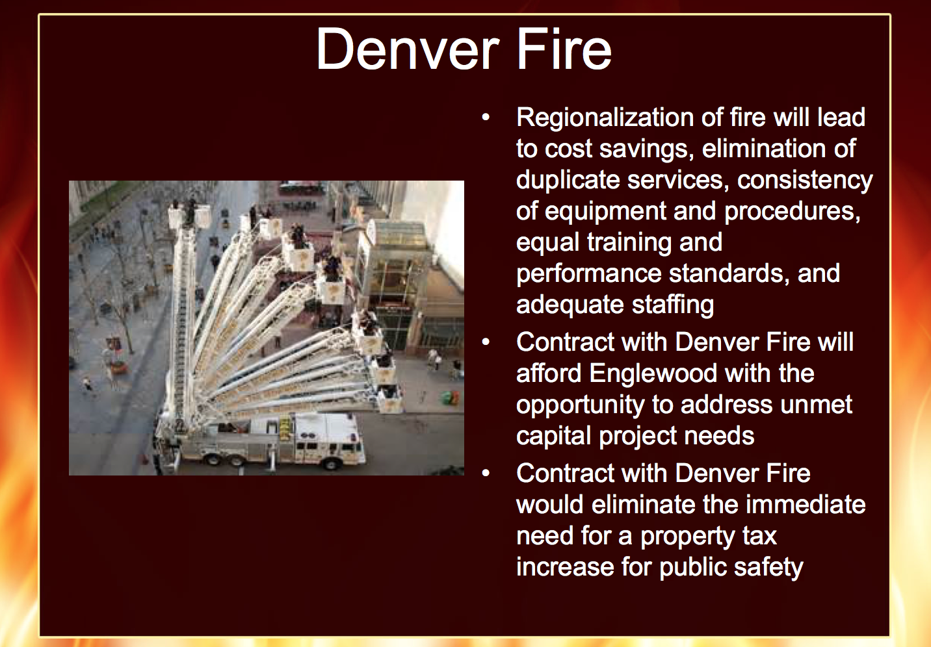
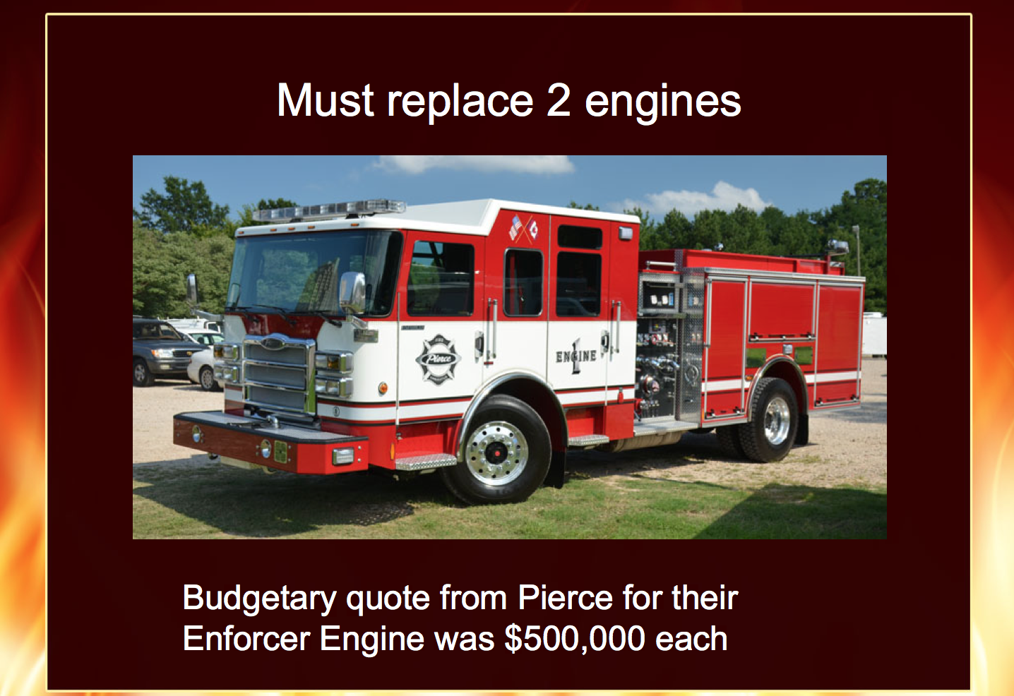
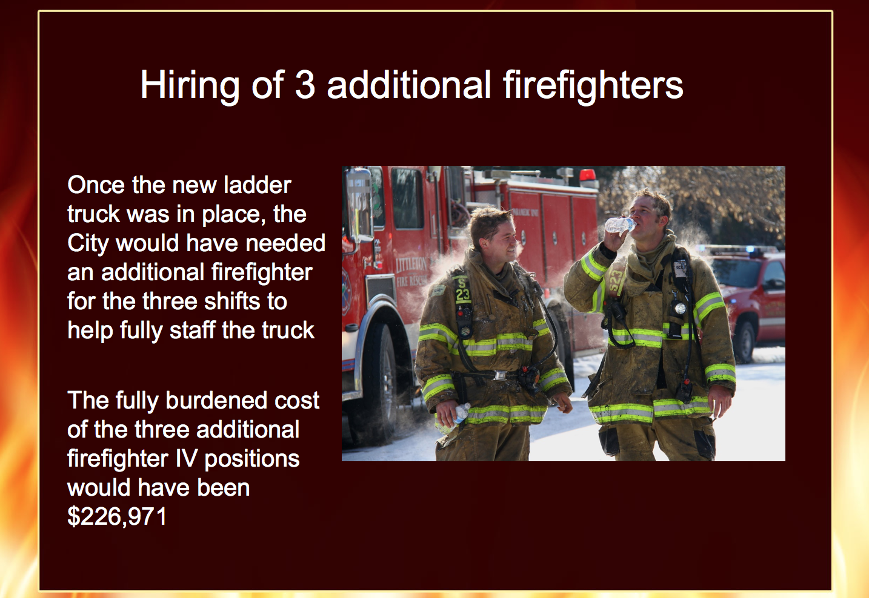
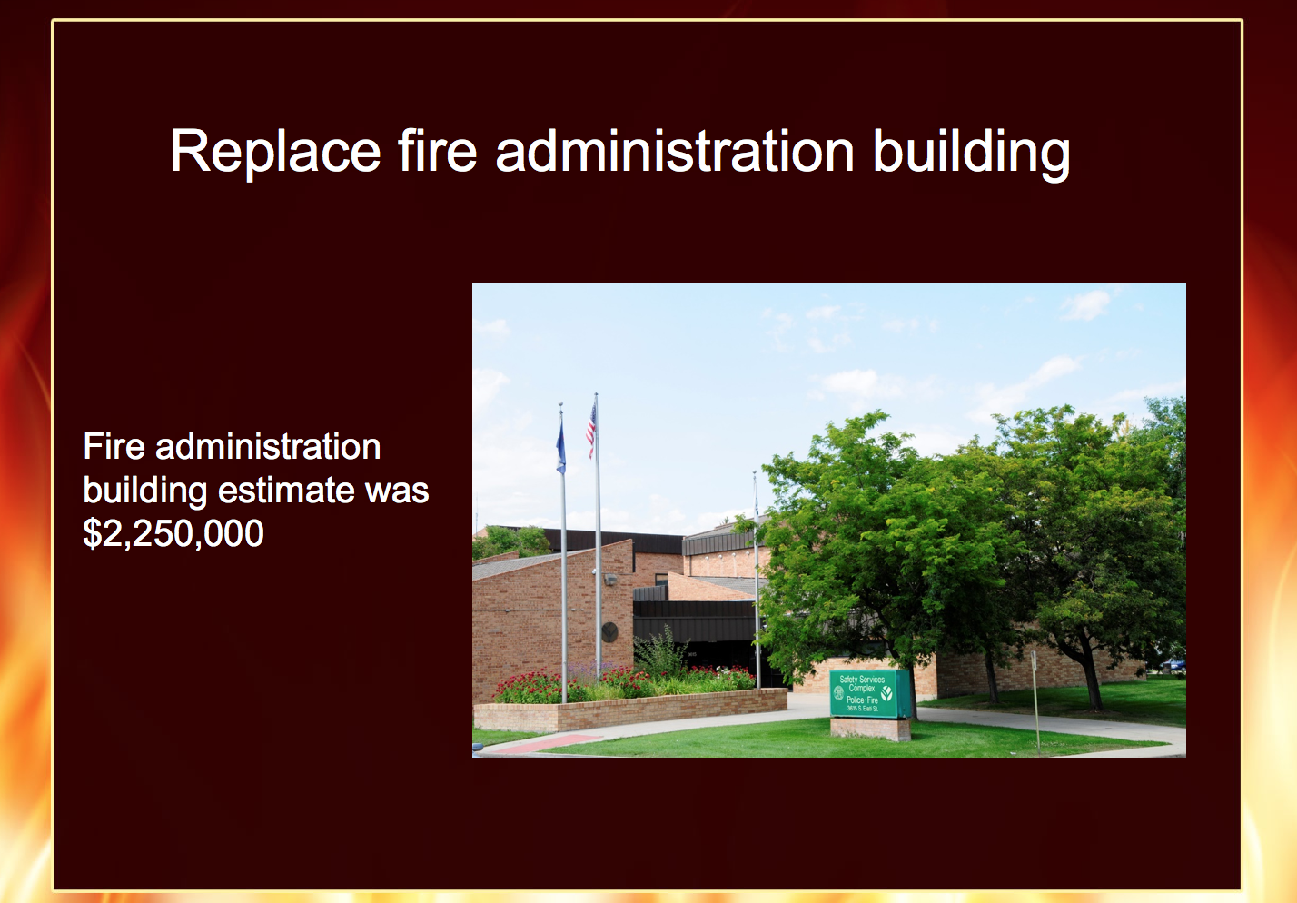
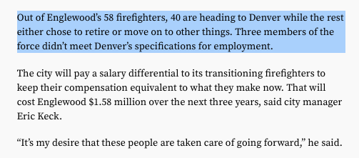
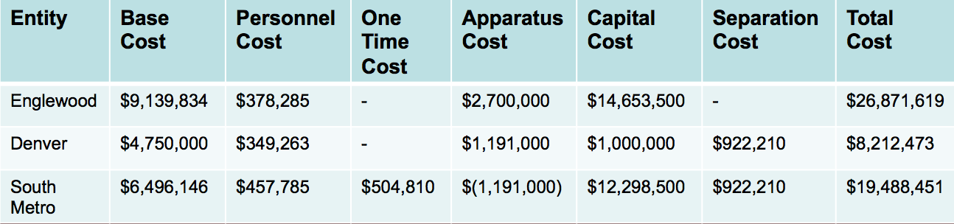
In-Sourcing
DENVER
COLORADO
fire services
Notes:
Let’s talk more about programs

Slide 17
PBB Blue Print
Opportunity Area
In-Sourcing Services, Grants
$7.4 Billion,
Other Public Sector
27%
Of your budget, on average
High Priority (Q1, Q2)
To Your Community
(and Offered by Others)...
41%
59%
$3.5 Billion,
Other Private Sector
14%
Of your budget, on average
Total Opportunity
High Priority, Offered by Public or Private
...the rest of
your budget
Punchline:
Are you looking for opportunities to be Englewood Fleet, to be Denver Fire?
Notes:
Let’s talk more about programs

Slide 18
Taking Action on Your PBB Data:
PBB Blue Print
Opportunity Area
In-Sourcing Services, Grants
Can we regionalize, in-source services and generate new revenue?
Are we reporting the true cost of services to granting agency?
Can we recoup additional funding, or attain new grant opportunities?
Basic Program Attributes:
What characteristics of programs would make the best opportunities?
Other PBB Considerations:
What characteristics of programs would make the best opportunities?
Cost Recovery
Program Relevance
Low
High
Low
High
What other factors might you take into consideration?
Degree of Mandate
Total Program Cost
Low
High
Low
High
Reliance from Users
Workload (FTE?)
Low
High
Low
High
Change in Demand
Political Sensitivity?
Low
High
Low
High
Notes:
Let’s talk more about programs

Slide 19
(Out)Sourcing
Can we leverage partners, or source services with public/private providers, in order to free up our resources?
Focus on the “irreducible core”
PBB Blue Print
To Fund the Future
Efficiencies
Can we apply technology to automate or free up human resources?
Can we augment service delivery with volunteers?
Free-up &
Re-allocate Resources
Service Levels
For programs less aligned with Results, can we reduce service levels, and free up resources? Or, can we eliminate services to free resources?
We have new needs…
…to launch new programs to tackle emerging challenges
…to enhance current programs that need additional resources
Fees, Charges
Do our fees cover the costs of providing the service?
Can we in-source, or provide any services regionally for a fee?
Generate
New
Revenue
In-sourcing, Grant Funding
Are we reporting the true cost of services to granting agency?
Can we recoup additional funding, or attain new grant opportunities?
We have no new needs…
Preserve, maintain current services
Or, seek to lower tax rates or refund tax-payers
Taxes, Rates
Last resort
Do we have no options left besides raising additional revenue from tax and rate payers?

Slide 20
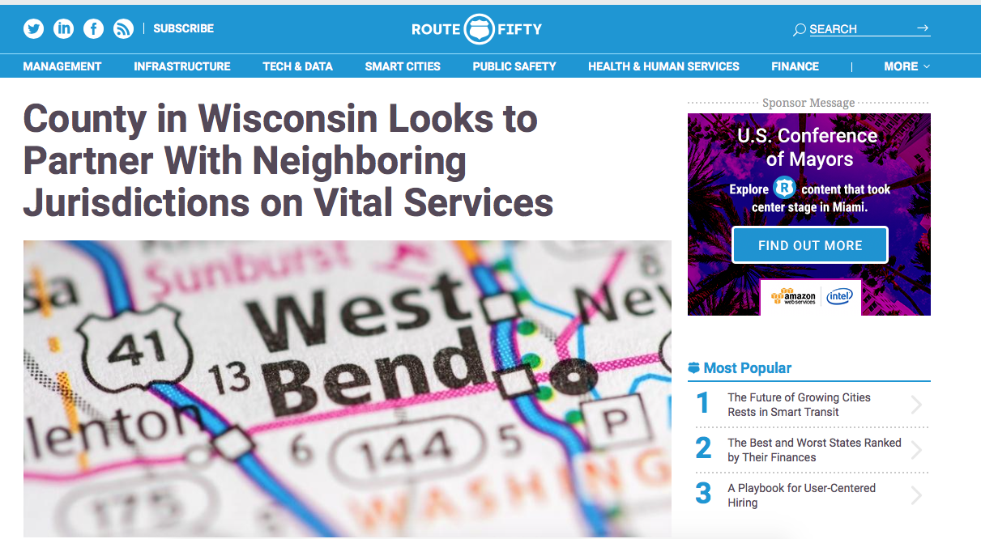
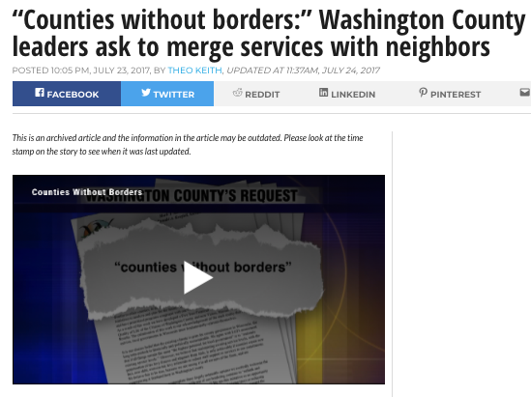
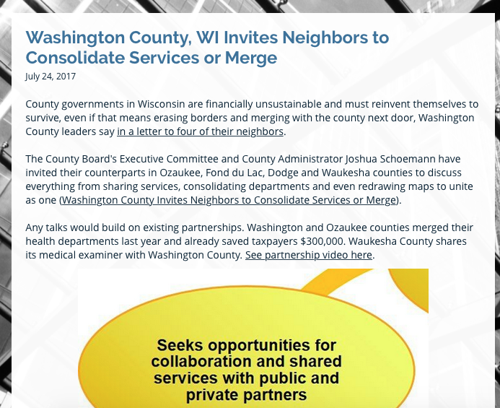
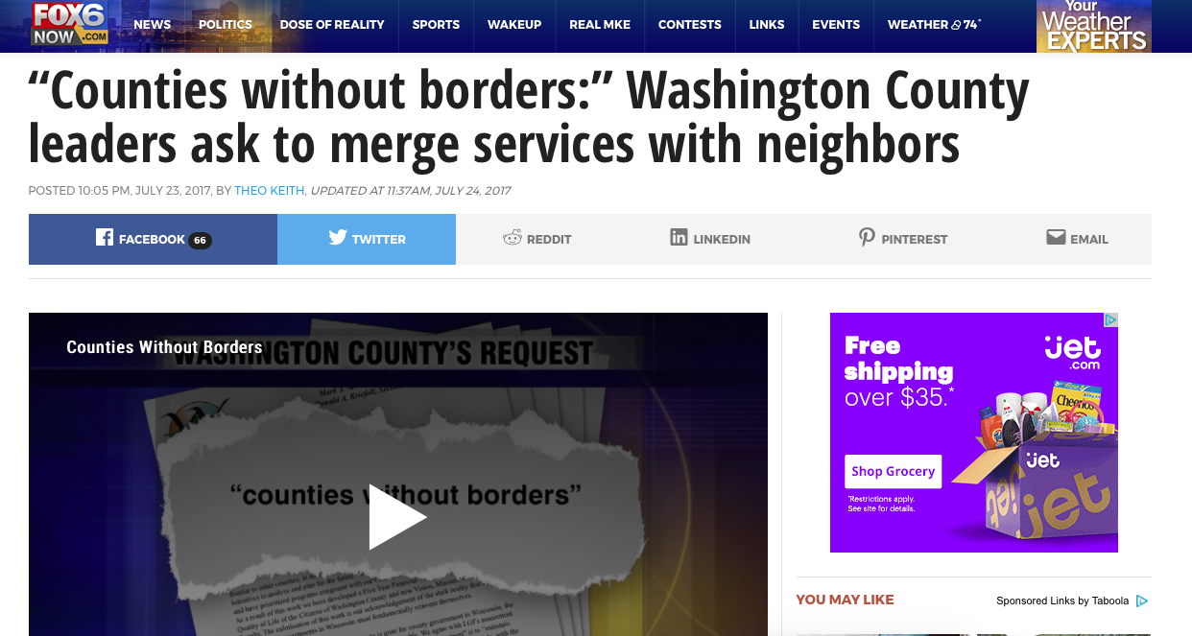
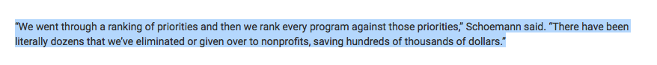
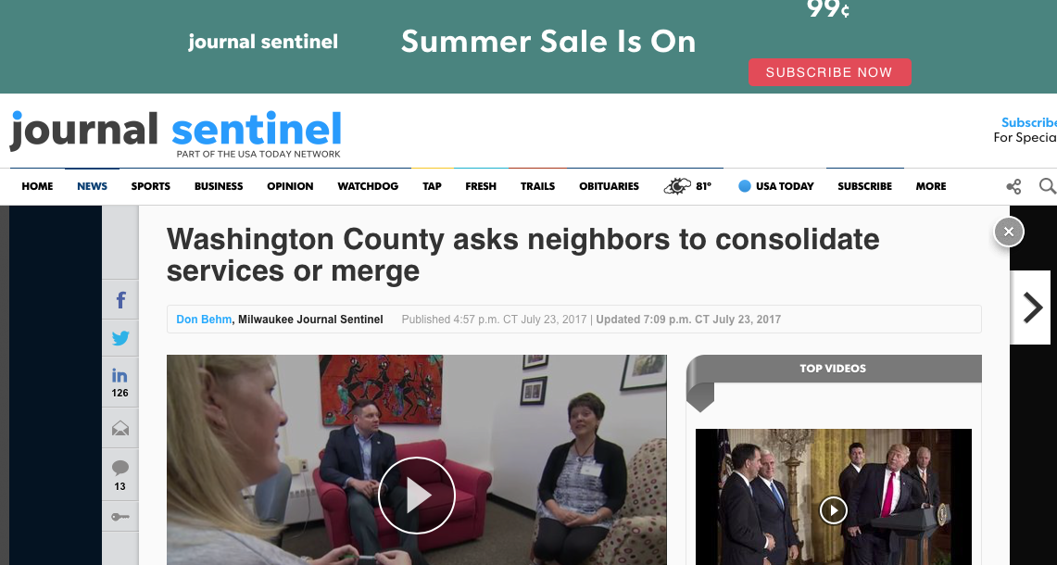


Merge, Off-load, Outsource
WASHINGTON COUNTY
WISCONSIN
“counties without borders”
Notes:
Let’s talk more about programs

Slide 21
Public / Private Partnership
Street Sweeping: Private sector wishes to help City provide a program that is highly influential (Q1, Q2) towards City’s Results, for which City isn’t uniquely qualified to provide the program
City-provided
Service
Public/Private Partnership
Out-source
Service
In-source
Service

Slide 22
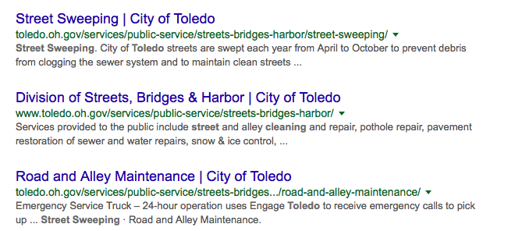
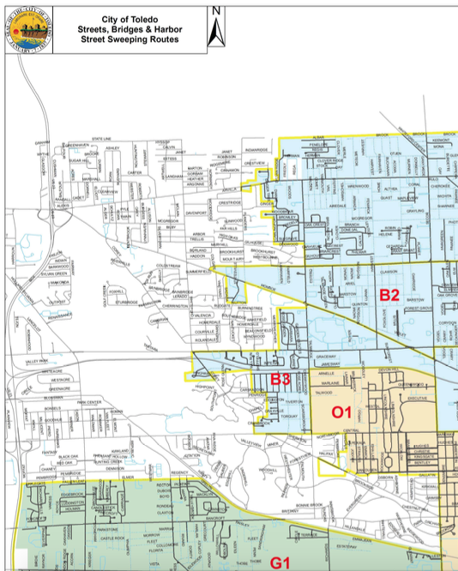
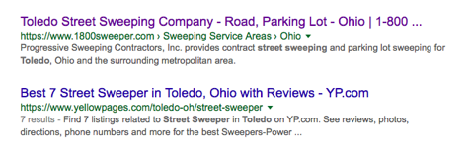
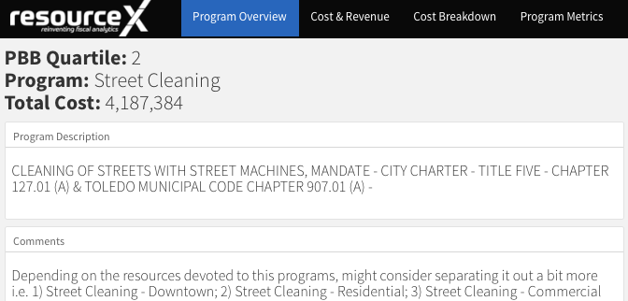
Street Sweeping
$4,187,384
TOLEDO
OHIO
street sweeping

Slide 23
(Out) Source to Private or Public Agency
Impound Lot Storage: outside agency wishes to propose providing entirely a service, and may charge the City, or customers of the service entirely
City-provided
Service
Public/Private Partnership
Out-source
Service
In-source
Service

Slide 24
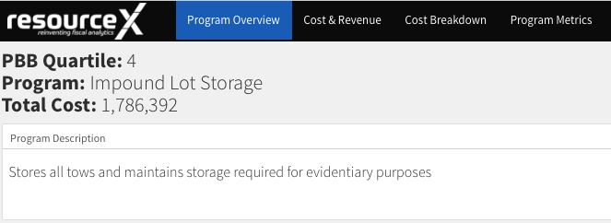
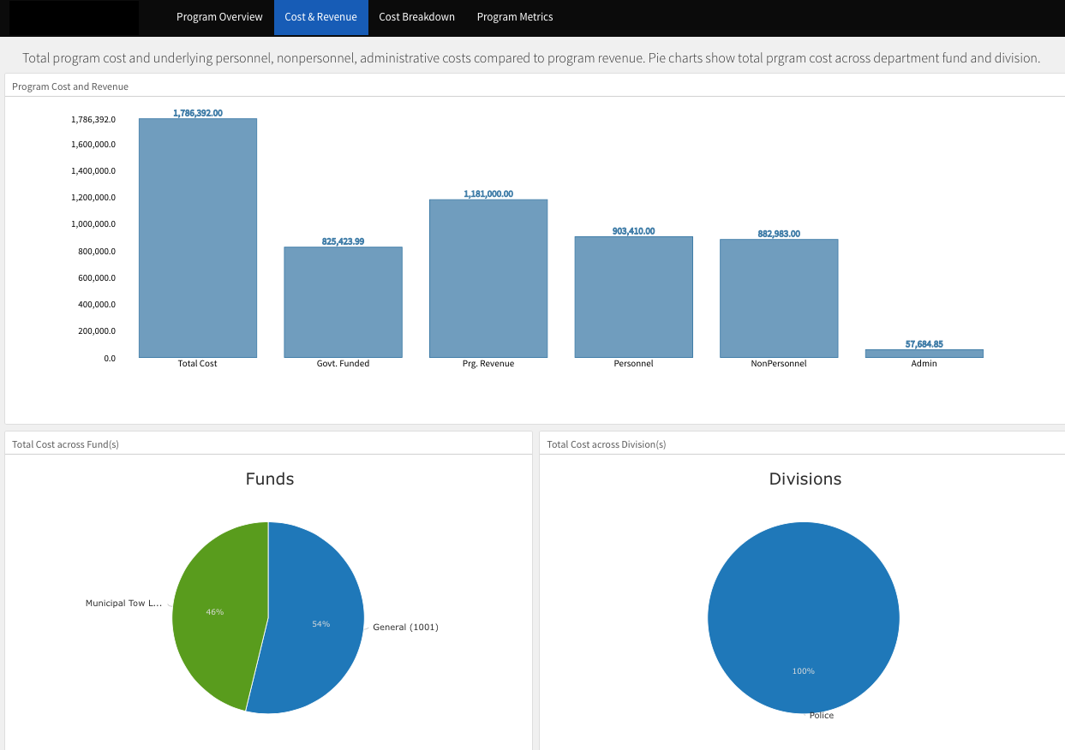
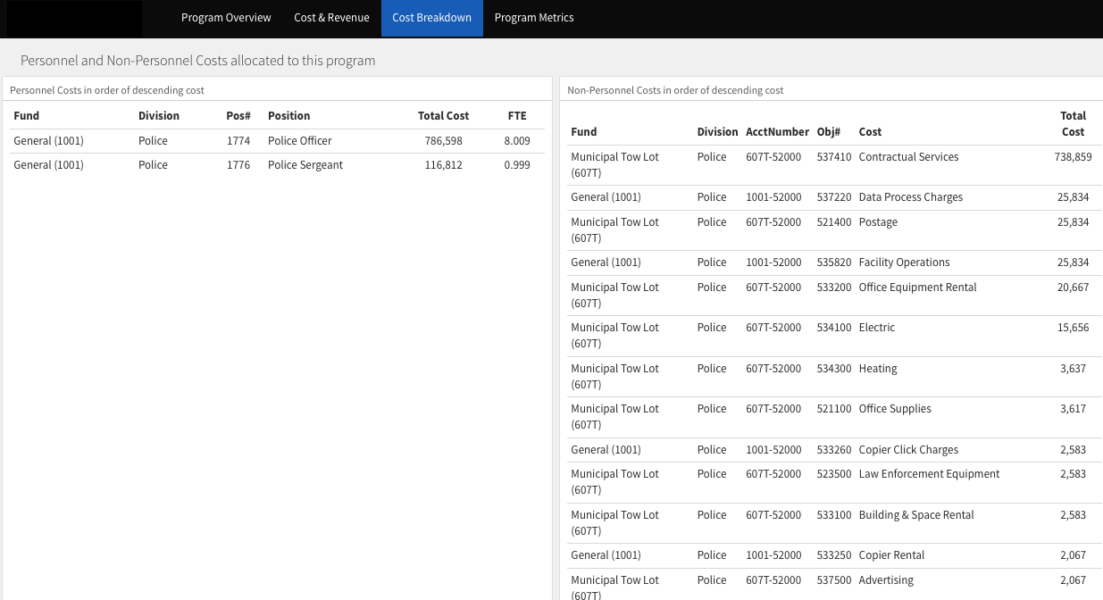
Impound Lot Storage
$1,786,392
TOLEDO
OHIO
impound lot storage
Notes:
Let’s talk more about programs

Slide 25
(Out) Source to Private or Public Agency
Leaf Pick-Up: outside agency wishes to propose providing entirely a service, and may charge the City, or customers of the service entirely
City-provided
Service
Public/Private Partnership
Out-source
Service
In-source
Service

Slide 26



Leaf Pick Up
$3,520,460
TOLEDO
OHIO
leaf pick up
Notes:
Let’s talk more about programs

Slide 27


Leveraging Partners
MOFFAT COUNTY
COLORADO
massive resource optimization
"How can we discover and partner with other organizations in our own community who are pursuing the same societal objectives we are?" Commissioner Ray Beck asked the participating agencies. The county is looking for opportunities not only to partner, but also to consolidate or merge services with other public and private entities.

Slide 28

Top 10: Moffat County, School District and Memorial Hospital
 | Moffat County | Moffat County, & Moffat County School District | Moffat County, & City of Craig | Moffat County & Memorial Hospital
Moffat County | 766 programs $30,846,582
Moffat County School District | 122 programs, $3,200,427
City of Craig | 510 programs, $13,210,997 | 97 programs, $2,482,014
Memorial Regional Hospital | 134 programs, $6,440,138 | 53 programs, $1,049,749 | 105 programs, $2,081,193

Slide 29


Laundry Services
MOFFAT COUNTY
COLORADO
laundry services
$45,144 to Moffat County
6-figures ($100k’s) to Memorial Hospital, who ships to Grand Junction

Slide 30
Moffat County Perspective of Opportunity Areas
59%
County is uniquely qualified to provide

Slide 31

Match Up: Step 1

Slide 32
Clear Creek County Perspective of Opportunity Areas
78.9%
Identified for partnership, merger, in-/out-source discussion
County is uniquely qualified to provide

Slide 33
PBB Blue Print
Opportunity Area
Out-Sourcing Services, Leveraging Partners
$9.2 Billion,
Other Public Sector
37%
Of your budget, on average
Government is
“uniquely qualified”
to provide (no apparent program partners)
40%
60%
$7.4 Billion,
Other Private Sector
23%
Of your budget, on average
Total Opportunity
Offered by Public or Private
“Offered by Others”
Leverage Partners
Punchline:
As Government seeks to fund the plethora of “new” programs uniquely unto government to provide, it leverages partner providers, seeking the “irreducible core”
Notes:
Let’s talk more about programs

Slide 34
Taking Action on Your PBB Data:
PBB Blue Print
Opportunity Area
Out-Sourcing Services, Leveraging Partners
Basic Program Attributes:
What characteristics of programs would make the best opportunities?
Other PBB Considerations:
What characteristics of programs would make the best opportunities?
Cost Recovery
Program Relevance
Low
High
Low
High
What other factors might you take into consideration?
Degree of Mandate
Total Program Cost
Low
High
Low
High
Reliance from Users
Workload (FTE?)
Low
High
Low
High
Change in Demand
Political Sensitivity?
Low
High
Low
High
Notes:
Let’s talk more about programs

Slide 35
(Out)Sourcing
Can we leverage partners, or source services with public/private providers, in order to free up our resources?
Focus on the “irreducible core”
PBB Blue Print
To Fund the Future
Efficiencies
Can we apply technology to automate or free up human resources?
Can we augment service delivery with volunteers?
Free-up &
Re-allocate Resources
Service Levels
For programs less aligned with Results, can we reduce service levels, and free up resources? Or, can we eliminate services to free resources?
We have new needs…
…to launch new programs to tackle emerging challenges
…to enhance current programs that need additional resources
Fees, Charges
Do our fees cover the costs of providing the service?
Can we in-source, or provide any services regionally for a fee?
Generate
New
Revenue
In-sourcing, Grant Funding
Are we reporting the true cost of services to granting agency?
Can we recoup additional funding, or attain new grant opportunities?
We have no new needs…
Preserve, maintain current services
Or, seek to lower tax rates or refund tax-payers
Taxes, Rates
Last resort
Do we have no options left besides raising additional revenue from tax and rate payers?

Slide 36


Program Efficiency
”Knocker-Ups”
“Lamp Lighters”
What Will Be 2030’s
“Knocker-Ups?”
Intergalactic Space Port
Ygnacio Valley Road Cone Program
Parking
Traffic Patrol
Parking Meter Reading
Water Meter Reading (Utilities)
Priority Based Budgeting Implementers

Slide 37

Program Benchmarking
Program Costs, Fees for Service, Level of Mandate, FTE, etc
  how much are other jurisdictions paying for each service?
  do they charge a fee?
  do they use automation, or labor?
  is it mandated, or regulated?
  filter by population, geography, budget size, city/county, etc

Slide 38

Program Benchmarking
Consider two classic studies:
  1.) “Leak Detection” - cities spend tons finding and repairing leaks in water mains, pipes and taps. Cities pay so much to treat drinking water, they can’t afford the water losses associated with old, failing infrastructure.
  2.) “Meter Reading” - one of the great debates is “to automate” versus using “real labor” - technology is bringing the costs down to a level where automation is definitely the key, but it requires one-time installment of new technology for the meters - is it worth it?

Slide 39



Benchmarking: “Meter Reading” (automated or manual)
Notes:
Let’s talk more about programs

Slide 40



Benchmarking: “Leak Detection and Repair”
Notes:
Let’s talk more about programs

Slide 41
Taking Action on Your PBB Data:
PBB Blue Print
Opportunity Area
Program Efficiency
Basic Program Attributes:
What characteristics of programs would make the best opportunities?
Other PBB Considerations:
What characteristics of programs would make the best opportunities?
Cost Recovery
Program Relevance
Low
High
Low
High
What other factors might you take into consideration?
Degree of Mandate
Total Program Cost
Low
High
Low
High
Reliance from Users
Workload (FTE?)
Low
High
Low
High
Change in Demand
Political Sensitivity?
Low
High
Low
High
Notes:
Let’s talk more about programs

Slide 42
(Out)Sourcing
Can we leverage partners, or source services with public/private providers, in order to free up our resources?
Focus on the “irreducible core”
PBB Blue Print
To Fund the Future
Efficiencies
Can we apply technology to automate or free up human resources?
Can we augment service delivery with volunteers?
Free-up &
Re-allocate Resources
Service Levels
For programs less aligned with Results, can we reduce service levels, and free up resources? Or, can we eliminate services to free resources?
We have new needs…
…to launch new programs to tackle emerging challenges
…to enhance current programs that need additional resources
Fees, Charges
Do our fees cover the costs of providing the service?
Can we in-source, or provide any services regionally for a fee?
Generate
New
Revenue
In-sourcing, Grant Funding
Are we reporting the true cost of services to granting agency?
Can we recoup additional funding, or attain new grant opportunities?
We have no new needs…
Preserve, maintain current services
Or, seek to lower tax rates or refund tax-payers
Taxes, Rates
Last resort
Do we have no options left besides raising additional revenue from tax and rate payers?

Slide 43

Chris Fabian, Jefferson County CO, circa 2006
Quartile 1:
1.) Brought to the County to create PBB (as an evolution of BFO)
2.) Risk Management Director
Quartile 4:
Employee “Safety Committee” for Risk Management
Quartile 2:
Creation of ISF’s for IT, Fleet and Facilities
Pollution: a “valuable resource” out of place (in the wrong place)
Notes:
Slideshows: 1, 3, 6

Slide 44

Workload Analysis
Percent of Time Allocated to the Programs they Serve
Programs they Serve (from greatest devotion of time to least)
Notes:
Slideshows: 1, 3, 6

Slide 45

Workforce Analysis: Mining Resources
Notes:
Slideshows: 1, 3, 6

Slide 46

Workforce Analysis: Mining Resources
Notes:
Slideshows: 1, 3, 6

Slide 47

(Human) Resource Re-allocation
Pollution: a “valuable resource” out of place (in the wrong place)
Notes:
Slideshows: 1, 3, 6

Slide 48

Goals:
1.) over the next month, let’s ensure that you’re spending ”No more” than 10% of your total time on these Q3 and Q4 programs.
2.) Over the next 2 months we’ll reassign your time away from Q4 and Q3 programs, and assign you to several new programs where we need the support.
OPPORTUNITY: FREE UP 65% of your time
Notes:
Slideshows: 1, 3, 6

Slide 49

Plan to Fill the High-Priority Programs (not necessarily the position)
Notes:
Slideshows: 1, 3, 6

Slide 50

Notes:
Slideshows: 1, 3, 6

Slide 51
Notes:
Slideshows: 1, 3, 6

Slide 52

Notes:
Slideshows: 1, 3, 6

Slide 53
Applying PBB to Workforce Analysis
Succession Planning and Vacancies
We don’t have to replace the person, just replace the ”high priority” (Q1 and Q2) time left vacant
Take advantage of natural attrition
Talent Management
Identify talented staff who are currently serving “lesser aligned” programs (Q3 and Q4), and reassign their time
    Fill vacancies left open in high priority programs
Notes:
Slideshows: 1, 3, 6

Slide 54
Taking Action on Your PBB Data:
PBB Blue Print
Opportunity Area
Service Levels
Basic Program Attributes:
What characteristics of programs would make the best opportunities?
Other PBB Considerations:
What characteristics of programs would make the best opportunities?
Cost Recovery
Program Relevance
Low
High
Low
High
What other factors might you take into consideration?
Degree of Mandate
Total Program Cost
Low
High
Low
High
Reliance from Users
Workload (FTE?)
Low
High
Low
High
Change in Demand
Political Sensitivity?
Low
High
Low
High
Notes:
Let’s talk more about programs

Slide 55
Sourcing
Can we leverage partners, or source services with public/private providers, in order to free up our resources?
Focus on the “irreducible core”
PBB Blue Print
To Fund the Future
Efficiencies
Can we apply technology to automate or free up human resources?
Can we augment service delivery with volunteers?
Free-up &
Re-allocate Resources
Service Levels
For programs less aligned with Results, can we reduce service levels, and free up resources? Or, can we eliminate services to free resources?
We have new needs…
…to launch new programs to tackle emerging challenges
…to enhance current programs that need additional resources
Fees, Charges
Do our fees cover the costs of providing the service?
Can we in-source, or provide any services regionally for a fee?
Generate
New
Revenue
In-sourcing Grant Funding
Are we reporting the true cost of services to granting agency?
Can we recoup additional funding, or attain new grant opportunities?
We have no new needs…
Preserve, maintain current services
Or, seek to lower tax rates or refund tax-payers
Taxes, Rates
Last resort
Do we have no options left besides raising additional revenue from tax and rate payers?

Slide 56

Approaches to
Drive More Action

Slide 57
Start with Needs
(or, “Get Real” about the gap you’re facing)

Slide 58
21st Century Government
  Data Driven
  Outcome Focused
  User-Centric (“Government for All”)
Rick Cole
Chris Fabian
March 27th 2018
Chris Fabian
March 27th 2018
Chris Fabian
March 27th 2018

Slide 59
Start here...
1.) What are the programs we need to be doing more of?
2.) What are the programs we need to launch (if only we had the money, or workforce to start)?
Sourcing
Can we leverage partners, or source services with public/private providers, in order to free up our resources?
Focus on the “irreducible core”
PBB Blue Print
To Fund the Future
Efficiencies
Can we apply technology to automate or free up human resources?
Can we augment service delivery with volunteers?
Free-up &
Re-allocate Resources
Service Levels
For programs less aligned with Results, can we reduce service levels, and free up resources? Or, can we eliminate services to free resources?
We have new needs…
…to launch new programs to tackle emerging challenges
…to enhance current programs that need additional resources
Fees, Charges
Do our fees cover the costs of providing the service?
Can we in-source, or provide any services regionally for a fee?
Generate
New
Revenue
Grant Funding
Are we reporting the true cost of services to granting agency?
Can we recoup additional funding, or attain new grant opportunities?
We have no new needs…
Preserve, maintain current services
Or, seek to lower tax rates or refund tax-payers
Taxes, Rates
Last resort
Do we have no options left besides raising additional revenue from tax and rate payers?

Slide 60
The Lesson of Step Aerobics
Quartile 4 Program: “Step Aerobics” in the Recreation Center
Notes:
Let’s talk more about programs

Slide 61
“Absent a compelling (high priority, Q1) new program to start (for which resources are needed), there is almost no motivation to stop doing any service offered today (even Step Aerobics)”

Slide 62
“Stop Doing List”
Fundamentally, the list is a mechanism to help you identify current practices that are diverting time, energy and resources that should be allocated elsewhere.
- Jim Collins, Good to Great
Key Lesson: we only need a “Stop Doing List” if we also have a “Start Doing List”

Slide 63
We must start here...
1.) What are the programs we need to be doing more of?
2.) What are the programs we need to launch (if only we had the money, or workforce to start)?
Sourcing
Can we leverage partners, or source services with public/private providers, in order to free up our resources?
Focus on the “irreducible core”
PBB Blue Print
To Fund the Future
Efficiencies
Can we apply technology to automate or free up human resources?
Can we augment service delivery with volunteers?
Free-up &
Re-allocate Resources
Service Levels
For programs less aligned with Results, can we reduce service levels, and free up resources? Or, can we eliminate services to free resources?
We have new needs…
…to launch new programs to tackle emerging challenges
…to enhance current programs that need additional resources
Fees, Charges
Do our fees cover the costs of providing the service?
Can we in-source, or provide any services regionally for a fee?
Generate
New
Revenue
Grant Funding
Are we reporting the true cost of services to granting agency?
Can we recoup additional funding, or attain new grant opportunities?
We have no new needs…
Preserve, maintain current services
Or, seek to lower tax rates or refund tax-payers
Taxes, Rates
Last resort
Do we have no options left besides raising additional revenue from tax and rate payers?

Slide 64


Slide 65
Once we’ve established future needs, we approach our options for resource reallocation, and revenue generation...
AKA: Applying PBB Data
Sourcing
Can we leverage partners, or source services with public/private providers, in order to free up our resources?
Focus on the “irreducible core”
PBB Blue Print
To Fund the Future
Efficiencies
Can we apply technology to automate or free up human resources?
Can we augment service delivery with volunteers?
Free-up &
Re-allocate Resources
Service Levels
For programs less aligned with Results, can we reduce service levels, and free up resources? Or, can we eliminate services to free resources?
We have new needs…
…to launch new programs to tackle emerging challenges
…to enhance current programs that need additional resources
Fees, Charges
Do our fees cover the costs of providing the service?
Can we in-source, or provide any services regionally for a fee?
Generate
New
Revenue
Grant Funding
Are we reporting the true cost of services to granting agency?
Can we recoup additional funding, or attain new grant opportunities?
We have no new needs…
Preserve, maintain current services
Or, seek to lower tax rates or refund tax-payers
Taxes, Rates
Last resort
Do we have no options left besides raising additional revenue from tax and rate payers?

Slide 66
Program Reviews
How to Drive Action: Frame your Fiscal Future

Slide 67

Structure
City of Boise, Idaho
    Small committees around each opportunity area
    3-month review and interviews
City of Rio Rancho, New Mexico

