Slide 1
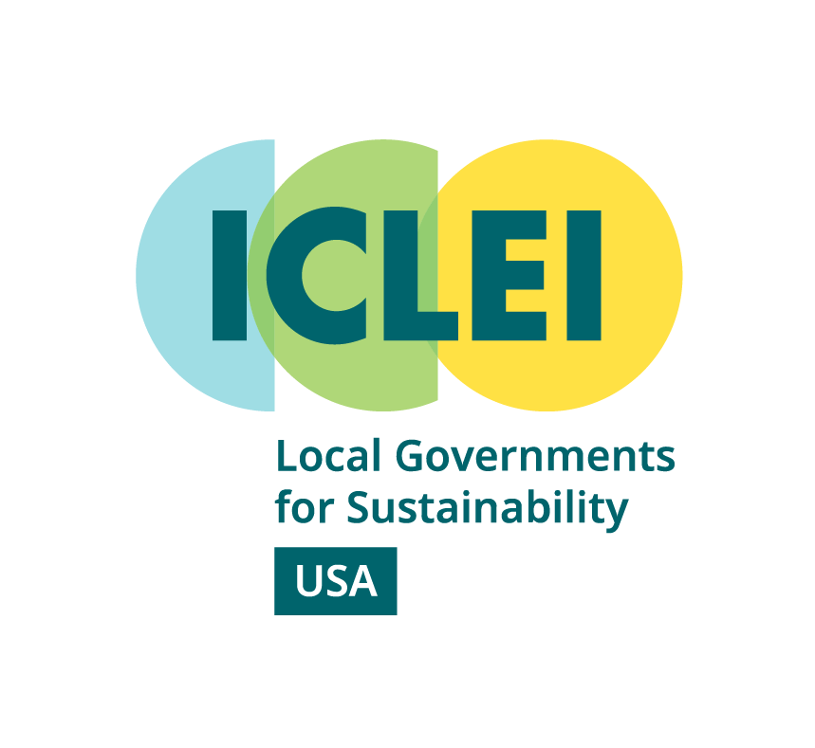
Welcome to Budgeting for Climate Action!
March 8th, 2023
Kick-Off and Q&A
Introductory remarks from each participating trainer and participants

Slide 2
ICLEI: Who We Are
The ICLEI network is united for worldwide action.
We influence sustainability policy and drive local action through 5 pathways:
Low emissions
Nature-based
Resilient
Equitable and people-centered
Circular
Our Members & team of experts collaborate to achieve measurable progress towards more economically, socially, and environmentally sustainable forms of development and management.
ICLEI Global Impact
2500+ Local & Regional Governments
24 Offices Worldwide
Active in 125+ Countries
Impacting more than 25% of people living in cities
5 Interconnected Development Pathways

Slide 3
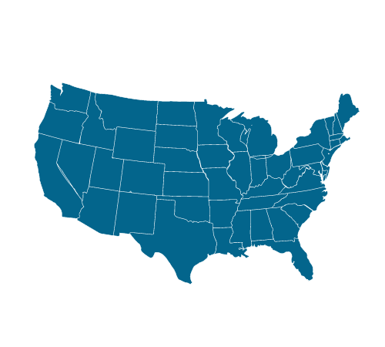
ICLEI USA
Serves more than 300 communities
Represents 55+ million US residents
Best in class GHG mitigation standards, tools
Supporting local climate action for over 30 years

Slide 4
ResourceX
ResourceX supports local governments to strategically align resources with community outcomes. Through Priority Based Budgeting (PBB) methodology and software, local governments are accelerating data-driven decision making and budgeting to align resources towards society’s biggest challenges. Providing a platform to fund equity initiatives, climate action plans, and a fiscally sustainable future for residents and the community.
ResourceX.net

Slide 5
ResourceX
Local Government Budget Solutions for the 21st Century
Provides software and services (training) to local governments to support the creation and application of priority-based and program-based budgeting
Priority Based Budgeting (PBB)
Supports local governments to strategically align resources with community outcomes
Empowers data-driven decision making and budgeting to align resources towards society’s biggest challenges
Provides a platform to fund equity initiatives, climate action plans, and a fiscally sustainable future for residents and the community.
Sole provider of PBB software in the world
300 local governments across North America have developed and applied PBB data
In 2021, ResourceX PBB software helped local governments uncover $73M in budget repurposing opportunities (to fund climate and equity initiatives)
ResourceX – Priority Based Budgeting software solutions to transform your budget
and align resources with community priorities. Let data lead the way!

Slide 6
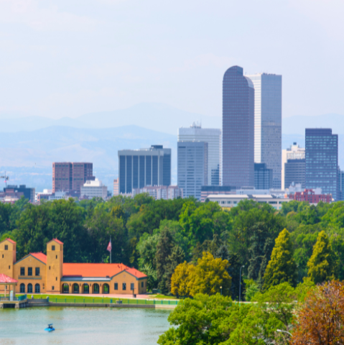
Homework
For the next session, please:
Read ICLEI USA Ambition Gap Policy Brief
Read ResourceX Essential Guide to Priority-Based Budgeting
Review and complete Organizational Overview Survey Exercise (please complete by March 17th).
Review and complete short Baseline Participant Survey (please complete by March 17th).

